Slide 1




2026 New Mexico CowBelles District Workshop
Farm and Ranch Financials
NMSU
Cooperative Extension Service
Jason Banegas
Extension Economist
May 2026

Slide 2
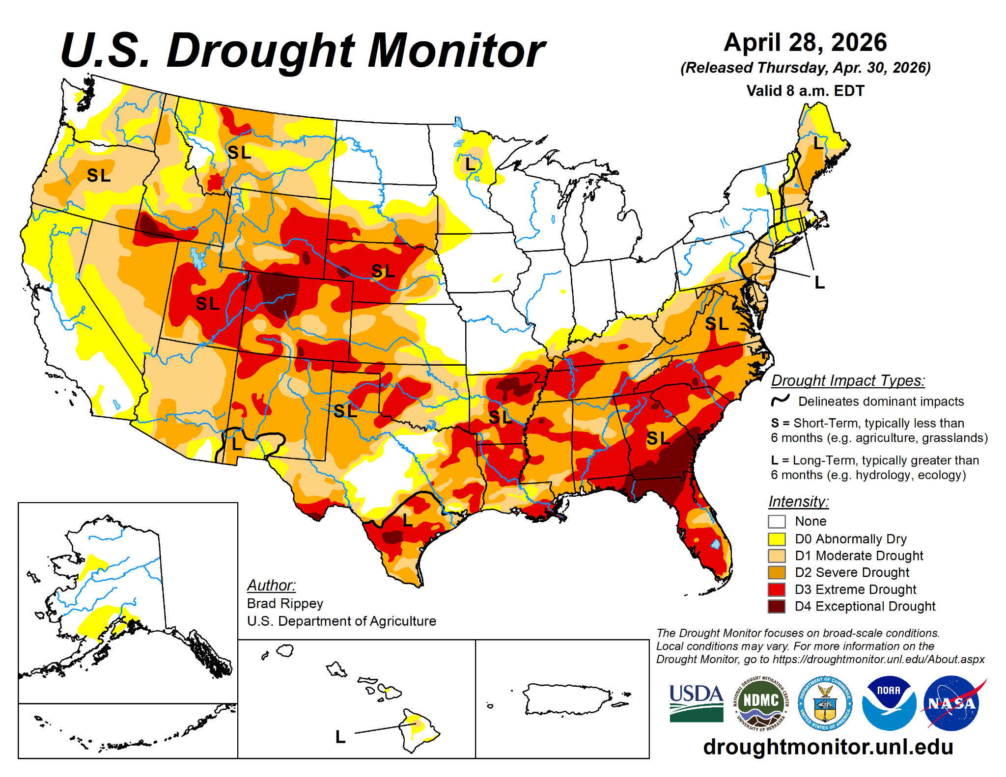

Slide 4
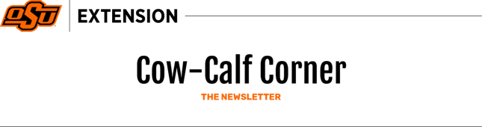
Derrell S. Peel, Cow-Calf Corner May 4, 2026
Pasture and hay production in the next few weeks will determine cattle production potential for much of the year.
The Drought Severity Index is the largest value for the end of April in the history of the Drought Monitor, back to 2000.
Drought is a significant threat to beef cattle production and potential herd rebuilding in 2026.

Slide 5
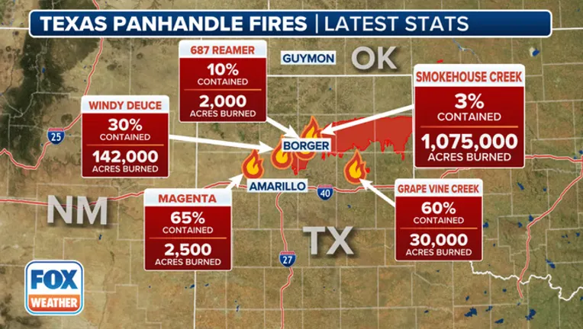
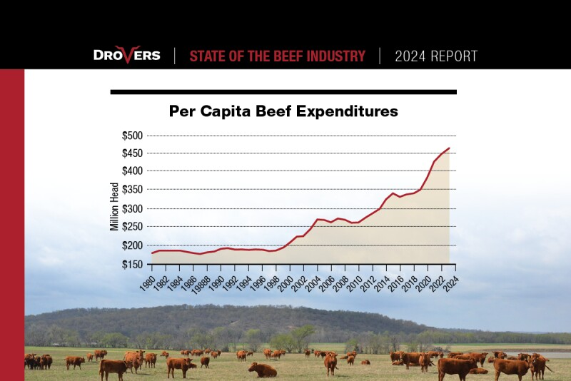
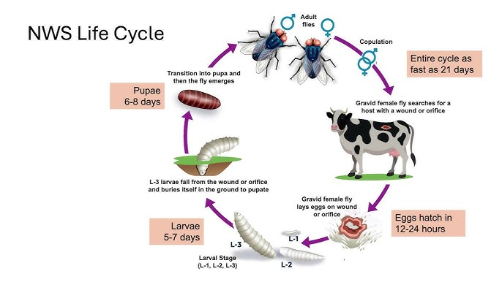
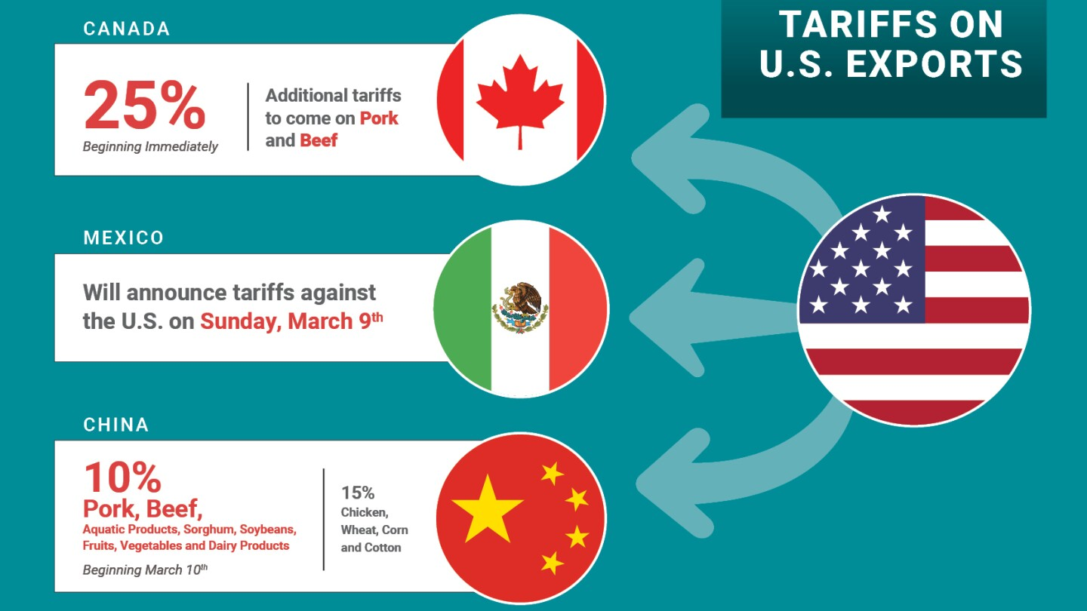

Slide 6
Minimize Risk
and
Maximize Opportunity

Slide 7
What Records Should Producers Keep?
Four Main Types of Records
Financial Records Income Expenses Loans Assets | Production Records Crop yields Livestock performance Feed use
Legal Records Leases Insurance papers Ownership documents | Tax Records Receipts Invoices Payroll records

Slide 8
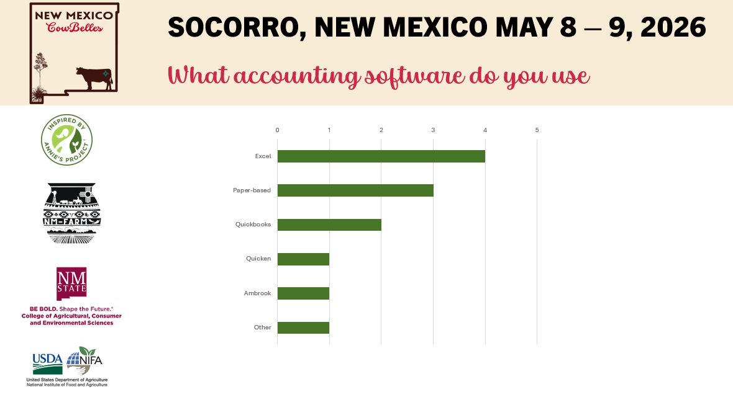
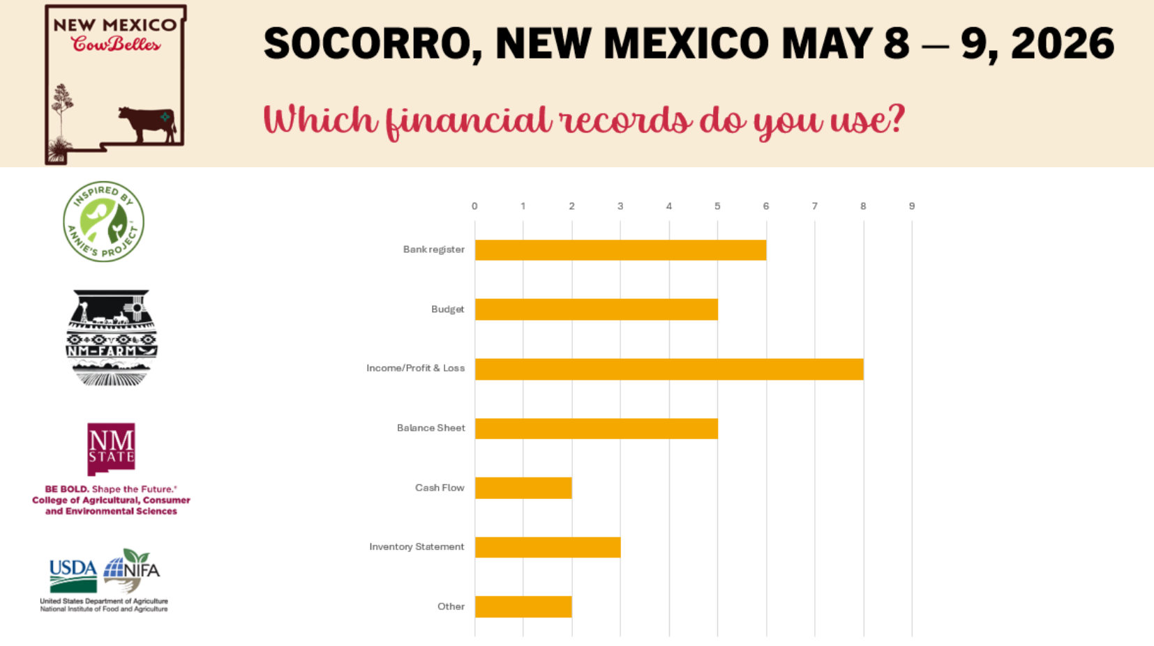
Financial Record Keeping / Bookkeeping
What’s your current method of tracking expenses?
Notebook
Spreadsheet (Excel, Google Sheets, Etc.)
App or Computer Program

Slide 9
Simple Record Keeping Goals
Record Keeping Should Help You:
Save time
Stay organized
Reduce stress
Keep records simple enough that you will actually use them.

Slide 10
Producers Need Financial Records to:
Understand cash flow
Monitor debt
Track profitability
Prepare taxes
Apply for loans

Slide 11
3 main financial statements
  Cash Flow Statement
  Profit and Loss Statement aka Income Statement
  Balance Sheet
What Financial Statements Do I Need?

Slide 12
Solvency
Liquidity
Depreciation
Appreciation
Financial Terminology

Slide 13
Financial Statement #1
Cash Flow Statement

Slide 14


A financial tool that tracks the movement of CASH in and out of an operation (usually on a monthly basis).
Actual CASH transactions, not accrual.
BEGINNING CASH BALANCE
CASH INFLOWS
Sales (livestock, crops, hay)
Government payments (ARC/PLC, EQIP)
Loans or advances
3. CASH OUTFLOWS
Operating expenses (seed, fuel, vet care)
Capital purchases
Debt payments
Labor costs
4. ENDING CASH BALANCE
What is a Cash Flow Statement?

Slide 15
Example:
Bills due before calf sales
You Can Be Profitable But Still Have Cash Problems

Slide 16
Simple Monthly Cash Flow Statement
January 1st: You start with $45,000 in your account
2025 Month by Month Revenues and Expenses
Beginning $45,000 | Jan | Feb | Mar | Apr | May | Jun | Jul | Aug | Sep | Oct | Nov | Dec
Inflows | 0 | 0 | $8,000 | $6,000 | 0 | 0 | 0 | 0 | 0 | $69,000 | $34,000 | 0
Outflows | $12,000 | $10,000 | $8,000 | $4,000 | $5,000 | $8,000 | $9,000 | $8,000 | $14,000 | $16,000 | $6,000 | $4,000
Net Flow | $-12,000 | $-10,000 | 0 | $2,000 | $-5,000 | $-8,000 | $-9,000 | $-8,000 | $-14,000 | $53,000 | $28,000 | $-4,000
Balance | $33,000 | $23,000 | $23,000 | $25,000 | $20,000 | $12,000 | $3,000 | $-5,000 | $-19,000 | $34,000 | $62,000 | Ending $58,000
 |  |  |  |  |  |  |  |  |  |  | Net Income: $13,000
How can you make it through this year with a negative account balance?

Slide 17
Cash flow planning helps producers:
Avoid missed payments
Plan purchases
Prepare for emergencies
Cash Flow for Planning

Slide 18
Create a “Spending Plan” from past cash flow statements with predicted adjustments.
  Support decision-making on capital investments, equipment repairs, or input purchases.
Good Cash Flow Statements Support:
  Loan applications and renewals
  Lenders use this info to ensure sufficient liquidity to repay loans.
Cash Flow for Planning

Slide 19
Crucial for analyzing the cash flow associated with specific enterprises within your whole operation.
Stress testing under different price volatility “what if” scenarios.
  Used to assess the feasibility of expansion and potential revenue streams.
  If major events have happened (lost leases, changed major enterprises, etc.) then construct a new plan.
Cash Flows for Analysis and Projections

Slide 20
CASH FLOW
helps a business
GO!

Slide 21
Financial Statement #2
Income Statements
aka
Profit and Loss Statements (P&L)

Slide 22
Profitability over a period of time.
  Fiscal Year or Calendar Year or Production Cycle
Revenue
  What you earned from selling crops, livestock, etc.
Expenses
  What you spent on animals, feed, seeds, labor, equipment, taxes, etc.
Income Statement aka Profit and Loss Statement (P&L)
2025 Revenue and Expenses
Category | Revenue | Category | Expenses
Bull Sales | $15,000 | Feed, Vet, Water, Fuel | $40,000
Cull Sales | $17,000 | Equipment Costs | $20,000
Calf Sales | $60,000 | Labor & Other Expenses | $30,000
Custom Labor | $25,000 | Depreciation | $5,000
 |  | Payments, Interest & Taxes | $9,000
Total Revenue | $117,000 | Total Expenses | $104,000
 | Net Income | $13,000

Slide 23
Cash Flow Statement vs. P&L
2025 Month by Month Revenues and Expenses
Beginning $45,000 | Jan | Feb | Mar | Apr | May | Jun | Jul | Aug | Sep | Oct | Nov | Dec
Inflows | 0 | 0 | $8,000 | $6,000 | 0 | 0 | 0 | 0 | 0 | $69,000 | $34,000 | 0
Outflows | $12,000 | $10,000 | $8,000 | $4,000 | $5,000 | $8,000 | $9,000 | $8,000 | $14,000 | $16,000 | $6,000 | $4,000
Net Flow | $-12,000 | $-10,000 | 0 | $2,000 | $-5,000 | $-8,000 | $-9,000 | $-8,000 | $-14,000 | $53,000 | $28,000 | $-4,000
Balance | $33,000 | $23,000 | $23,000 | $25,000 | $20,000 | $12,000 | $3,000 | $-5,000 | $-19,000 | $34,000 | $62,000 | Ending $58,000
 |  |  |  |  |  |  |  |  |  |  | Net Income: $13,000
2025 Revenue and Expenses
Category | Revenue | Category | Expenses
Bull Sales | $15,000 | Feed, Vet, Water, Fuel | $40,000
Cull Sales | $17,000 | Equipment Costs | $20,000
Calf Sales | $60,000 | Labor & Other Expenses | $30,000
Custom Labor | $25,000 | Depreciation | $5,000
 |  | Payments, Interest & Taxes | $9,000
Total Revenue | $117,000 | Total Expenses | $104,000
 | Net Income | $13,000
Itemized Revenues and Expenses from January 1st - Dec 31st
Calculate Net Income over the Period

Slide 24

Determine if income covered expenses (Net Income)
Essential for loan applications and tax planning
Guides management decisions
Used for setting goals and improving profitability
Why use a P&L?
2025 Revenue and Expenses
Category | Revenue | Category | Expenses
Bull Sales | $15,000 | Feed, Vet, Water, Fuel | $40,000
Cull Sales | $17,000 | Equipment Costs | $20,000
Calf Sales | $60,000 | Labor & Other Expenses | $30,000
Custom Labor | $25,000 | Depreciation | $5,000
 |  | Payments, Interest & Taxes | $9,000
Total Revenue | $117,000 | Total Expenses | $104,000
 | Net Income | $13,000

Slide 25

Sales records
  invoices, receipts
Expense records
  seeds, feed, labor, equipment
Depreciation values
Loan Payments, Interest, and Taxes
Creating a P&L

Slide 26
Inventory Records
Hay inventory
Feed inventory
Livestock inventory
Stored crops
What Isn’t on a P&L

Slide 27
Cash Accounting
  Income and expenses are recorded when:
    Money is received → Income
    Money is paid → Expenses
Cash accounting can distort performance
  Large purchase → huge expense spike
  Delayed sales → income swings
  Inventory changes invisible
Cash or Accrual?

Slide 28
Accrual Accounting
  Large or complex enterprises should use this for better financial analysis and decision-making.
Accrual adjustments help evaluate:
  True profitability
  Cost of production
  Enterprise performance
Cash or Accrual?

Slide 29
Schedule F is fundamentally CASH-BASED.
Some adjustments involve accrual-like elements. (Inventories & Cost of Livestock Purchased for Resale)
Shows the amount of cash sales less cash purchases and depreciation.
Schedule F

Slide 30

Tracking P&L Changes Over Time
Year | Revenue | Expenses | Net Income ($)
2020 | $60,000 | $125,000 | $65,000
2021 | $90,000 | $100,000 | $10,000
2022 | $100,000 | $95,000 | $5,000
2023 | $115,000 | $107,000 | $8,000
2024 | $110,000 | $100,000 | $10,000
2025 Revenue and Expenses
Category | Revenue | Category | Expenses
Bull Sales | $15,000 | Feed, Vet, Water, Fuel | $40,000
Cull Sales | $17,000 | Equipment Costs | $20,000
Calf Sales | $60,000 | Labor & Other Expenses | $30,000
Custom Labor | $25,000 | Depreciation | $5,000
 |  | Payments, Interest & Taxes | $9,000
Total Revenue | $117,000 | Total Expenses | $104,000
 | Net Income | $13,000

Slide 31
Increase Revenue
  Find better markets, improve yields, diversify income, sell assets
Reduce Costs
  Buy inputs in bulk, improve efficiency, reduce waste
Monitor
  Review finances regularly, adjust operations
Income Statement for Decision Making
2025 Revenue and Expenses
Category | Revenue | Category | Expenses
Bull Sales | $15,000 | Feed, Vet, Water, Fuel | $40,000
Cull Sales | $17,000 | Equipment Costs | $20,000
Calf Sales | $60,000 | Labor & Other Expenses | $30,000
Custom Labor | $25,000 | Depreciation | $5,000
 |  | Payments, Interest & Taxes | $9,000
Total Revenue | $117,000 | Total Expenses | $104,000
 | Net Income | $13,000

Slide 32
Not tracking small expenses
→ Keep detailed records
Forgetting depreciation
→ Calculate equipment value over time
Accrual Errors
→ Keep detailed records
Mixing personal & farm finances
→ Separate accounts
Common Mistakes & How to Fix Them

Slide 33
Financial Statement #3
Balance Sheets

Slide 34



Everything Owned and Owed
A balance sheet shows your NET WORTH / OWNER EQUITY at a specific point in time
NET WORTH = Assets - Liabilities
What is a Balance Sheet?

Slide 35
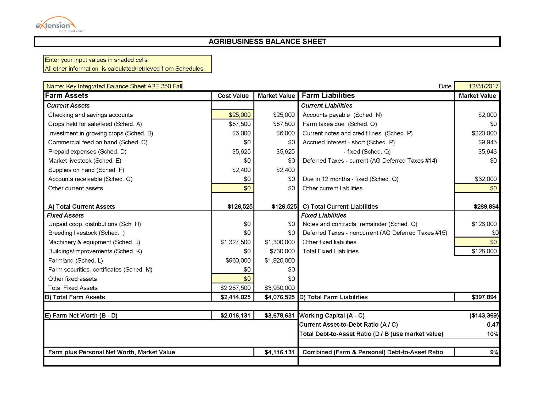
Balance Sheet
Everything Owned and Owed
A balance sheet shows your NET WORTH / OWNER EQUITY at a specific point in time.
NET WORTH = Assets - Liabilities

Slide 36

Your Balance Sheet Changes
Time Period: 2025
Assets - Liabilities
Owned vs Owed
Net Worth #1
Cash Flows
and
Assets Change
over time
Time Period: 2026
Assets - Liabilities
Owned vs Owed
Net Worth #2

Slide 37
Measures solvency and liquidity
Quantify vs. Feelings
Measure your Performance
Risk assessment
Needed when applying for a loan
Guides management decisions
Why use a Balance Sheet?

Slide 38
Should your Balance Sheet have Business and Personal information together or separate?
  If you are using personal assets as collateral for a loan they will probably need to be together for a lender.
  Excluding personal information makes it easier to analyse the performance of your operation and plan for changes.
Business or Personal?

Slide 39
When to do it?
Annually (at end of accounting period) and Consistently
Take an inventory of your assets and resources
Determine and record your asset values
Record liabilities
Building a Balance Sheet

Slide 40
Record and Value Your Assets
Current Assets
Short Term Assets most easily turned into cash or used within a year.
Assets on Left
Fixed Assets
Non-current, Intermediate, and Long-term Assets that likely won’t be sold within a year and have a lifespan of more than a year.

Slide 41
Cost Basis (cash cost + investment expenses - depreciation)
  Cost-basis balance sheets conform to GAAP and are easily compared to balance sheets from other types of businesses.
Market value (what a buyer is willing to pay you - selling costs)
  Market value balances more accurately reflect current financial positions and loan collateral values.
The Farm Financial Standards Council recommends using both methods
We Use Two Valuation Methods

Slide 43
Our simplified example shows only 2 categories
  Current (less than 1 year)
  Fixed (more than 1 year)
Some balance sheet have 3 categories
  Current (less than 1 year)
  Intermediate (1-10 year) used for breeding livestock, equipment, machinery, and intermediate term loans.
  Fixed (more than 10 year)
Short, Intermediate, and Long-Term

Slide 44

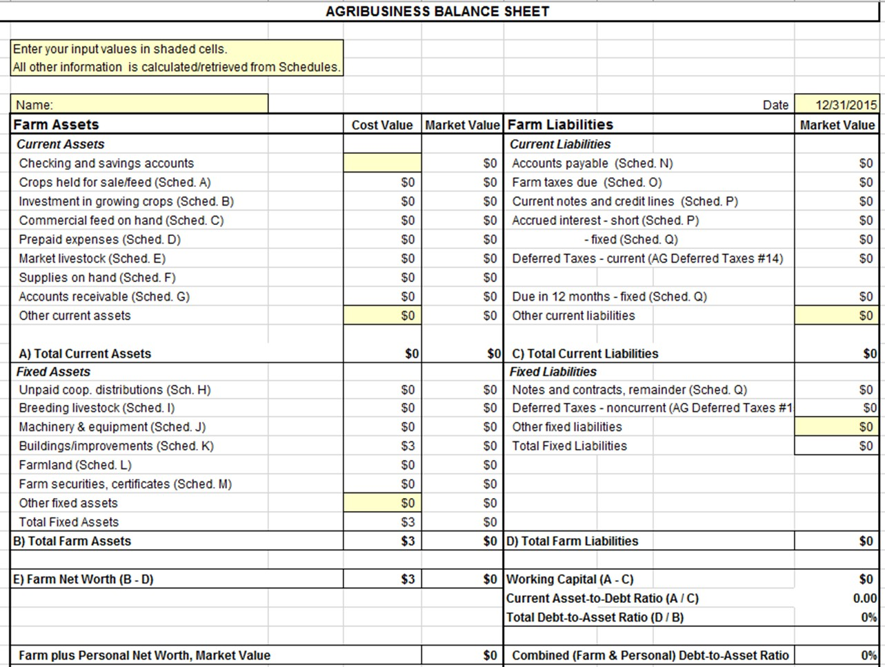
3. Record Your Liabilities
Current Liabilities
Short Term Liabilities are obligations expected to be paid within a year
Liabilities on Right
Fixed Liabilities
Intermediate or Long-term debts, bonds, mortgages or loans that are payable over a term exceeding one year

Slide 45
Net Worth / Owner Equity
Net Worth
is what is left over if all assets are sold and all debts paid.

Slide 46
Key Business Concepts
  Calculating costs
    Do you know how much your business is costing you?
  Profit
    Do you have $ after accounting for expenses?
  Reinvestment
    Using profits to buy better tools, improve land and grow herds.
    Invest in your family and community with your food production.

Slide 47
If Something Matters, it Should be Measured
Consistent Recordkeeping helps you:
  Calculate cost per unit.
  Determine profitability per animal/acre.
  Compare across years or against other producers.
  Identify where cost can be cut.
  Identify where revenue can be increased.

Slide 48
Topic Question
Do you know your Cost of Production?
If not, what would you need to start tracking that?

Slide 49
Cost of Production in a Cow-Calf Operation
Unit Cost of Production = Cost to produce one unit
(e.g., lb. of weaned calf)
Formula
Unit Cost = Total Expenses ÷ Total lbs of weaned calf produced

Slide 50
Cost of Production in an Operation
Why It Matters
  Knowing your per unit cost helps you to:
    Calculate profitability per calf, pound, acre, etc.
    Benchmark against previous production years and other producers.
    Identify cost reduction & revenue opportunities
    Make informed changes to your operation and pricing decisions.

Slide 51
Cost of Production in a Cow-Calf Operation
If you know the per pound cost to raise an animal, you know the per pound price you need to sell it for to break even.
If you don’t know the production cost you can’t make good decisions or compare your production to anyone else's.

Slide 52
Cost of Production in an Operation
Step 1: Categorize your Costs
  Costs fall into two main types:
Fixed / Overhead Costs (Costs that don’t change as you increase the number of cows) Building & Equipment depreciation Land rent or opportunity cost Labor (hired & owner labor) Taxes, Insurance, & fees | Direct / Variable Costs (costs that increase with each additional animal that’s added to the operation) Feed & supplements Veterinary & Breeding costs Depreciation

Slide 53
Cost of Production in a Cow-Calf Operation
Step 2: Assign Costs to Enterprise
  Many farms and ranches have multiple enterprises (livestock, breeding stock, orchard, vegetables, growing hay, etc.), allocate shared fixed costs proportionally.
  Example: allocate insurance by acreage, # animals, or revenue share.

Slide 54
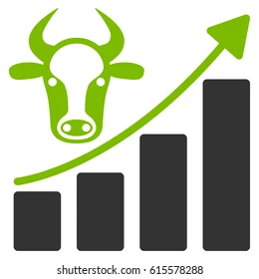

Cost of Production in a Cow-Calf Operation
Cost accounting requires good records
  Challenges with shared costs across enterprises
  Tracking depreciation and opportunity costs
    https://beef.unl.edu/cow-depreciation-for-cow-calf-producers

Slide 55
Cost of Production in a Cow-Calf Operation
Total Annual Cow-Calf Expenses
Expense Type | Amount($)
Feed | $28,000
Health care and Vet | $7,500
Fuel & Equipment | $10,000
Labor | $13,500
Land / opportunity cost | $9,000
Depreciation | $16,000
Total | $59,000 vs. $84,000

Slide 56
Cost of Production in a Cow-Calf Operation
Step 3: Calculate Weaned Calf Output
  Measure total pounds of calves weaned for a fiscal year.
    40 calves to be weaned at 550 lbs each
    → Total = 22,000 lbs

Slide 57
Cost of Production in a Cow-Calf Operation
Step 4: Compute Unit Cost
  Total expense = $84,000
  Weaned lbs = 22,000 lbs
Unit cost = $84,000 ÷ 22,000 lbs = $3.81 per lb
Unit cost (w/o deprec. and opp. cost) = $59,000 ÷ 22,000 lbs = $2.68 per lb

Slide 58
Cost of Production in a Cow-Calf Operation
Step 5: Compute Other Costs (helpful for benchmarking)
Cost per Hundredweight Cost per cwt = $3.81×100 = $381/cwt | Cost per Breeding Female If 45 breeding females with $84,000 total expenses: $84,000 ÷ 45 = $1,867 per breeding female | Profitability Per Animal Selling price vs unit cost. If market price = $4.90/lb Gross margin = $4.90 – $3.81 = $1.09/lb

Slide 59
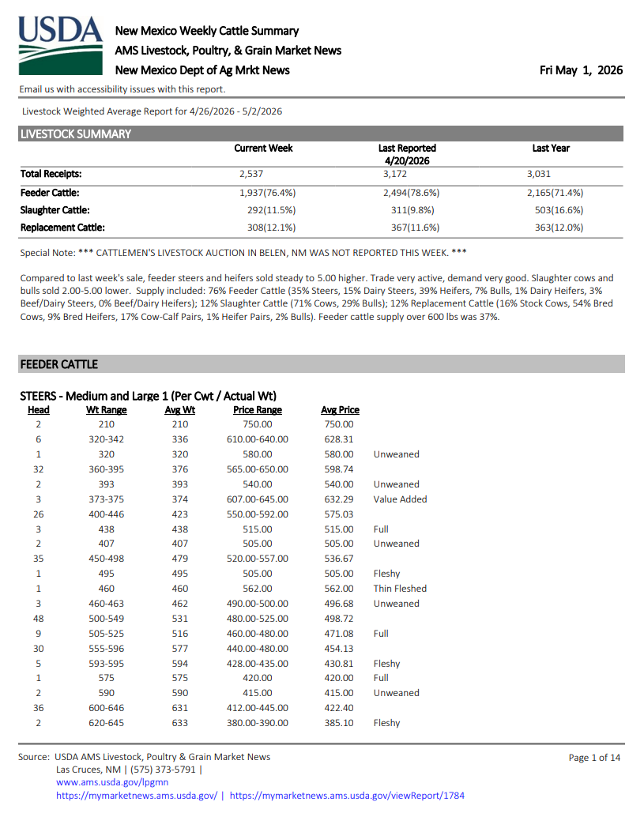
Step 6: Market Analysis
  550 lb calves and sold at $4.90/lb.
  What is your market?
    Can you accurately calculate potential revenue?

Slide 60
Cost of Production in a Cow-Calf Operation
Step 7: Calculate Profit per Calf
  If weaned at 550 lbs and sold at $4.90/lb.
    Revenue = $2,695
  Unit cost is $3.81/lb x 550 lbs
    Cost = $2,095.50
→ Profit = $599.50 per calf

Slide 61
Cost of Production in an Operation
Step 8: Calculate Profit for this enterprise
Profit = $599.50 per calf
Profit (w/o deprec. and opp. cost) = $1,221 per calf
Total Profit = $599.50 x 40 = $23,980
Total Profit (w/o deprec. and opp. cost) = $1,221 x 40 = $48,8400

Slide 62


Break-Even Analysis and Ratios
Other Metrics that can help you evaluate your operation
  Feed Cost Ratio
    Feed costs / Total costs (under 50% in ideal grazing systems)
    $28,000 / $84,000 = .33 or 33%
  Ratios
    Operating Cost Ratio
    Labor Cost Ratio
    Cost Structure Breakdown

Slide 63
Benchmarking Against Yourself Across Time
Track unit costs annually to see trends
  Compare 2020 vs 2021 vs 2022 vs 2023 vs 2024 vs 2025 costs
    Assess the effects resulting from changes in the price of:
      Labor, Land, Fuel, Feed, etc.

Slide 64
Benchmarking Against Other Producers
Compare with industry averages or peers to assess the competitiveness of your operation.
  Compare 2021 vs 2022 vs 2023 vs 2024 vs 2025 costs
  Using benchmarking for decision making.
    Higher cost than peers → assess your inefficiencies
    Lower cost → competitive advantage

Slide 65
Assess Financial Health
  A snapshot of assets, liabilities, and equity, helps you understand your financial position to make informed decisions.
Improve Loan Access & Creditworthiness
  Lenders evaluate a farm’s financial stability for loans or lines of credit necessary for expansion or operational improvements.
Track Progress Toward Goals
  Monitor changes in net worth over time, track financial growth, debt reduction, or investment in new equipment and land.
Enhance Decision-Making & Risk Management
  Identify strengths and weaknesses, adjust strategies, optimize resources, and mitigate market fluctuations risks or unexpected expenses.
Your Goals

Slide 66
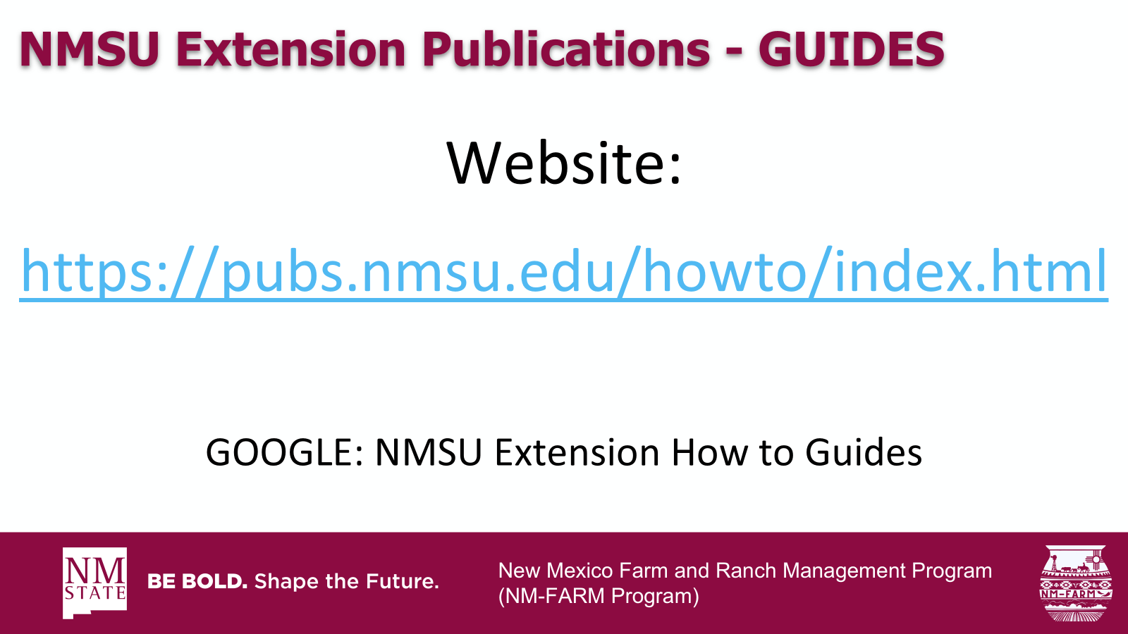

New Mexico Farm and Ranch Management Program
(NM-FARM Program)

Slide 67
Questions?

Slide 68
2026 New Mexico CowBelles District Workshop
Farm and Ranch Financials
NMSU
Cooperative Extension Service
Jason Banegas
Extension Economist
May 2026

