Slide 1


Cost of Production
Essentials for Producers
Jason Banegas
Extension Economist
Cooperative Extension Service
Oct 2026

Slide 2

Growing as a Responsibility, not Just a Commodity
How do we manage scarce resources?
How do we prepare for uncertainty?
What makes an operation sustainable?
How do individual decisions affect family and community well-being?

Slide 3
Why is This Important?
Knowing what it costs to produce each unit of your product helps you make better decisions about pricing, resource use, and future investments.
It helps you identify which enterprises are supporting your operation, where costs or risks are increasing, and what changes could improve sustainability.

Slide 4
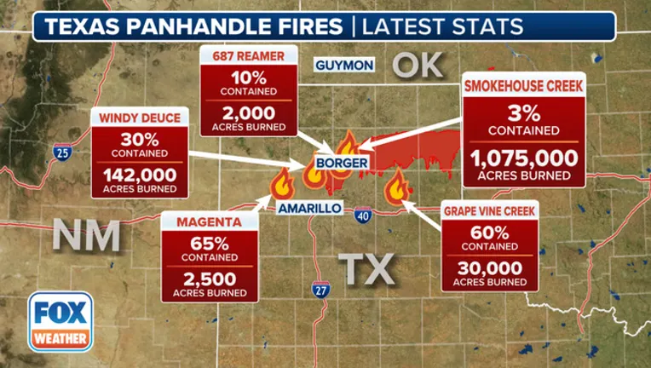
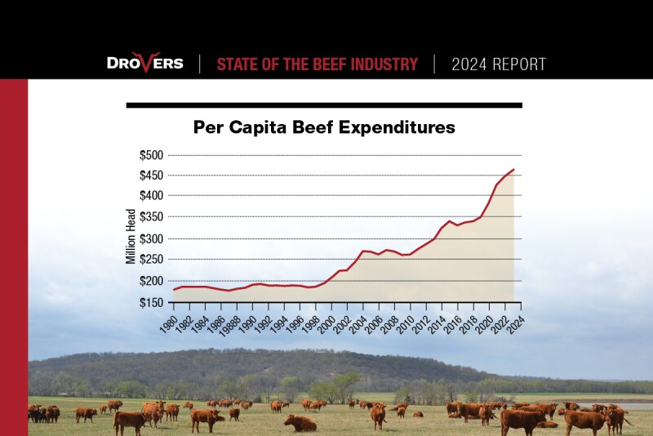
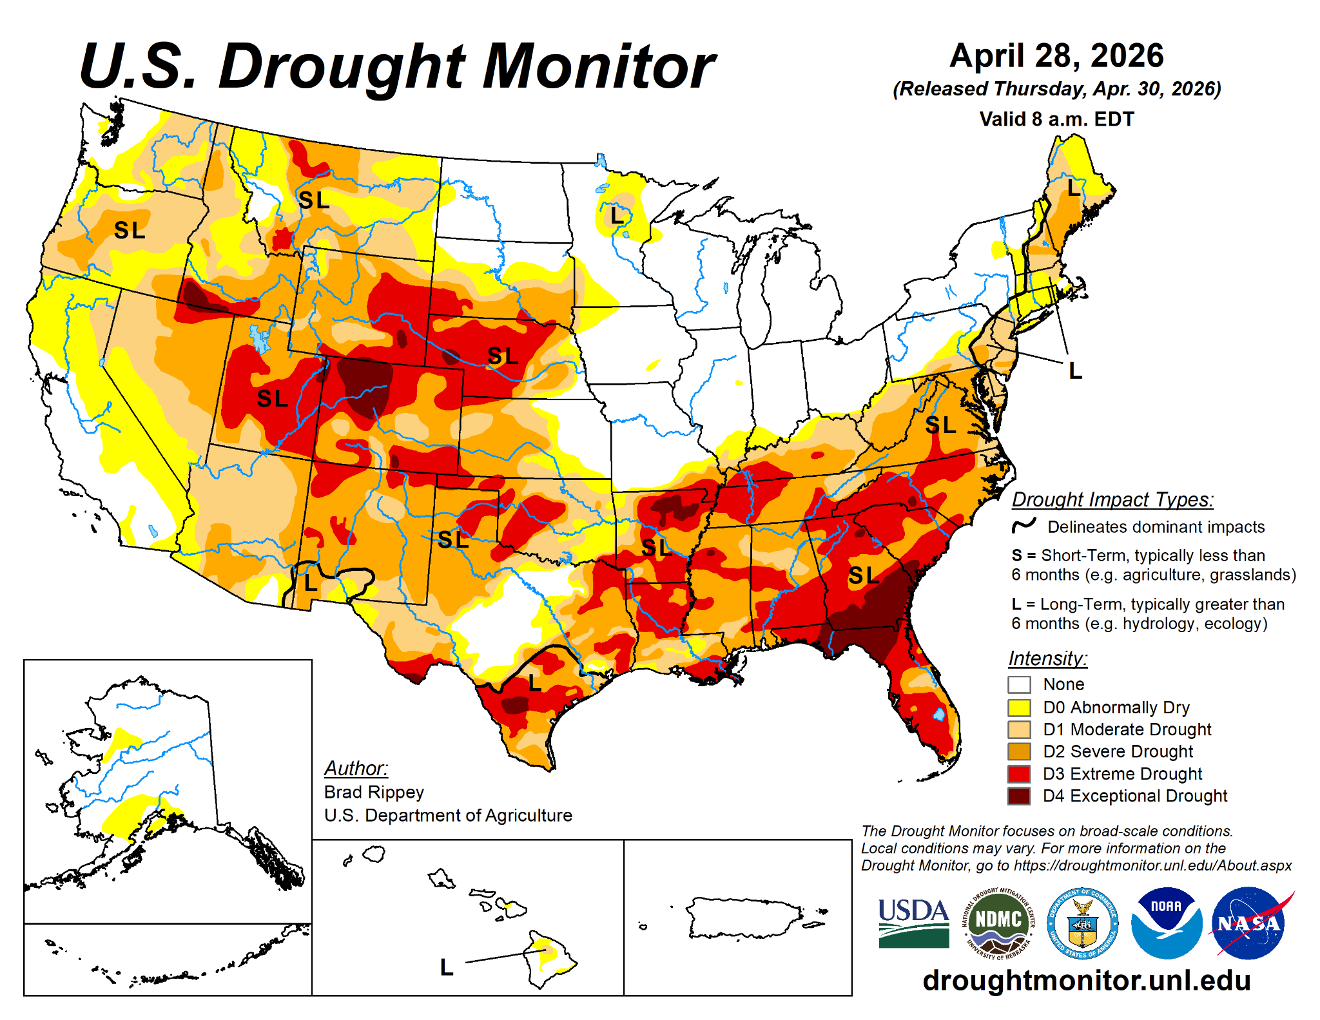
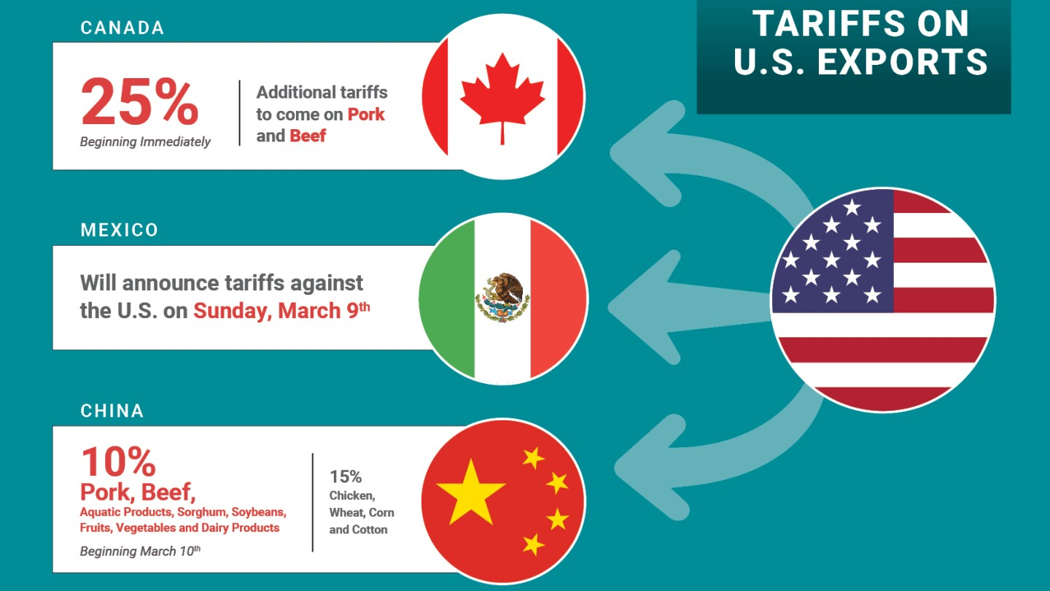

Slide 5
Minimize Risk
and
Maximize Opportunity

Slide 6
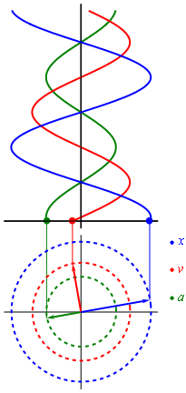
AGENDA - Topics We Will Cover
  Recordkeeping, Business, and Stewardship
  Build a Tool
    Cost of Production Exercise
  Decision-Making & Risk Management

Slide 7

Business Concepts
and Stewardship

Slide 8
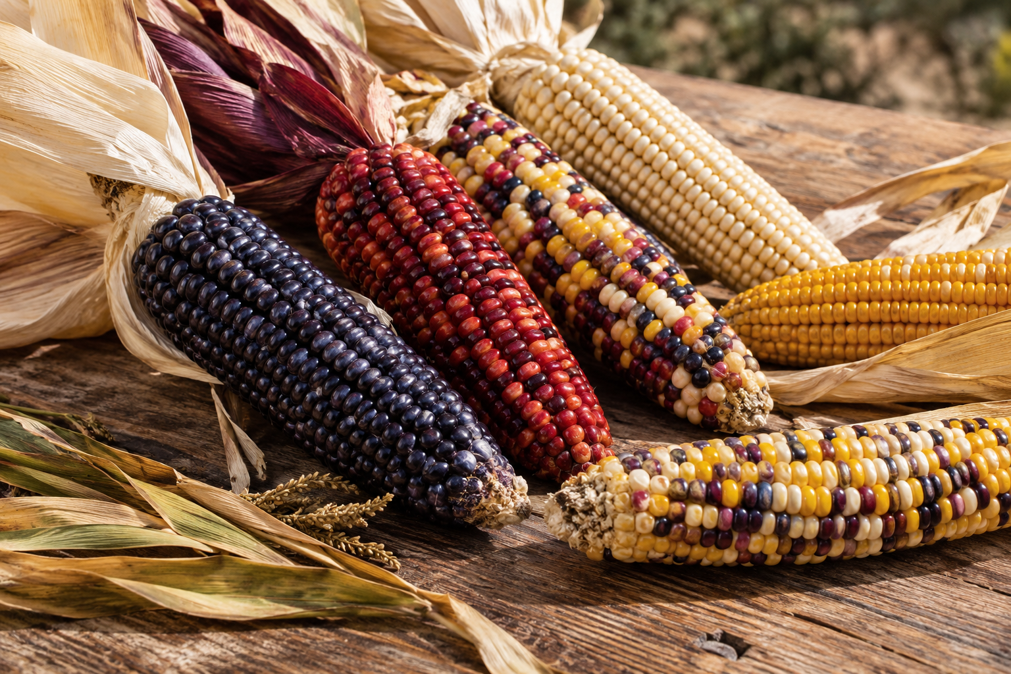
A Question of Value
What responsibilities come with growing a crop or raising an animal beyond producing something we can sell?

Slide 9

A Question of Value
A Farm or Ranch budget can separate:
Products sold for cash.
Products retained for household use or seed.
Products given away or exchanged.
Inputs and resources used to produce all of them.

Slide 10
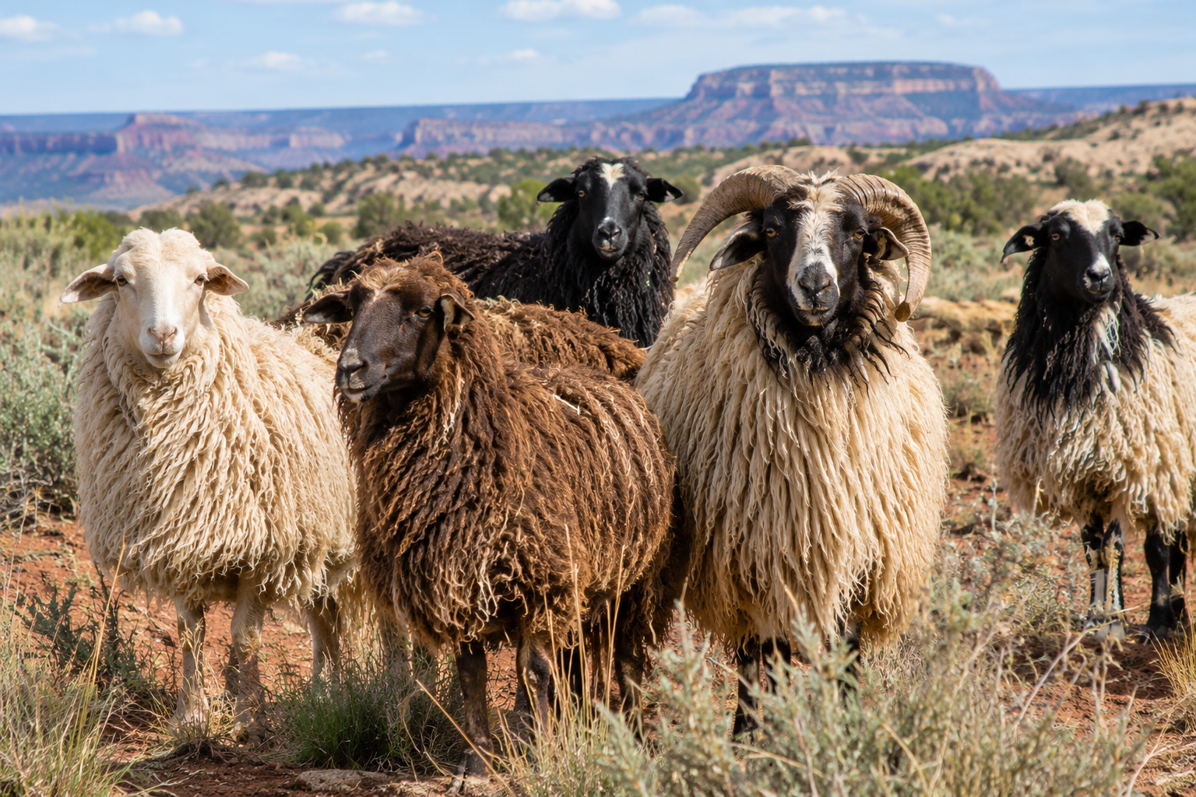
Sarah’s Scenario
  Sarah
    Grows corn and has a small herd of sheep.
    Has a job in town and uses that income for her supplies/feed/other expenses.
    Spends 6 hours a week on average taking care of crops and livestock.
    Shares her harvest among her family and neighbors.

Slide 11

Sarah’s Scenario
  Does Sarah have a Business?

Slide 12
Sarah’s Scenario
Sarah sees an opportunity: Demand for her corn and sheep products in her local market.
  Sarah calculates costs (Feed, water, labor, packaging…etc.)
  Sets prices to reflect quality of product and her costs.
  Sarah sells wool harvest for $400, one of her lambs for $250, and an older ewe for $175, and sells $125 of corn each week for 4 weeks at the local farmer’s market.
  Sarah records all of her income and expenses and has a $325 profit over the year.
  Sarah still has a herd of sheep (replaced an old ewe with a lamb she kept), kept corn seed for next year, and gave her family and neighbors some corn and wool as well.

Slide 13
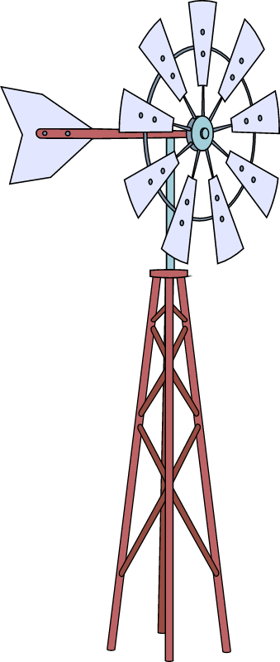
Sarah’s Business
Can Sarah keep doing what she is doing?
Can Sarah expand the farm and livestock operation?

Slide 14

Good Business Can be Stewardship
  Profitability, Sustainability, and Reinvestment
    Using profits to buy better tools and equipment, expand acreage, connect with more customers, improve land and grow herds.
    Invest in your family and community with your production.

Slide 15

If Something Matters, it Should be Measured
  Calculate cost per unit.
    Do you know how much your business is costing you?
  Determine profitability per animal/acre.
    Do you have $ left over after accounting for expenses?
  Compare across years or against other producers.
  Identify where cost can be cut and revenue increased.

Slide 16

Recordkeeping
(a story of your operation)

Slide 17
What Records Should Producers Keep?
Four Main Types of Records
Financial Records Income Expenses Loans Assets | Production Records Crop yields Livestock performance Feed use
Legal Records Leases Insurance papers Ownership documents | Tax Records Receipts Invoices Payroll records

Slide 18





Simple Record Keeping Goals
Stay organized
Save time
Reduce stress
Assess your Solvency
Assess your Liquidity
Keep records simple enough that you will actually use them.
Method to the Madness!!!

Slide 19
Financial Statements

Slide 20

The movement of FUNDS in and out of an operation (usually on a monthly basis).
CASH FLOW helps a business GO!
BEGINNING CASH BALANCE
CASH INFLOWS / Revenue
Sales (livestock, crops, hay)
Government payments (ARC/PLC, EQIP)
Loans or advances
3. CASH OUTFLOWS / Expenses
Operating expenses (seed, fuel, vet care)
Capital purchases
Debt payments
Labor costs
4. ENDING CASH BALANCE
Cash Flow Statement

Slide 21
Profitability over a period of time.
  Fiscal Year / Calendar Year / Production Cycle
Revenue
  What you earned from selling crops, livestock, etc.
Expenses
  What you spent on animals, feed, seeds, labor, equipment, taxes, etc.
Income Statement aka Profit and Loss Statement (P&L)
2025 Revenue and Expenses
Category | Revenue | Category | Expenses
Bull Sales | $15,000 | Feed, Vet, Water, Fuel | $40,000
Cull Sales | $17,000 | Equipment Costs | $20,000
Calf Sales | $60,000 | Labor & Other Expenses | $30,000
Custom Labor | $25,000 | Depreciation | $5,000
 |  | Payments, Interest & Taxes | $9,000
Total Revenue | $117,000 | Total Expenses | $104,000
 | Net Income | $13,000

Slide 22
Cash Flow Statement vs. P&L
2025 Month by Month Revenues and Expenses
Beginning $45,000 | Jan | Feb | Mar | Apr | May | Jun | Jul | Aug | Sep | Oct | Nov | Dec
Inflows | 0 | 0 | $8,000 | $6,000 | 0 | 0 | 0 | 0 | 0 | $69,000 | $34,000 | 0
Outflows | $12,000 | $10,000 | $8,000 | $4,000 | $5,000 | $8,000 | $9,000 | $8,000 | $14,000 | $16,000 | $6,000 | $4,000
Net Flow | $-12,000 | $-10,000 | 0 | $2,000 | $-5,000 | $-8,000 | $-9,000 | $-8,000 | $-14,000 | $53,000 | $28,000 | $-4,000
Balance | $33,000 | $23,000 | $23,000 | $25,000 | $20,000 | $12,000 | $3,000 | $-5,000 | $-19,000 | $34,000 | $62,000 | Ending $58,000
 |  |  |  |  |  |  |  |  |  |  | Net Income: $13,000
2025 Revenue and Expenses
Category | Revenue | Category | Expenses
Bull Sales | $15,000 | Feed, Vet, Water, Fuel | $40,000
Cull Sales | $17,000 | Equipment Costs | $20,000
Calf Sales | $60,000 | Labor & Other Expenses | $30,000
Custom Labor | $25,000 | Depreciation | $5,000
 |  | Payments, Interest & Taxes | $9,000
Total Revenue | $117,000 | Total Expenses | $104,000
 | Net Income | $13,000
Itemized Revenues and Expenses from January 1st - Dec 31st
Calculate Net Income over the Period

Slide 23
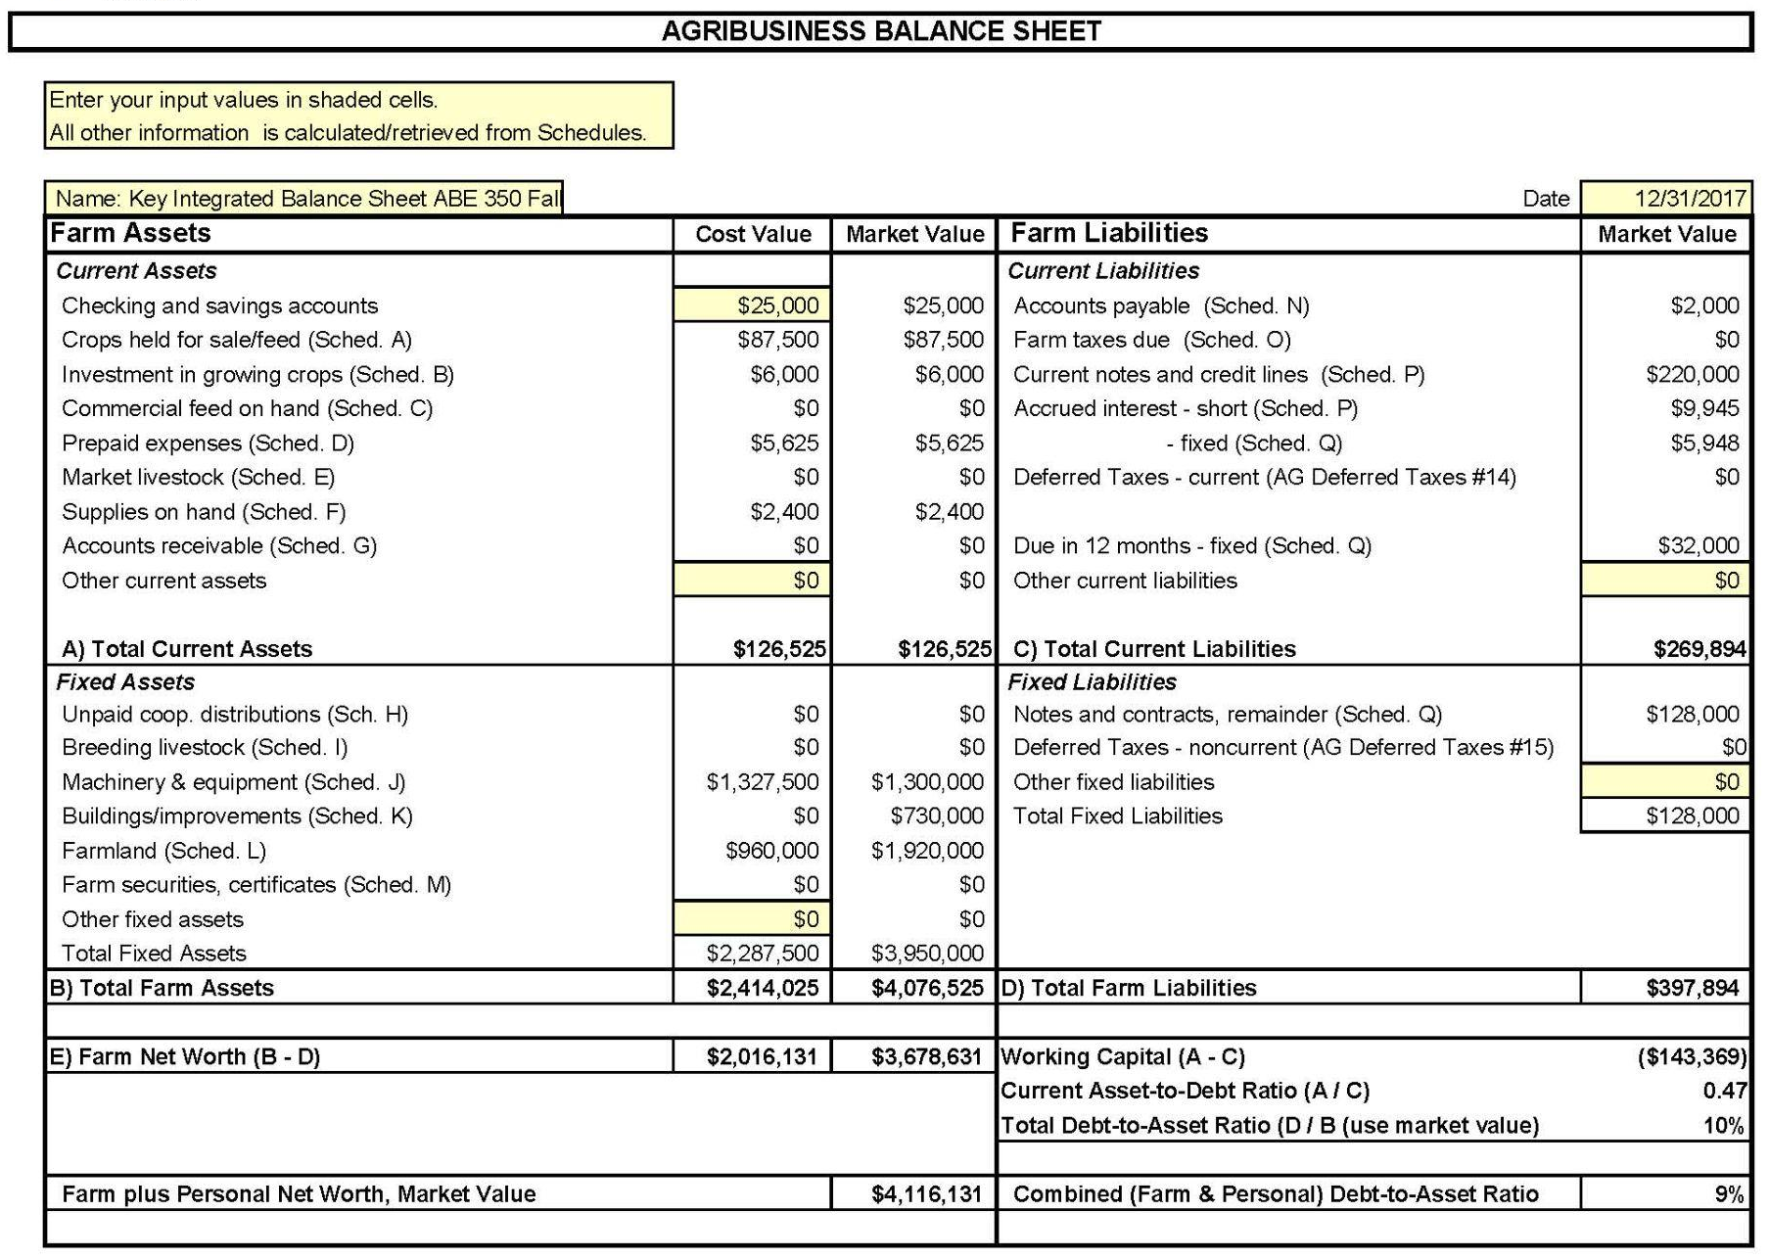
Balance Sheet
Everything Owned and Owed
A balance sheet shows your NET WORTH / OWNER EQUITY at a specific point in time.
NET WORTH =
Assets - Liabilities

Slide 24


Cost of Production

Slide 25
Cost of Production
You know your land, livestock, crops, and markets.
Cost-of-production analysis adds another tool
  Helps understand the economics behind your business decisions.

Slide 26

Cost of Production Can Help You:
Compare enterprises
Protect scarce resources
Strengthen market decisions
Plan investments
Support the next generation

Slide 27

Cost of Production
Do you know your Cost of Production?
If not, what would you need to start tracking that?

Slide 28
Cost of Production in a Farm Operation
Unit Cost of Production = Cost to produce one unit
(e.g. Bushel, Pound, Per Acre,...)
Formula
Unit Cost = Total Expenses ÷ Total yield of Vegetables produced

Slide 29
Cost of Production in a Cow-Calf Operation
Unit Cost of Production = Cost to produce one unit
(e.g., lb. of weaned calf)
Formula
Unit Cost = Total Expenses ÷ Total lbs of weaned calf produced

Slide 30

Cost of Production in an Operation
Why It Matters
  Knowing your per unit cost helps you to:
    Calculate profitability per acre/plot/greenhouse/etc.
    Benchmark against previous production years and other producers.
    Identify cost reduction & revenue opportunities
    Make informed changes to your operation and pricing decisions.

Slide 31

Cost of Production in an Operation
If you know the per pound/acre cost to grow a plant or raise an animal, you can calculate the per unit price you need to sell it for to break even.
If you don’t know the production cost you can’t make good decisions or compare your production to anyone else's.

Slide 32

Calculating CoP - Step 1
Categorize your Costs
  Costs fall into two main types:
Fixed (Overhead) Costs (Costs that don’t change as you increase the number of cows) Building & Equipment depreciation Land rent or opportunity cost Labor (hired & owner labor) Taxes, Insurance, & fees | Direct / Variable Costs (costs that increase with each additional cow that’s added to the operation) Seed and Fertilizer Feed & supplements Veterinary & Breeding costs Depreciation
Recordkeeping!!!

Slide 33
Calculating CoP - Step 2
Assign Costs to Enterprise
  Many farms and ranches have multiple enterprises (livestock, breeding stock, orchard, vegetables, growing hay, etc.), allocate shared fixed costs proportionally.
  Example: allocate insurance by acreage, # animals, or revenue share.

Slide 34
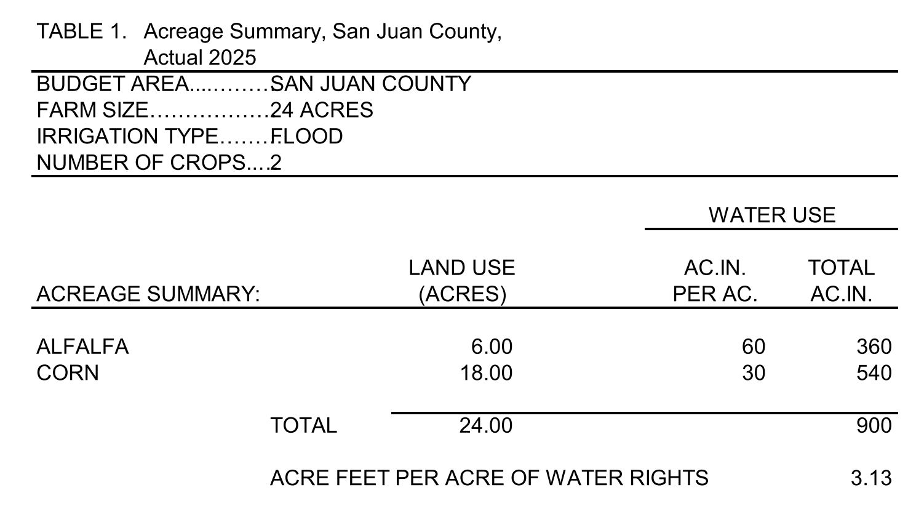
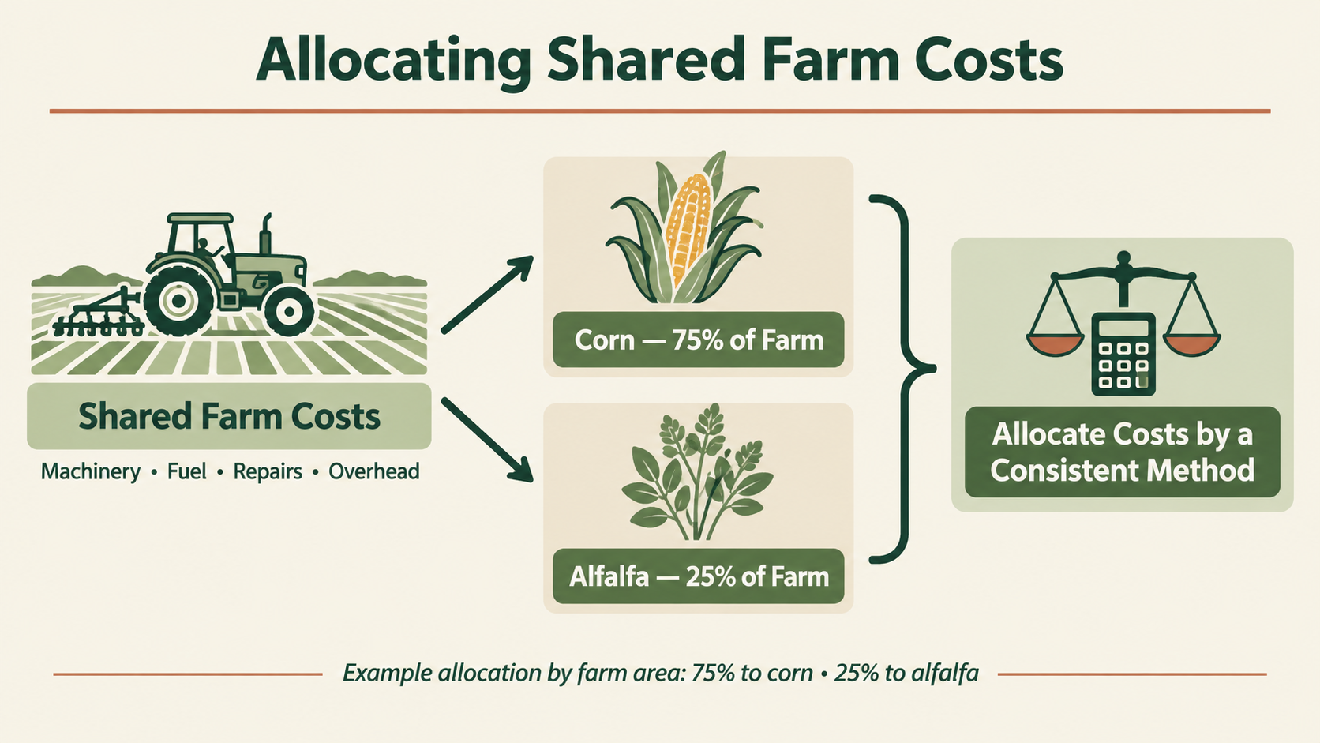
Cost of Production in a Farm Operation
Representative Farm - NMSU 2025 Cost and Return Estimates
https://costsandreturns.nmsu.edu/documents/2025%20Fruitfield_flood.pdf

Slide 35
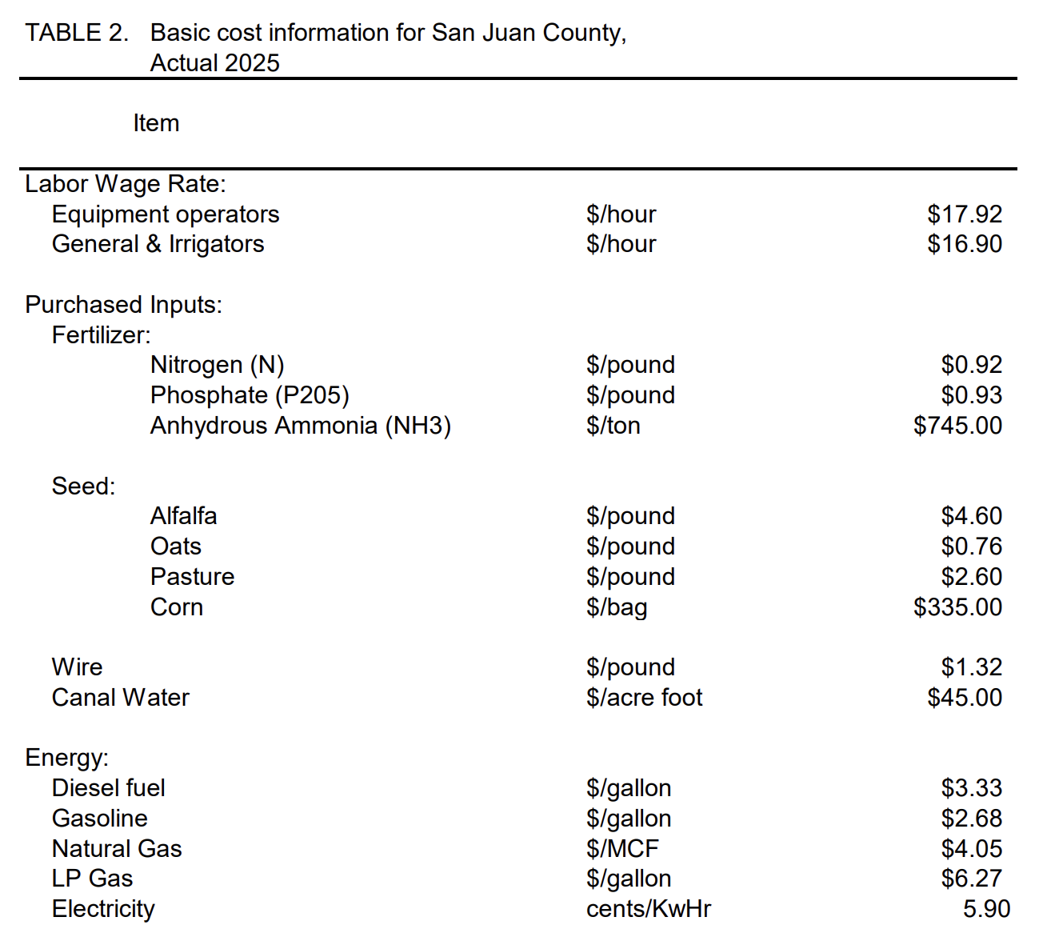
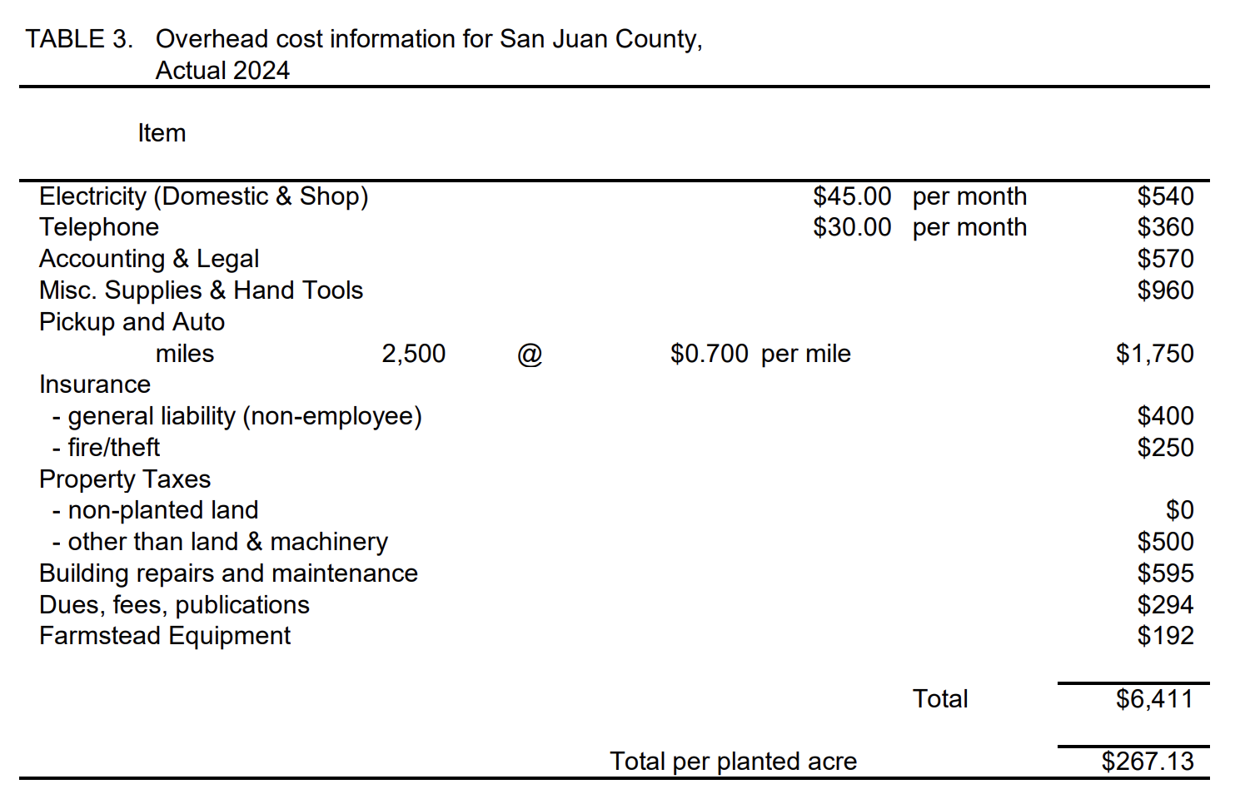
Representative Farm - NMSU 2025 Cost and Return Estimates

Slide 36
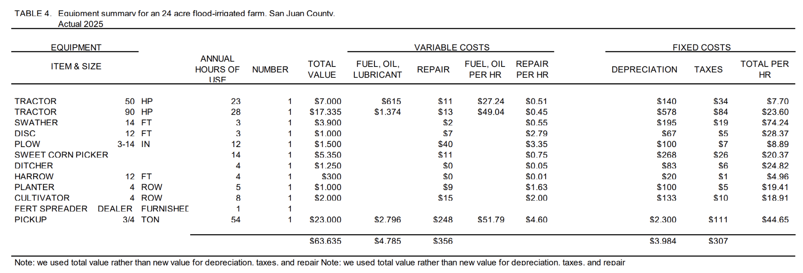
Representative Farm - NMSU 2025 Cost and Return Estimates

Slide 37
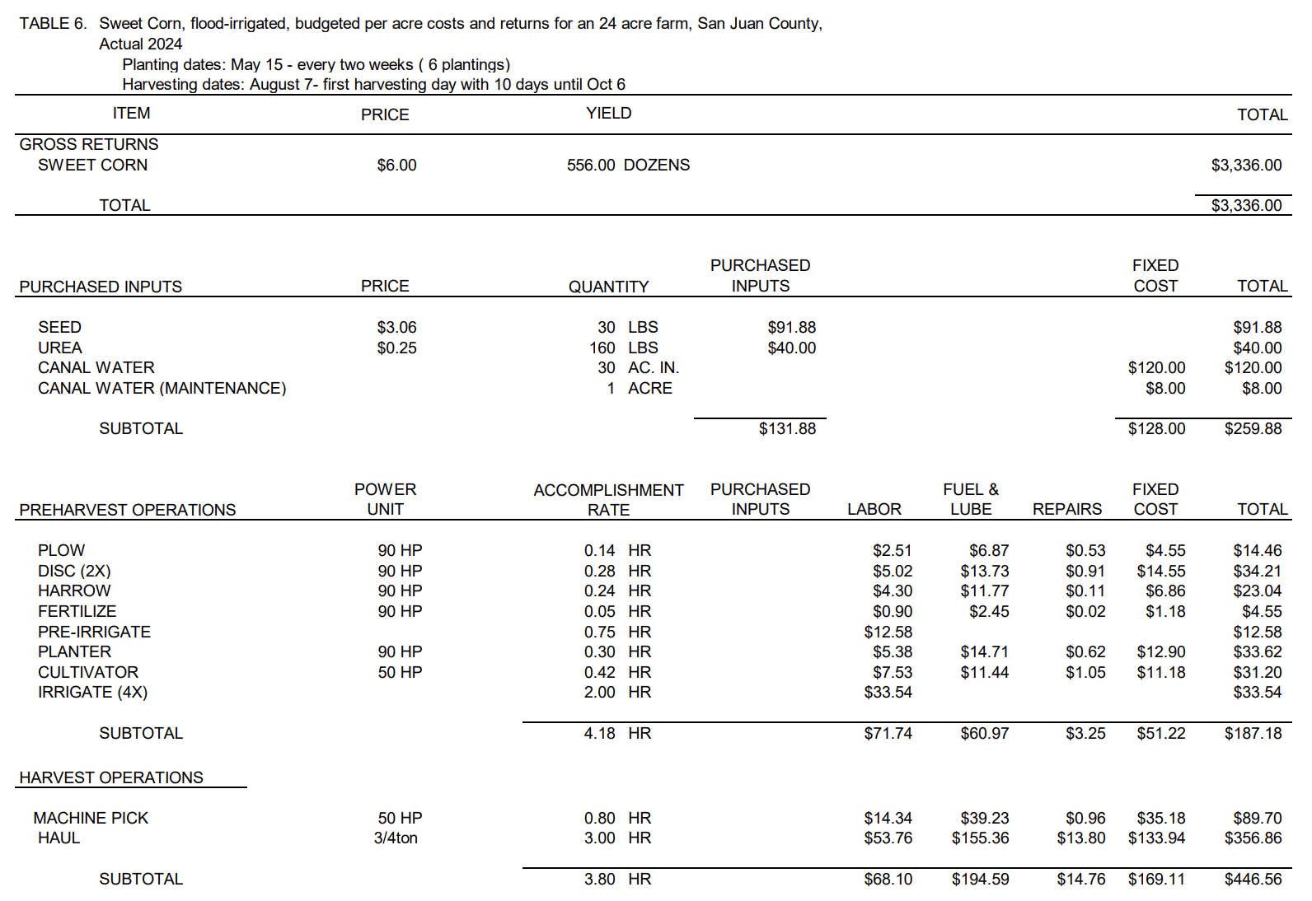
Representative Farm - NMSU 2025 Cost and Return Estimates

Slide 38
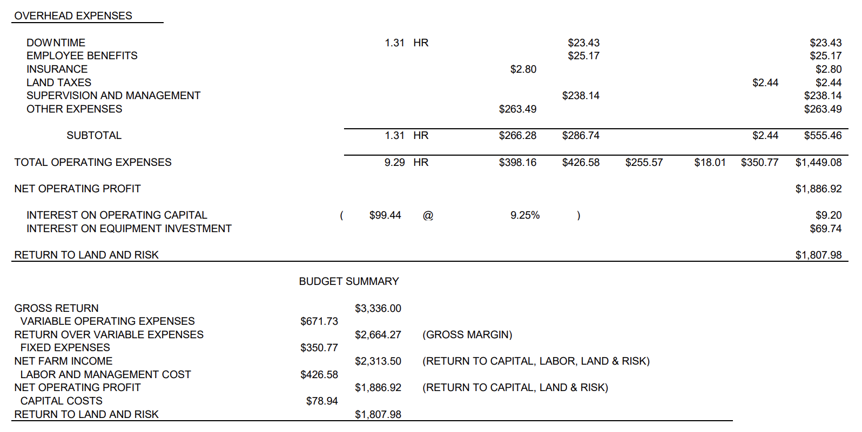
Representative Farm - NMSU 2025 Cost and Return Estimates

Slide 39
Cost of Production in a Farm Operation
Total Annual Sweet Corn Expenses (per acre)
Expense Type | Amount($)
Water, Seed, Urea | $259.88
Pre-Harvest Ops | $187.18
Harvest Ops | $446.56
Overhead | $555.46
Total | $1,449.08

Slide 40
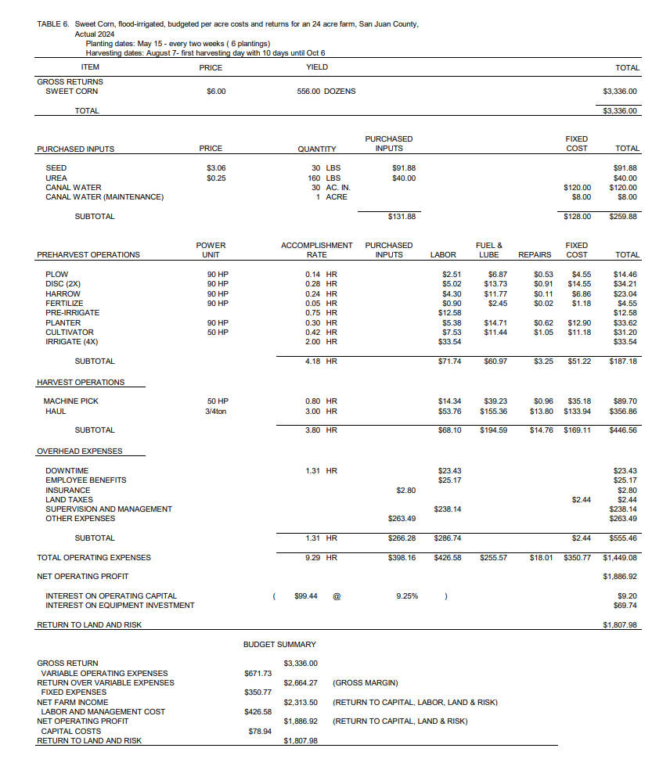
Cost of Production in a Farm Operation
Total Annual Sweet Corn Expenses (per acre)
Expense Type | Amount($)
Water, Seed, Urea | $259.88
Pre-Harvest Ops | $187.18
Harvest Ops | $446.56
Overhead | $555.46
Total | $1,449.08

Slide 41
Cost of Production in a Farm Operation
Total Annual Sweet Corn Expenses (per acre)
Expense Type | Amount($)
Water, Seed, Urea | $259.88
Pre-Harvest Ops | $187.18
Harvest Ops | $446.56
Overhead | $555.46
Total | $1,449.08

Slide 42
Calculating CoP - Step 3
Calculate YIELD (Sweet Corn Output)
  Measure total amount of Corn in a production year.
    556 Dozen ears / acre

Slide 43
Calculating CoP - Step 4
Compute Unit Cost
  Total expense = $1,449.08 per acre
  # Dozen Ears per acre = 556
Unit cost = $1,449.08 ÷ 556 = $2.61 per dozen

Slide 44
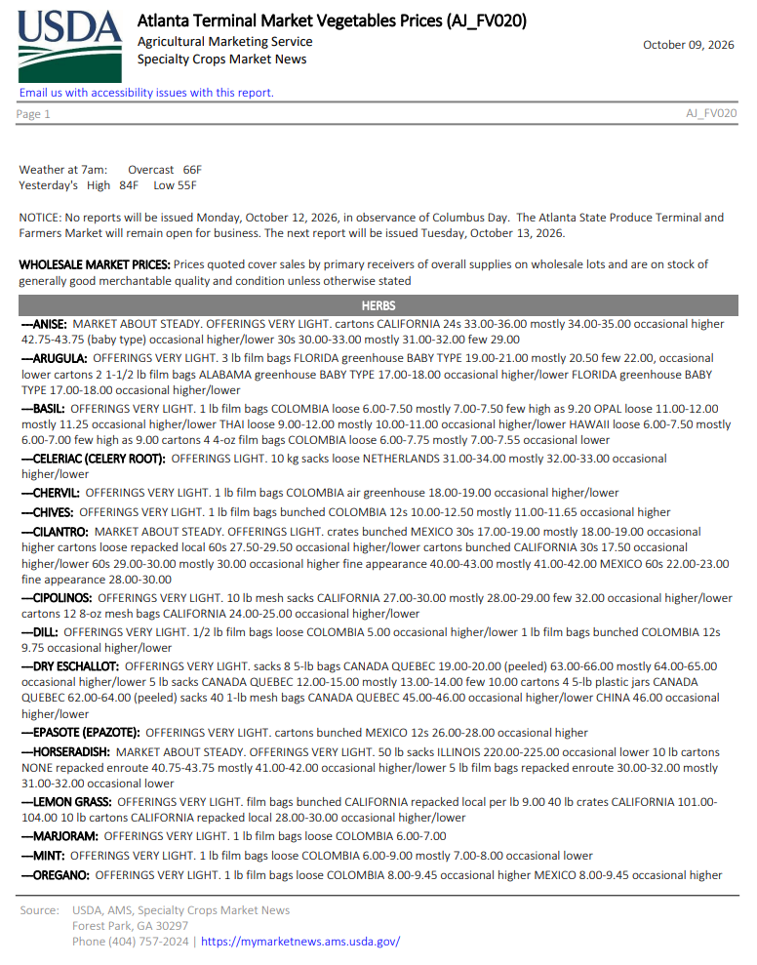

Calculating CoP - Step 5
Market Analysis
  Your Price for 1 Dozen Ears of Sweet Corn @ local market = $6.00
    ~$24 sack of 4 dozen
  What is your market?
    Can you accurately calculate potential revenue?
  Gross Revenue: $3,336 per acre

Slide 45
Calculating CoP - Step 6
Calculate Profit
  If 1 Dozen Ears sell for $6.00 at your market
  Unit cost is $2.61 per Dozen
→ Profit = $3.39 per 1 Dozen Ears
Would you expand production?

Slide 46

Cost of Production Management Decisions
Would you expand production?
What else would you need to know before deciding?
  Labor availability, water, demand, market access, equipment, and whether the extra production can be sold.

Slide 47
Calculating CoP - Step 7
Calculate Profit for this enterprise
Profit = $3.39 per Dozen
Per Acre Profit = $3.39 x 556 = $1,884

Slide 48
What About Other Costs?
Subtract additional costs
Interest, depreciation, etc.
Return to Land and Risk:
$1,807.98

Slide 49

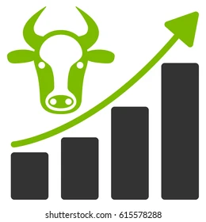
Cost of Production in an Operation
Cost accounting requires good records
  Challenges with shared costs across enterprises
  Track depreciation and opportunity costs
    https://beef.unl.edu/cow-depreciation-for-cow-calf-producers
Not accounting for these can result in very inaccurate cost estimates!!!

Slide 50
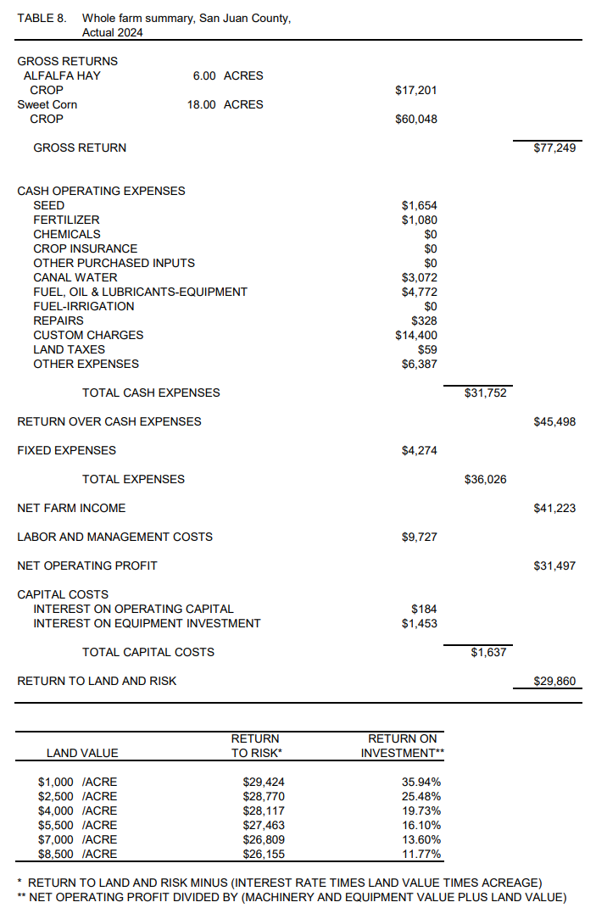
The Whole Farm
Total Farm return: $29,860
This operation is producing a little over $1,200 per acre
The Sweet Corn enterprise is performing better ($1,807.98 Acre).
The Alfalfa enterprise had a net negative profit (-$447 Acre) this year.

Slide 51
Land Value and Returns
Make informed decisions about your operation based on the value of your land.
Opportunity Cost = The next best alternative use of this resource.

Slide 52

Not tracking small expenses
→ Keep detailed records
Forgetting depreciation
→ Calculate equipment value over time
Accrual Errors
→ Keep detailed records
Mixing personal & farm finances
→ Separate accounts
Common Mistakes & How to Fix Them

Slide 53
Cost and Return Estimates (CARE)
https://costsandreturns.nmsu.edu/
NMSU Enterprise Budgets

Slide 54
Cost of Production for Decision Making

Slide 55
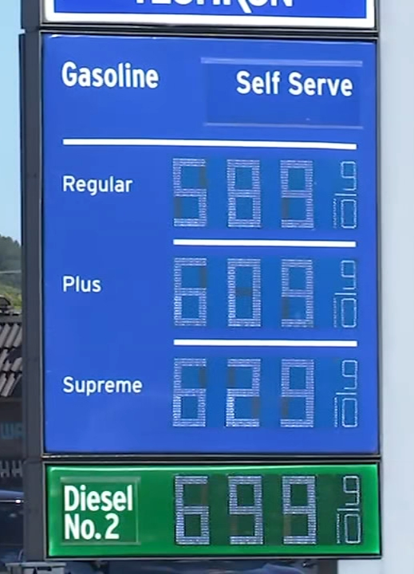
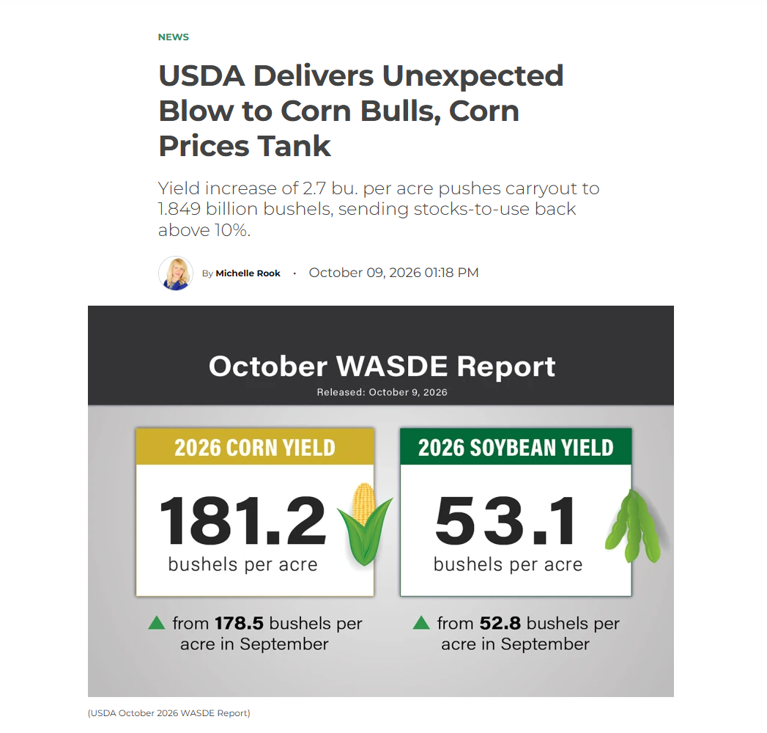
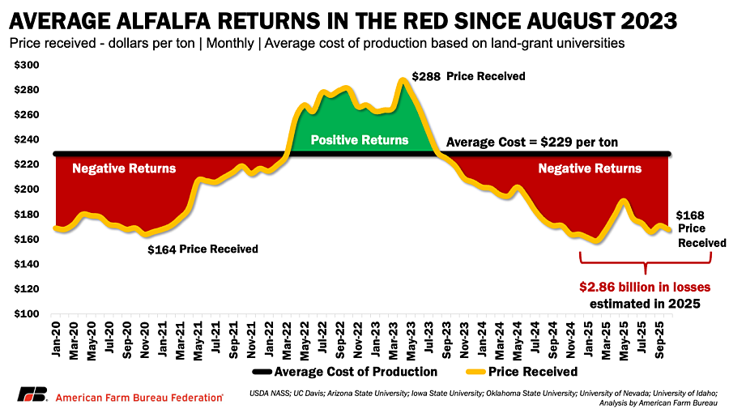
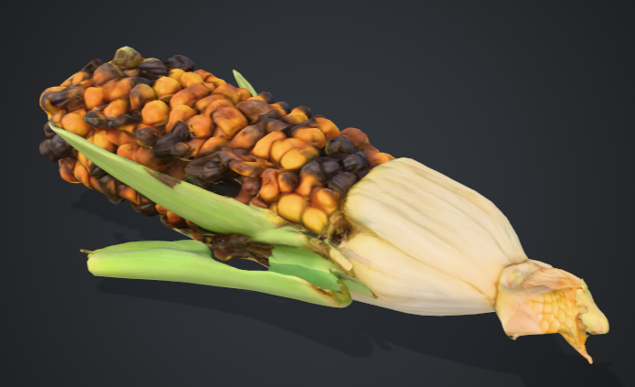
Cost of Production in a Farm Operation
What if?

Slide 56

Adaptabilty Using CoP
What does a producer do in a good year to prepare for a difficult one?
The best decision is not always the one that maximizes immediate sales.

Slide 57
Benchmarking Against Yourself Across Time
Track unit costs annually to see trends
  Compare 2020 vs 2021 vs 2022 vs 2023 vs 2024 vs 2025 costs
    Assess the effects resulting from changes in the price of:
      Labor, Land, Fuel, Feed, etc.

Slide 58
Benchmarking Against Other Producers
Compare with industry averages or peers to assess the competitiveness of your operation.
  Compare 2021 vs 2022 vs 2023 vs 2024 vs 2025 costs
  Using benchmarking for decision making.
    Higher cost than peers → assess your inefficiencies
    Lower cost → competitive advantage

Slide 59
What does this operation need to do today so that the next generation has a viable operation and healthy land to inherit?
Cost of Production & The Future of Your Operation
2025 Revenue and Expenses
Category | Revenue | Category | Expenses
Bull Sales | $15,000 | Feed, Vet, Water, Fuel | $40,000
Cull Sales | $17,000 | Equipment Costs | $20,000
Calf Sales | $60,000 | Labor & Other Expenses | $30,000
Custom Labor | $25,000 | Depreciation | $5,000
 |  | Payments, Interest & Taxes | $9,000
Total Revenue | $117,000 | Total Expenses | $104,000
 | Net Income | $13,000

Slide 60
The GOAL!
Not just to keep records. It is to use your numbers to protect your operation, strengthen your family and community, and keep your agricultural operation productive for the next generation.

Slide 61
Questions?
Jason Banegas
Zumbabwe@nmsu.edu
aeab.nmsu.edu

