Slide 1


Tribal Ranching Seminar Series
Financial and Business Management
Jason Banegas
Extension Economist
Cooperative Extension Service

Slide 2
Tribal Ranching Seminar Series
What is the GOAL For This Learning Series?

Slide 3
Tribal Ranching Seminar Series
Gain Knowledge and Build Tools so you can keep doing what you love and pass it on to your family.

Slide 4
Minimize Risk
and
Maximize Opportunity

Slide 5
Purpose of Today’s Session
Build practical financial and business skills to operate more confidently and profitably.
Topics covered:
  Recordkeeping / Bookkeeping
  Financial Statements
  Asset management
  Decision-making with your Financial Assessment

Slide 6
Topic Question
What’s your current method of tracking ranch expenses?
  Notebook
  Spreadsheet (Excel, Google Sheets, Etc.)
  App or Computer Program
  None

Slide 7
Bookkeeping and Expense Tracking
Track Your Costs Exercise:
  Write down the name of 3 Business expenses from this month.

Slide 8
Bookkeeping and Expense Tracking
Track Your Costs Exercise:
  Write down the name of 3 business expenses from this month.
  Did you save the receipts?

Slide 9
Bookkeeping and Expense Tracking
Track Your Costs Exercise:
  Write down the name of 3 business expenses from this month.
  Did you save the receipts?
  How much did they cost?

Slide 10
Why Records Matter
Do you know where your money goes?
  Records show your real costs. Without them, it’s easy to lose money without noticing.
Receipts are essential for:
  Taxes
  Loans
  Decision-making

Slide 11
Common Ranch Expenses
What should you track?
Fuel (truck, ATVs) Hay and Feed Mineral Supplements | Vet and Medicine Repairs (fences, wells) Labor
…and Your Time!!!

Slide 12
Simple Tracking System
Basic Tools to track finances:
Tracking Tips
  Record all income and expenses monthly.
  Review records regularly to understand your financial habits.
Notebook Spreadsheet Computer Program | Phone app or Select the method that best works for you

Slide 13
3 main financial statements
  Balance Sheet
  Profit and Loss Statement aka Income Statement
  Cash Flow Statement
What Financial Statements Do I Need?

Slide 14
Financial Statement #1
Balance Sheets

Slide 15

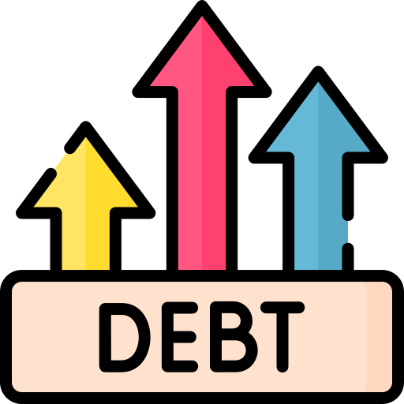

Everything Owned and Owed
A balance sheet shows your NET WORTH / OWNER EQUITY at a specific point in time
NET WORTH = Assets - Liabilities
What is a Balance Sheet?

Slide 16

Your Balance Sheet Changes
Time Period #1
Assets - Liabilities
Owned vs Owed
Net Worth #1
Cash Flows
and
Assets Change
over time
Time Period #2
Assets - Liabilities
Owned vs Owed
Net Worth #2
Record Keeping is Essential!

Slide 17
Measures solvency and liquidity
Quantify vs. Feelings
Measure your Performance
Risk assessment
Needed when applying for a loan
Guides management decisions
Why use a Balance Sheet?

Slide 18
Solvency
  The ability to pay off all liabilities / financial obligations if all assets are sold.
  Liabilities > Assets = Insolvent
Liquidity
  The ability to generate cash to pay obligations.
  You want to have liquidity without affecting normal business operations.
Financial Terminology

Slide 19
Depreciation
  The gradual loss of value of farm assets over time due to wear, aging, or obsolescence
    Tractors, Irrigation Systems, Barns, and Fencing.
  Depreciation spreads the cost of long-term assets over their useful life.
  Take advantage of tax deductions, reducing taxable income.
Financial Terminology

Slide 20
Should your Balance Sheet have Business and Personal information together or separate?
  If you are using personal assets as collateral for a loan they will probably need to be together for a lender.
  Excluding personal information makes it easier to analyse the performance of your operation and plan for changes.
Business or Personal?

Slide 21
When to do it?
Annually (at end of accounting period) and Consistently
Take an inventory of your assets and resources
Determine and record your asset values
Record liabilities
Building a Balance Sheet

Slide 22
Financial assets
Land and Buildings
Machinery, equipment, implements, and tools
Operating inputs purchased but not yet used
Livestock - Breeding, Specialty, and Market
Harvested crops in storage
1. Inventory Your Assets

Slide 23
Assets have value because they can be sold for cash or can be used to produce goods or services that can earn money in the future.
2. Asset Valuation

Slide 24
Cost Approach
  The original investment amount and replacement cost
Market value
  Sales price at market
Income Capitalization Approach
  Potential income requires accurate projections of future income and operating expenses.
2. Asset Valuation Methods

Slide 25
Cost Basis (cash cost + investment expenses - depreciation)
  Cost-basis balance sheets conform to GAAP and are easily compared to balance sheets from other types of businesses.
Market value (what a buyer is willing to pay you - selling costs)
  Market value balances more accurately reflect current financial positions and loan collateral values.
The Farm Financial Standards Council recommends using both methods
2. We Will Use Two Valuation Methods

Slide 26
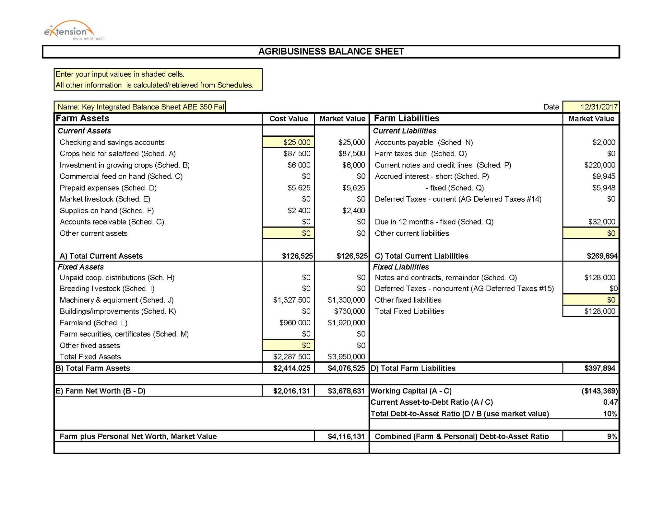

Slide 27

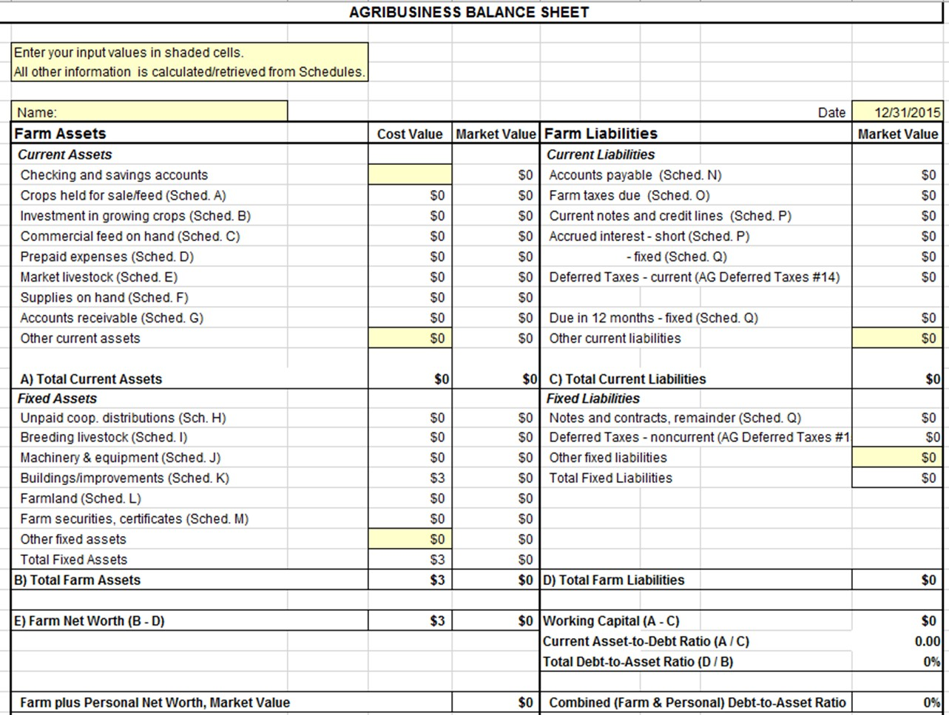
2. Record Your Assets
Assets on Left

Slide 28
Many times assets and liabilities are listed on a balance sheet in 3 categories based on their lifespan.
Our simplified example shows only 2 categories:
  Current (less than 1 year) and
  Fixed (more than 1 year)
An intermediate category (1-10 year) can be used for assets such as breeding livestock, equipment, and machinery; and intermediate term loans.
Short, Intermediate, and Long-Term

Slide 29
2. Current Assets
Current Assets
Short Term Assets most easily turned into cash or used within a year.

Slide 30
2. Fixed Assets
Fixed Assets
Non-current, Intermediate, and Long-term Assets that likely won’t be sold within a year and have a lifespan of more than a year.

Slide 31
Accounts payable
Loan information
  Current portions of principal and interest payments
  Delinquent principal and interest payments
  Unpaid, accrued interest
Other Debts
  Personal liabilities (if using consolidated balance sheet)
3. Inventory Your Liabilities

Slide 32
3. Record Your Liabilities
Liabilities on Right

Slide 33
2. Current Liabilities
Current Liabilities
Short Term Liabilities are obligations expected to be paid within a year

Slide 34
2. Fixed Liabilities
Fixed Liabilities
Intermediate or Long-term debts, bonds, mortgages or loans that are payable over a term exceeding one year

Slide 35
Net Worth / Owner Equity
Net Worth
is what is left over if all assets are sold and all debts paid.

Slide 36
Balance Sheet Exercise

Slide 37
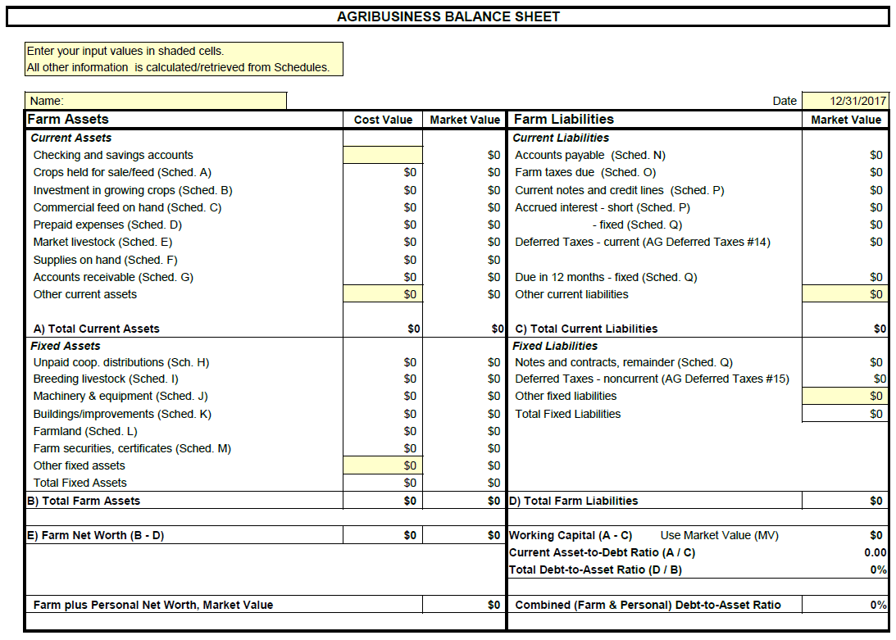

Slide 38
Where would you enter…
Tractor – last payment made was on March 20, 2024. Balance of note is $60,000. Annual interest rate is 5%. Principle due in next 12 months is $20,000.
Schedule Q. Fixed Notes and Contracts (Loans/Notes Against Machinery)

Slide 39
Where would you enter…
seed corn 25 units at $225 per unit.
Schedule D. Prepaid Expenses

Slide 40
Where would you enter…
320 acres at a MARKET VALUE of $6,000 per acre. Previous cost value was $3,000 per acre.
Schedule L. Farmland

Slide 41
Where would you enter…
10,000 bushels corn at $4 and 5000 bushels soybeans at $9.50.
Schedule A - Crops Held For Sale/Feed

Slide 42
Where would you enter…
40 acres wheat at $150 per acre.
Schedule B. Investment in Growing Crops

Slide 43
Where would you enter…
Line of grain farm machinery MARKET value $1,300,000. Cost value is $1,475,000. Depreciation will automatically compute at 10%.
Schedule J. Machinery and Equipment

Slide 44
Where would you enter…
Operating notes at annual 6% interest for $220,000, borrowed on March 31, 2024.
Schedule P. Current Notes and Credit Lines

Slide 45
Where would you enter…
General accounts payable $2,000.
Schedule N. Accounts Payable

Slide 46
Where would you enter…
600 gallons of fuel at $4 per gallon
Schedule F. Supplies on Hand

Slide 48
Financial Ratios help to determine the health of a business.
A single ratio cannot determine the overall health, several ratios and other data are necessary.
Measure your Solvency
  Debt to Asset Ratio
Measure your Liquidity
  Current Ratio
  Working Capital
Key Ratios

Slide 49
Measurement of Solvency Total Liabilities / Total Assets
  $100 / $70 = 1.43
  $100 / $100 = 1
  $100 / $256 = .39
Less is better
  Ratio over 1 = insolvent
  Ratio equal to or under 1 = solvent
What financial statement is used to find Debt to Asset Ratio?
Debt to Asset Ratio

Slide 50
Measurement of Liquidity Current Asset Value / Current Liabilities
  $100 / $46 = 2.17
  $100 / $100 = 1
  $100 / $189 = .53
Ratios over 2 are preferred
Larger ratios = more liquidity = More ability to pay bills
What financial statement is used to find Debt to Asset Ratio?
Current Ratio

Slide 51
Measurement of Liquidity Current Asset Value - Current Liabilities
  $100 - $78 = $22
  $100 - $100 = $0
  $100 - $211 = -$111
Working capital is a CASH BUFFER to pay bills and for operating expenses.
What financial statement is used to find Debt to Asset Ratio?
Working Capital

Slide 52
Measurement of Liquidity in relation to business size Working Capital / Gross Revenue
  $29 / $345 = 8%
  $66 / $345 = 19%
  $100 / $345 = 29%
  $290 / $345 = 84%
Higher percentages equal more cash for short-term needs. A ratio less than 25% puts a business at risk of needing financing due to market volatility.
Working Capital to Gross Revenue Ratio

Slide 53
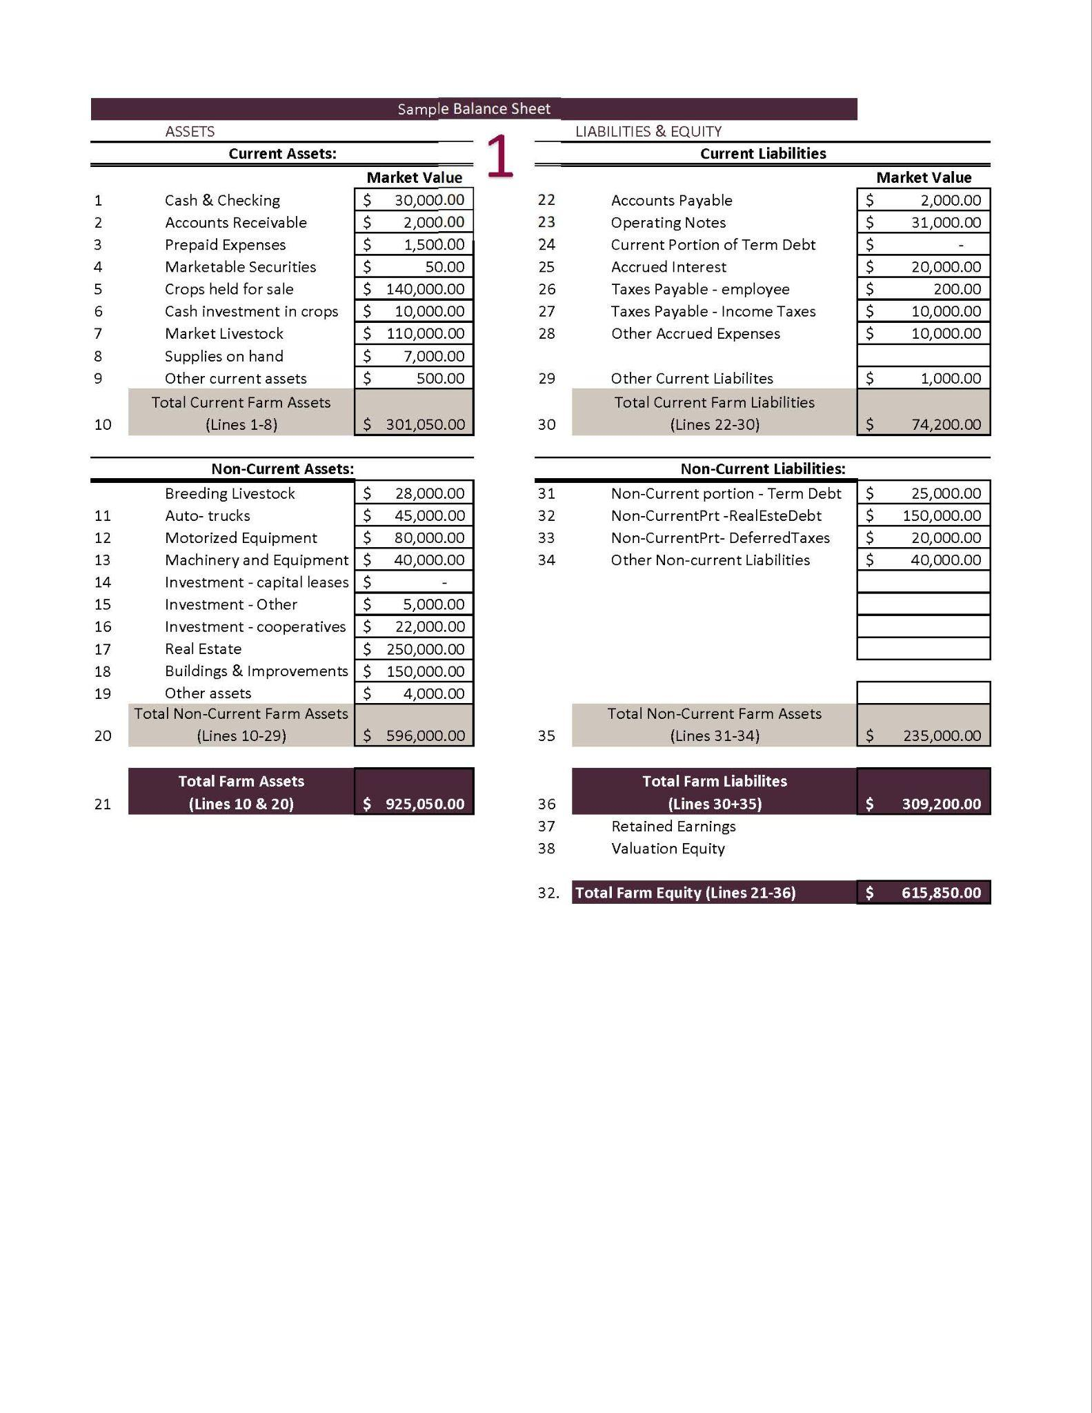

Slide 54
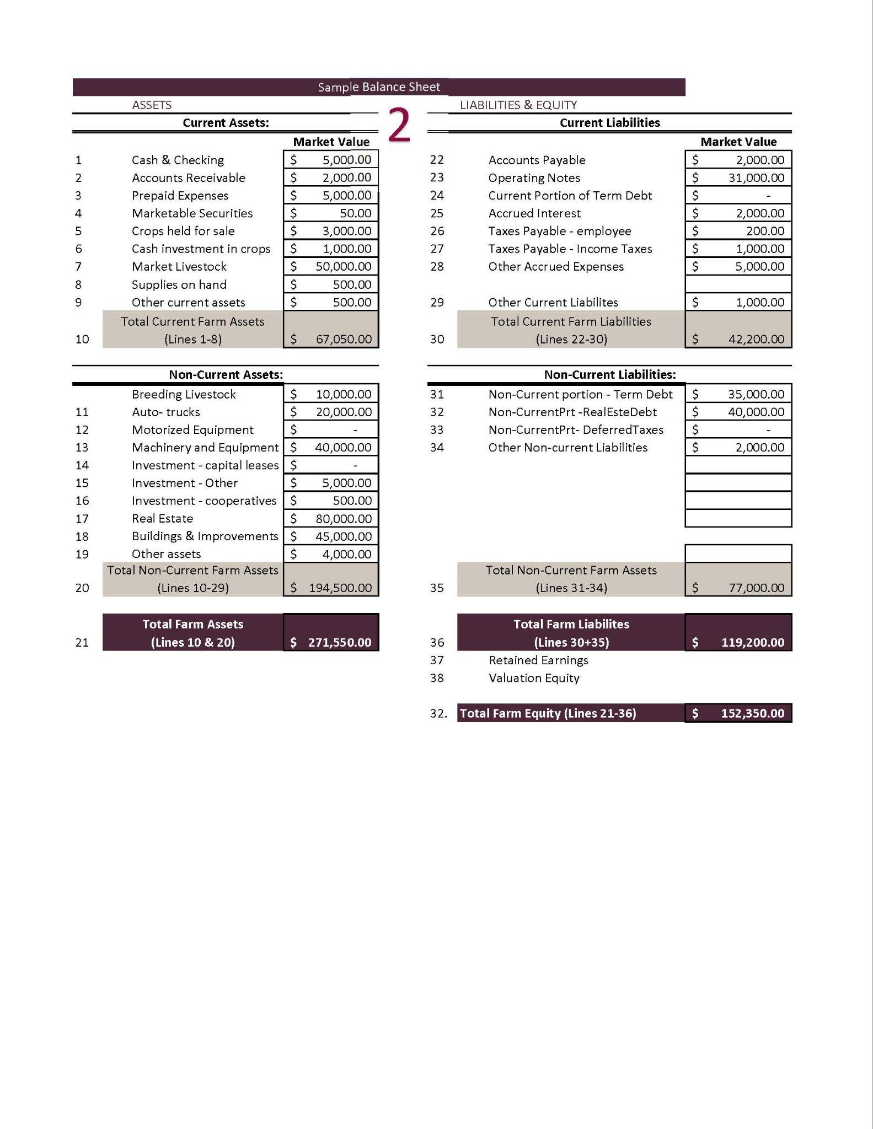

Slide 55
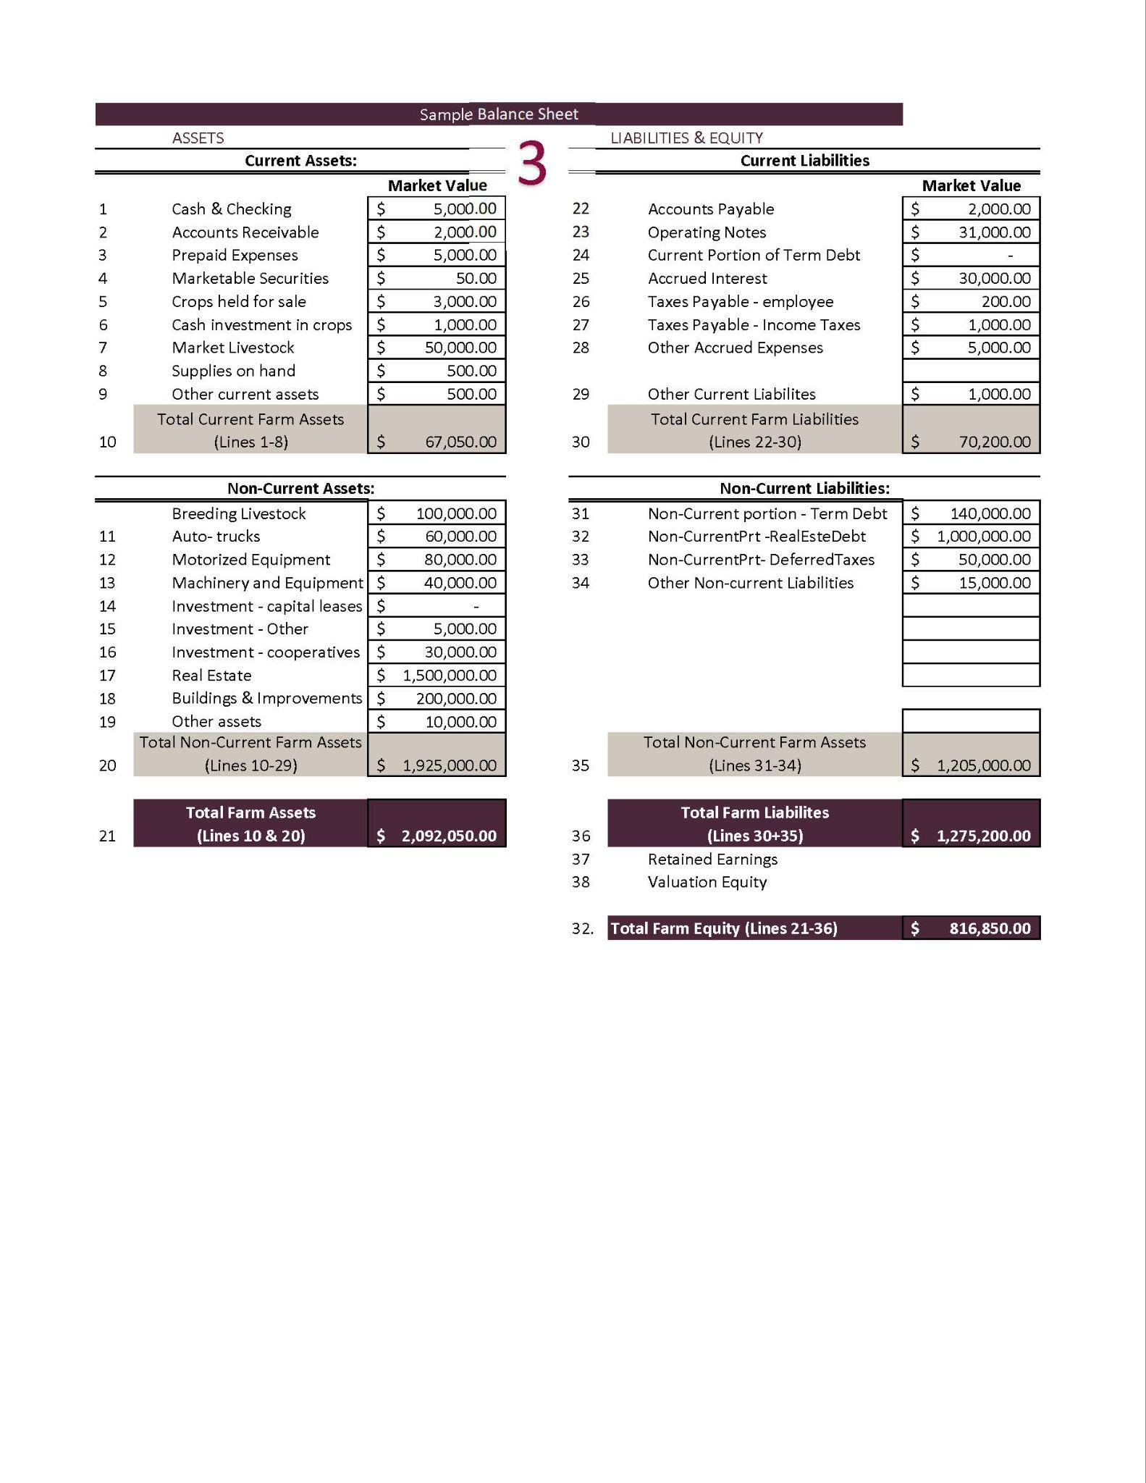

Slide 56
Financial Statement #2
Income Statements
aka
Profit and Loss Statements (P&L)

Slide 57
Profitability over a period of time.
  Fiscal or Calendar Year or Production Cycle
Revenue
  What you earned from selling crops, livestock, etc.
Expenses
  What you spent on feed, seeds, labor, equipment, etc.
Income Statement aka Profit and Loss Statement (P&L)

Slide 58

Determine if income covers expenses
Essential for loan applications and tax planning
Guides management decisions
Used for setting goals and improving profitability
Why use a P&L?

Slide 59

Sales records
  invoices, receipts
Expense records
  seeds, feed, labor, equipment
Inventory changes
  livestock, stored crops
Depreciation values
Loan Payments, Interest, and Taxes
Creating an P&L

Slide 60
Accrual Accounting
  Large or complex farms should use this for better financial analysis and decision-making because it provides a more complete picture of income and expenses by recognizing them when earned or incurred, not just when cash is received or paid out.
Cash Accounting
  Most small farms with simple operations can use cash accounting due to its simplicity and ability to manage cash flow better in volatile market conditions.
Cash or Accrual?

Slide 61
Many farmers are on a cash accounting system for taxes.
Their Schedule F shows the amount of cash sales less cash purchases and depreciation.
Schedule F

Slide 62
Ranch Income Statement
2025 Sales and Expenses
Category | Revenue | Category | Expenses
Cattle Sales | $190,000 | Feed & Veterinary | $(50,000)
Hunting Permits | $10,000 | Land Lease & Maintenance | $(40,000)
 |  | Labor & Other Expenses | $(40,000)
 |  | Depreciation | $(5,000)
 |  | Payments, Interest & Taxes | $(15,000)
 |  | Net Income | $50,000

Slide 63
Farm Income Statement
2025 Sales and Expenses
Category | Revenue | Category | Expenses
Corn Sales | $60,000 | Seed, Fertilizer, Pesticides | $(40,000)
Alfalfa Sales | $90,000 | Equipment Costs | $(10,000)
 |  | Labor & Other Expenses | $(20,000)
 |  | Depreciation | $(5,000)
 |  | Payments, Interest & Taxes | $(25,000)
 |  | Net Income | $50,000

Slide 64
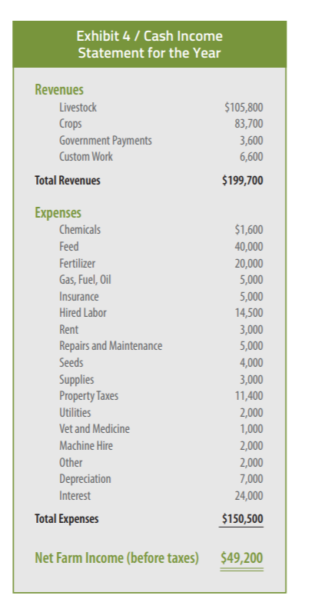
https://agwestfc.com/education-and-resources

Slide 65
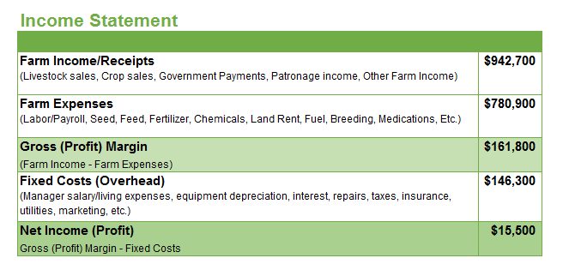
https://www.agsouthfc.com/news/blog/understanding-farm-financials-part-1
Gross Margin (Profit Margin) – The profit or loss of that year’s production.
  Doesn’t account for fixed costs. An operation should have enough Gross Profit Margin to cover the operation’s fixed costs.
Net Income (Profit) – True picture of profit/loss of the farm operation.
  Is the operating income sufficient to cover costs of both production and overhead.
$942,700 - $780,900
= $161,800
$161,800 - $146,300
= $15,500

Slide 66
Accrual adjusted income statement combines the cash basis accounting records with inventories from a balance sheet.
Increases or Decreases of the values of inventories from the beginning to the end of a year are shown on the income statement.
Accrual Adjustments

Slide 67
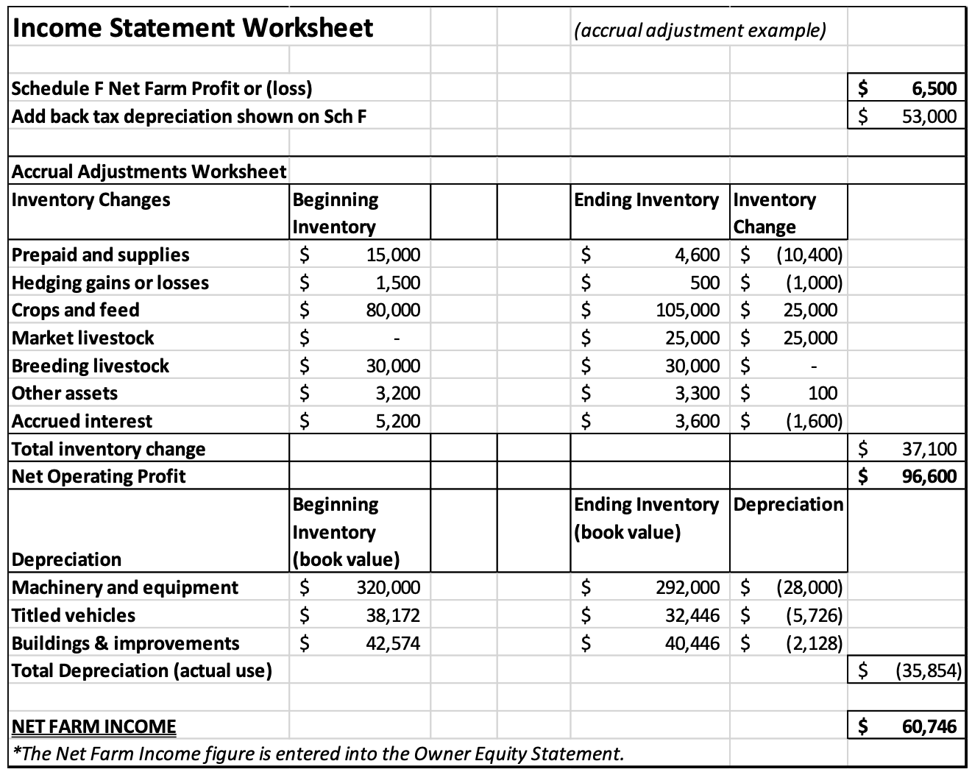
In this same example, all the weaned calves were sold before the first of the year
Livestock inventory on the beginning balance sheet is zero.
During the year the calves raised are all still in inventory at a $25,000 value at yearend.
By figuring these accrual adjustments, net farm income, otherwise known as “true” or real profitability is calculated for a given period.
https://cap.unl.edu/news/net-farm-income-impacts-net-worth-growth/

Slide 68
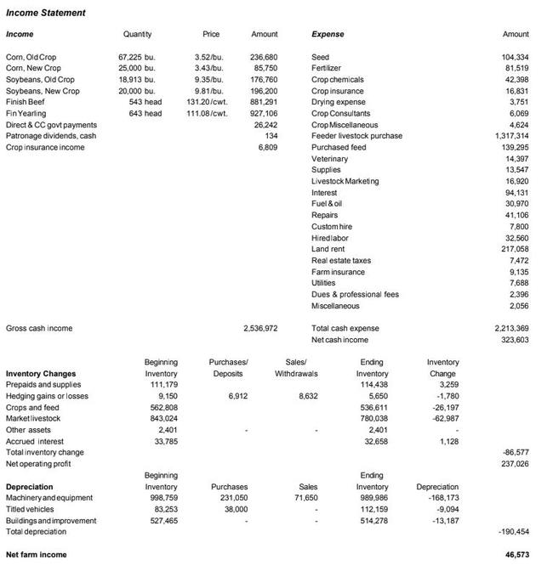
This accrual adjusted income statement from FINPACK shows a more complete picture of a farm’s annual finances than a simple cash based income statement.

Slide 69
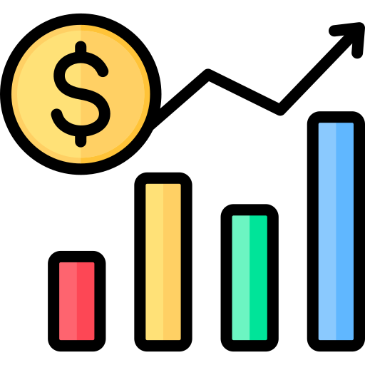
Tracking P&L Changes Over Time
Year | Revenue | Expenses | Net Income ($)
2020 | 60,000 | (125,000) | (65,000)
2021 | 90,000 | (100,000) | (10,000)
2022 | 120,000 | (100,000) | 20,000
2023 | 135,000 | (105,000) | 30,000
2024 | 150,000 | (100,000) | 50,000

Slide 70
Income Statement for Decision Making

Slide 71
Increase Revenue
  Find better markets, improve yields, diversify income, sell assets
Reduce Costs
  Buy inputs in bulk, improve efficiency, reduce waste
Monitor
  Review finances regularly, adjust operations
Income Statement for Decision Making

Slide 72
Not tracking small expenses
→ Keep detailed records
Forgetting depreciation
→ Calculate equipment value over time
Accrual Errors
→ Keep detailed records
Mixing personal & farm finances
→ Separate accounts
Common Mistakes & How to Fix Them

Slide 73

Farm accounting software
  (QuickBooks, Excel, Ambrook, FINPACK, other Ag-specific apps)
Online income statement templates
NMSU Extension and farm financial advisors
Income Statement Help

Slide 74
Financial Statement #3
Cash Flow Statements

Slide 75

A financial tool that tracks the movement of cash in and out of an operation (usually on a monthly basis).
Cash Inflows
  crop/livestock sales, government payments, loans
Cash Outflows
  feed, fuel, labor, loan payments
Actual cash transactions, not accrual.
What is a Cash Flow Statement?

Slide 76

Beginning Cash Balance
Cash Inflows
Sales (livestock, crops, hay)
Government payments (ARC/PLC, EQIP)
Loans or advances
3. Cash Outflows
Operating expenses (seed, fuel, vet care)
Capital purchases
Debt payments
Labor costs
4. Ending Cash Balance
Components of a Cash Flow Statement

Slide 77
Simple Monthly Cash Flow Statement
January 1st: You start with $45,000 in your account
 | Jan | Feb | Mar | Apr | May | Jun | Jul | Aug | Sep | Oct | Nov | Dec
Inflows | 0 | 0 | 8,000 | 6,000 | 0 | 0 | 0 | 0 | 0 | 69,000 | 34,000 | 0
Outflows | 12,000 | 10,000 | 8,000 | 4,000 | 5,000 | 8,000 | 9,000 | 8,000 | 14,000 | 16,000 | 6,000 | 4,000
Net Flow | -12,000 | -10,000 | 0 | 2,000 | -5,000 | -8,000 | -9,000 | -8,000 | -14,000 | 53,000 | 28,000 | -4,000
Balance | 23,000 | 13,000 | 13,000 | 15,000 | 10,000 | 2,000 | -7,000 | -15,000 | -29,000 | 24,000 | 52,000 | 48,000
How can you make it through this year with a negative account balance?

Slide 78
Agriculture is seasonal
  Manage timing mismatches between income (e.g., fall harvest) and expenses (e.g., spring planting).
Support decision-making on capital investments, equipment repairs, or livestock purchases.
Cash Flow Management

Slide 79
Variability in Production and Markets affect cash flow and may require additional funding.
Plan for obtaining lines of credit or reducing expenses.
Identify Shortfalls

Slide 80
Monitor and manage cash flow effectively to ensure working capital is available throughout the production cycle.
  Optimize spending during low-revenue periods.
  Time marketing decisions to maximize cash inflows.
Buying and Selling

Slide 81
Good Cash Flow Statements Support:
  Loan applications and renewals
  Purchase decisions
  Crisis planning (drought, price volatility)
Lenders use this information to ensure that farmers have sufficient liquidity to meet financial obligations and repay loans.
Cash Flows for Planning

Slide 82
Crucial for analyzing the cash flow associated with specific enterprises within your whole operation.
Cash flow stress testing under different commodity price “what if” scenarios.
Cash Flow Analysis

Slide 83
Create a “Spending Plan”
  Created from past cash flow statements with predicted adjustments
Used to assess the feasibility of expansion and potential revenue streams.
If major events have happened (lost leases, changed major enterprises, etc.) then reconstruct a new plan
Cash Flow Projections

Slide 84
CASH FLOW
helps a business
GO!

Slide 85
Assess Financial Health
  A snapshot of assets, liabilities, and equity, helps you understand your financial position to make informed decisions.
Improve Loan Access & Creditworthiness
  Lenders evaluate a farm’s financial stability for loans or lines of credit necessary for expansion or operational improvements.
Track Progress Toward Goals
  Monitor changes in net worth over time, track financial growth, debt reduction, or investment in new equipment and land.
Enhance Decision-Making & Risk Management
  Identify strengths and weaknesses, adjust strategies, optimize resources, and mitigate market fluctuations risks or unexpected expenses.
Your Goals

Slide 86
Questions?

Slide 87
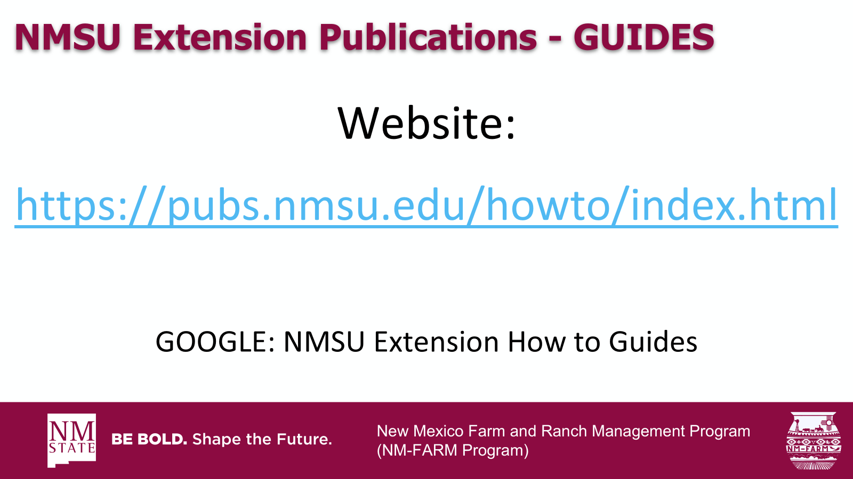

New Mexico Farm and Ranch Management Program
(NM-FARM Program)

Slide 88
NM-FARM
Goals:
  Develop a financial benchmarking program for NM farms and ranches
  Increased financial sustainability for NM farmers and ranchers
  Website: www.nmfarm.nmsu.edu
New Mexico Farm and Ranch Management Program
(NM-FARM Program)

Slide 89

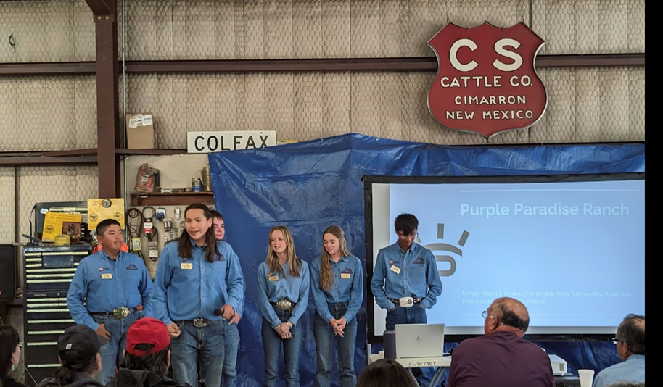
New Mexico Youth Ranch Management Camp
@ CS Ranch | Cimarron, NM
June 21-26, 2026
nmyrm.nmsu.edu
Helps youth appreciate the 'why' behind ranching.

