Slide 1


Tribal Ranching Seminar Series
Financial and Business Management
Jason Banegas
Extension Economist
Cooperative Extension Service

Slide 2
Tribal Ranching Seminar Series
What is the GOAL For This Learning Series?

Slide 3
Tribal Ranching Seminar Series
Gain Knowledge and Build Tools so you can keep doing what you love and pass it on.

Slide 4
Minimize Risk
and
Maximize Opportunity

Slide 5
Purpose of Today’s Session
Build practical financial and business skills to operate more confidently and profitably.
Topics covered:
Recordkeeping / Bookkeeping
Financial Statements
Asset management
Decision-making with your Financial Assessment

Slide 6
Topic Question
What’s your current method of tracking ranch expenses?
Notebook
Spreadsheet (Excel, Google Sheets, Etc.)
App or Computer Program
None

Slide 7
Bookkeeping and Expense Tracking
Track Your Costs Exercise:
Write down the name of 3 Business expenses from this month.

Slide 8
Bookkeeping and Expense Tracking
Track Your Costs Exercise:
Write down the name of 3 business expenses from this month.
Did you save the receipts?

Slide 9
Bookkeeping and Expense Tracking
Track Your Costs Exercise:
Write down the name of 3 business expenses from this month.
Did you save the receipts?
How much did they cost?

Slide 10
Why Records Matter
Do you know where your money goes?
Records show your real costs. Without them, it’s easy to lose money without noticing.
Receipts are essential for:
Taxes
Loans
Decision-making

Slide 11
Common Ranch Expenses
What should you track?
Fuel (truck, ATVs) Hay and Feed Mineral Supplements | Vet and Medicine Repairs (fences, wells) Labor
…and Your Time!!!

Slide 12
Simple Tracking System
Basic Tools to track finances:
Tracking Tips
Record all income and expenses monthly.
Review records regularly to understand your financial habits.
Notebook Spreadsheet Computer Program | Phone App Select the method that best works for you

Slide 13
3 main financial statements
Balance Sheet
Profit and Loss Statement aka Income Statement
Cash Flow Statement
What Financial Statements Do I Need?

Slide 14
Financial Statement #1
Balance Sheets

Slide 15

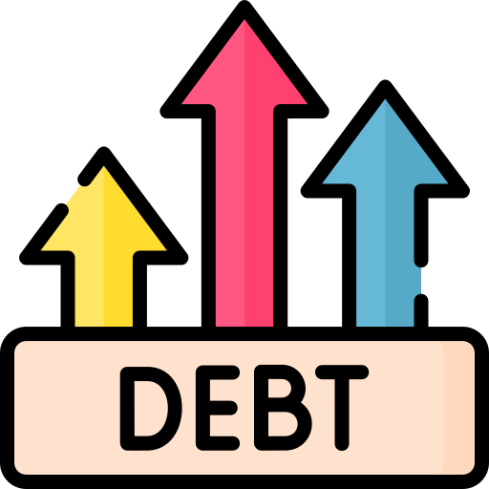

Everything Owned and Owed
A balance sheet shows your NET WORTH / OWNER EQUITY at a specific point in time
NET WORTH = Assets - Liabilities
What is a Balance Sheet?

Slide 16
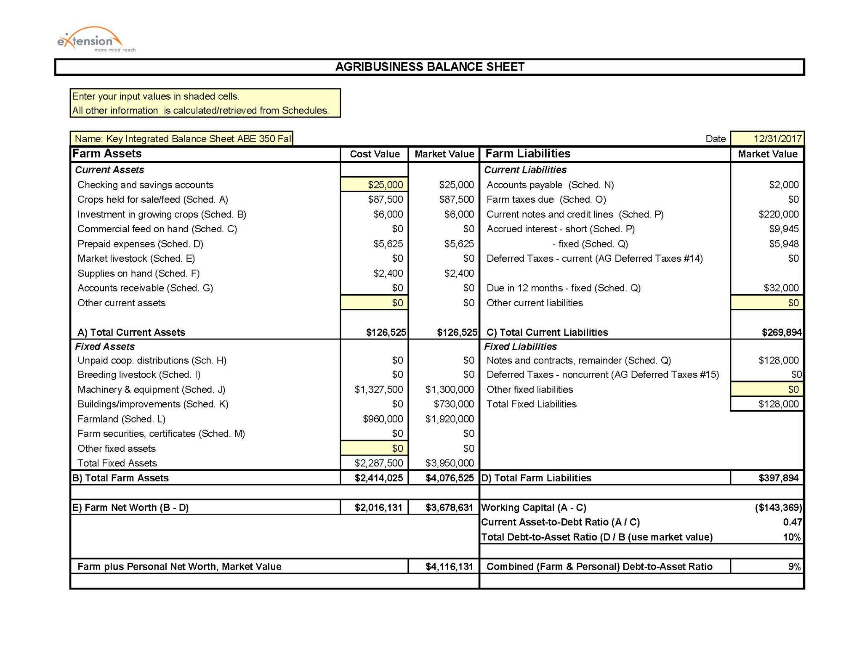
Balance Sheet
Everything Owned and Owed
A balance sheet shows your NET WORTH / OWNER EQUITY at a specific point in time
NET WORTH = Assets - Liabilities

Slide 17

Your Balance Sheet Changes
Time Period #1
Assets - Liabilities
Owned vs Owed
Net Worth #1
Cash Flows
and
Assets Change
over time
Time Period #2
Assets - Liabilities
Owned vs Owed
Net Worth #2
Record Keeping is Essential!

Slide 18
Measures solvency and liquidity
Quantify vs. Feelings
Measure your Performance
Risk assessment
Needed when applying for a loan
Guides management decisions
Why use a Balance Sheet?

Slide 19
Solvency
The ability to pay off all liabilities / financial obligations if all assets are sold.
Liabilities > Assets = Insolvent
Liquidity
The ability to generate cash to pay obligations.
You want to have liquidity without affecting normal business operations.
Financial Terminology

Slide 20
Depreciation
The gradual loss of value of farm assets over time due to wear, aging, or obsolescence
Tractors, Irrigation Systems, Barns, and Fencing.
Depreciation spreads the cost of long-term assets over their useful life.
Take advantage of tax deductions, reducing taxable income.
Financial Terminology

Slide 21
Should your Balance Sheet have Business and Personal information together or separate?
If you are using personal assets as collateral for a loan they will probably need to be together for a lender.
Excluding personal information makes it easier to analyse the performance of your operation and plan for changes.
Business or Personal?

Slide 22
When to do it?
Annually (at end of accounting period) and Consistently
Take an inventory of your assets and resources
Determine and record your asset values
Record liabilities
Building a Balance Sheet

Slide 23
Financial assets
Land and Buildings
Machinery, equipment, implements, and tools
Operating inputs purchased but not yet used
Livestock - Breeding, Specialty, and Market
Harvested crops in storage
1. Inventory Your Assets

Slide 24
Assets have value because they can be sold for cash or can be used to produce goods or services that can earn money in the future.
2. Asset Valuation

Slide 25
Cost Approach
The original investment amount and replacement cost
Market value
Sales price at market
Income Capitalization Approach (not covered today)
Potential income requires accurate projections of future income and operating expenses.
2. Asset Valuation Methods

Slide 26
Cost Basis (cash cost + investment expenses - depreciation)
Cost-basis balance sheets conform to GAAP and are easily compared to balance sheets from other types of businesses.
Market value (what a buyer is willing to pay you - selling costs)
Market value balances more accurately reflect current financial positions and loan collateral values.
The Farm Financial Standards Council recommends using both methods
2. We Will Use Two Valuation Methods

Slide 28

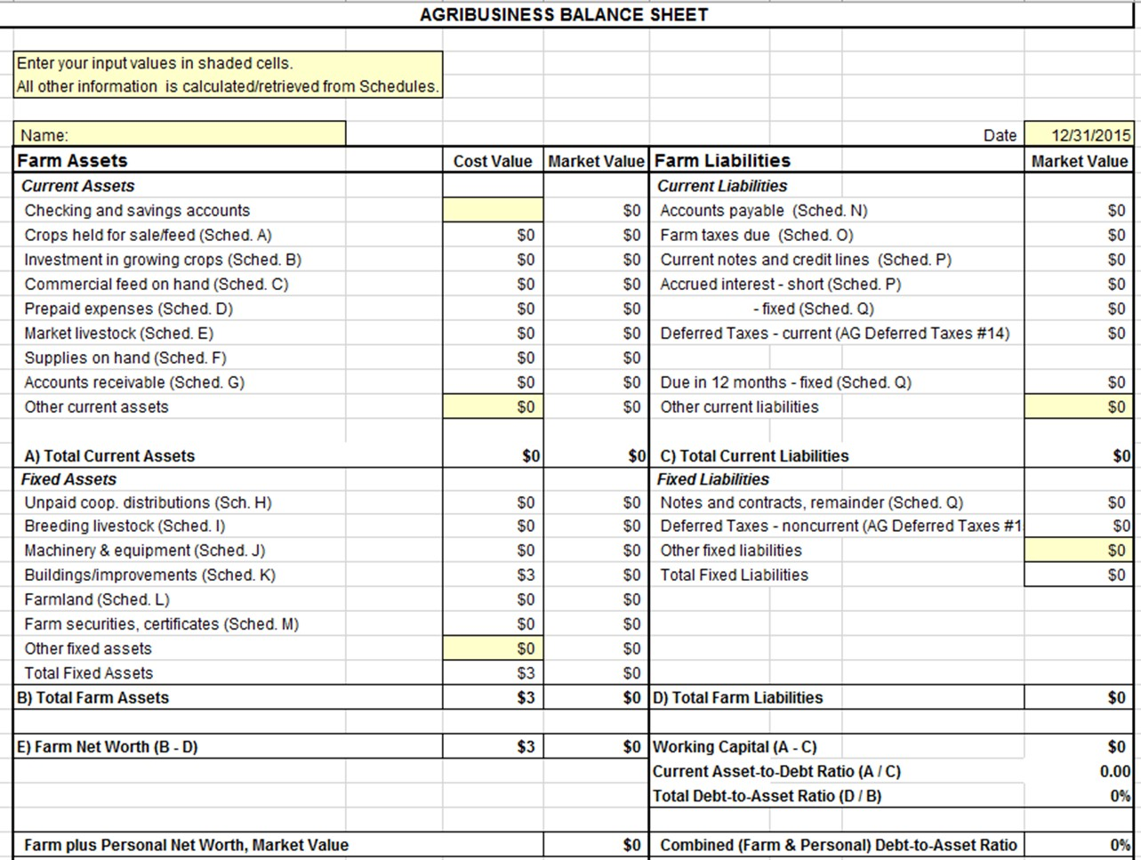
2. Record Your Assets
Assets on Left

Slide 29
Many times assets and liabilities are listed on a balance sheet in 3 categories based on their lifespan.
Our simplified example shows only 2 categories:
Current (less than 1 year) and
Fixed (more than 1 year)
An intermediate category (1-10 year) can be used for assets such as breeding livestock, equipment, and machinery; and intermediate term loans.
Short, Intermediate, and Long-Term

Slide 30
2. Current Assets
Current Assets
Short Term Assets most easily turned into cash or used within a year.

Slide 31
2. Fixed Assets
Fixed Assets
Non-current, Intermediate, and Long-term Assets that likely won’t be sold within a year and have a lifespan of more than a year.

Slide 32
Accounts payable
Loan information
Current portions of principal and interest payments
Delinquent principal and interest payments
Unpaid, accrued interest
Other Debts
Personal liabilities (if using consolidated balance sheet)
3. Inventory Your Liabilities

Slide 33
3. Record Your Liabilities
Liabilities on Right

Slide 34
2. Current Liabilities
Current Liabilities
Short Term Liabilities are obligations expected to be paid within a year

Slide 35
2. Fixed Liabilities
Fixed Liabilities
Intermediate or Long-term debts, bonds, mortgages or loans that are payable over a term exceeding one year

Slide 36
Net Worth / Owner Equity
Net Worth
is what is left over if all assets are sold and all debts paid.

Slide 37
Balance Sheet Exercise

Slide 38
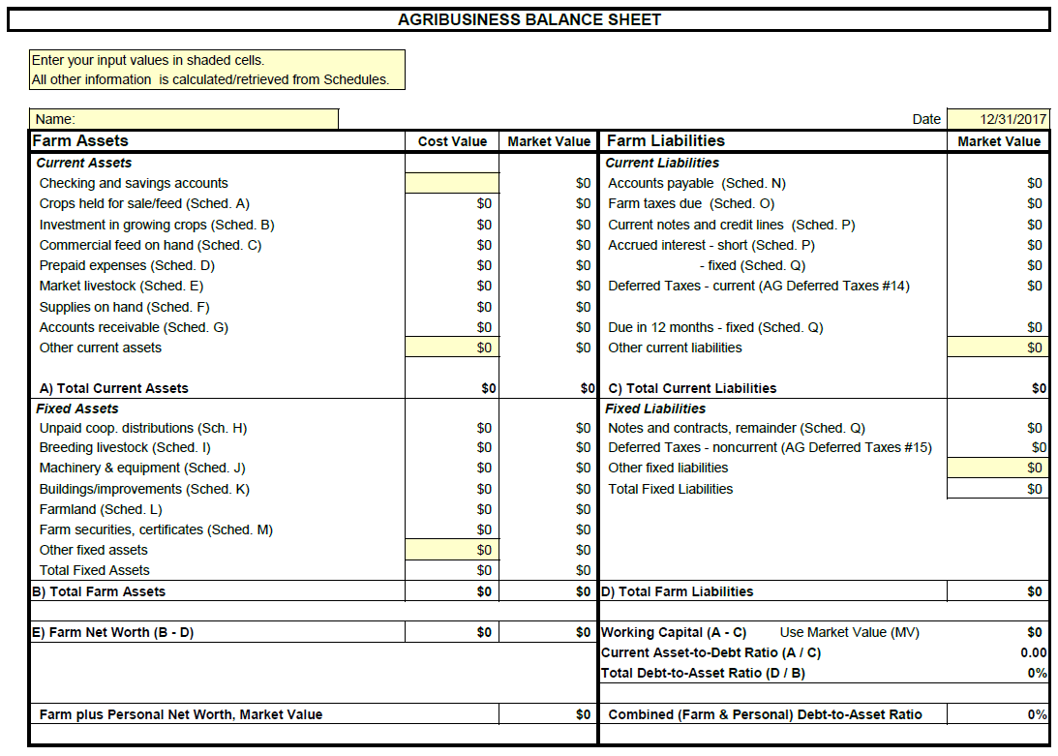

Slide 39
Where would you enter…
Tractor – (36 months of payments left. Balance of loan is $60,000.)
Payments due over next 12 months is $20,000.
Schedule Q. Fixed Notes and Contracts (Loans/Notes Against Machinery)

Slide 40
Where would you enter…
seed corn 25 units at $225 per unit.
Schedule D. Prepaid Expenses

Slide 41
Where would you enter…
320 acres at a MARKET VALUE of $6,000 per acre. Previous cost value was $3,000 per acre.
Schedule L. Farmland

Slide 42
Where would you enter…
10,000 bushels corn at $4 and 5000 bushels soybeans at $9.50.
Schedule A - Crops Held For Sale/Feed

Slide 43
Where would you enter…
40 acres wheat at $150 per acre.
Schedule B. Investment in Growing Crops

Slide 44
Where would you enter…
Line of grain farm machinery MARKET value $1,300,000. Cost value is $1,475,000. Depreciation will automatically compute at 10%.
Schedule J. Machinery and Equipment

Slide 45
Where would you enter…
Operating notes at annual 6% interest for $220,000, borrowed on March 31, 2024.
Schedule P. Current Notes and Credit Lines

Slide 46
Where would you enter…
General accounts payable $2,000.
Schedule N. Accounts Payable

Slide 47
Where would you enter…
600 gallons of fuel at $4 per gallon
Schedule F. Supplies on Hand

Slide 49
Financial Ratios help to determine the health of a business.
A single ratio cannot determine the overall health, several ratios and other data are necessary.
Measure your Solvency
Debt to Asset Ratio
Measure your Liquidity
Current Ratio
Working Capital
Key Ratios

Slide 50
Measurement of Solvency Total Liabilities / Total Assets
$100 / $70 = 1.43
$100 / $100 = 1
$100 / $256 = .39
Less is better
Ratio over 1 = insolvent
Ratio equal to or under 1 = solvent
What financial statement is used to find Debt to Asset Ratio?
Debt to Asset Ratio

Slide 51
Measurement of Liquidity Current Asset Value / Current Liabilities
$100 / $46 = 2.17
$100 / $100 = 1
$100 / $189 = .53
Ratios over 2 are preferred
Larger ratios = more liquidity = More ability to pay bills
What financial statement is used to find Debt to Asset Ratio?
Current Ratio

Slide 52
Measurement of Liquidity Current Asset Value - Current Liabilities
$100 - $78 = $22
$100 - $100 = $0
$100 - $211 = -$111
Working capital is a CASH BUFFER to pay bills and for operating expenses.
What financial statement is used to find Debt to Asset Ratio?
Working Capital

Slide 53
Measurement of Liquidity in relation to business size Working Capital / Gross Revenue
$29 / $345 = 8%
$66 / $345 = 19%
$100 / $345 = 29%
$290 / $345 = 84%
Higher percentages equal more cash for short-term needs. A ratio less than 25% puts a business at risk of needing financing due to market volatility.
Working Capital to Gross Revenue Ratio

Slide 54
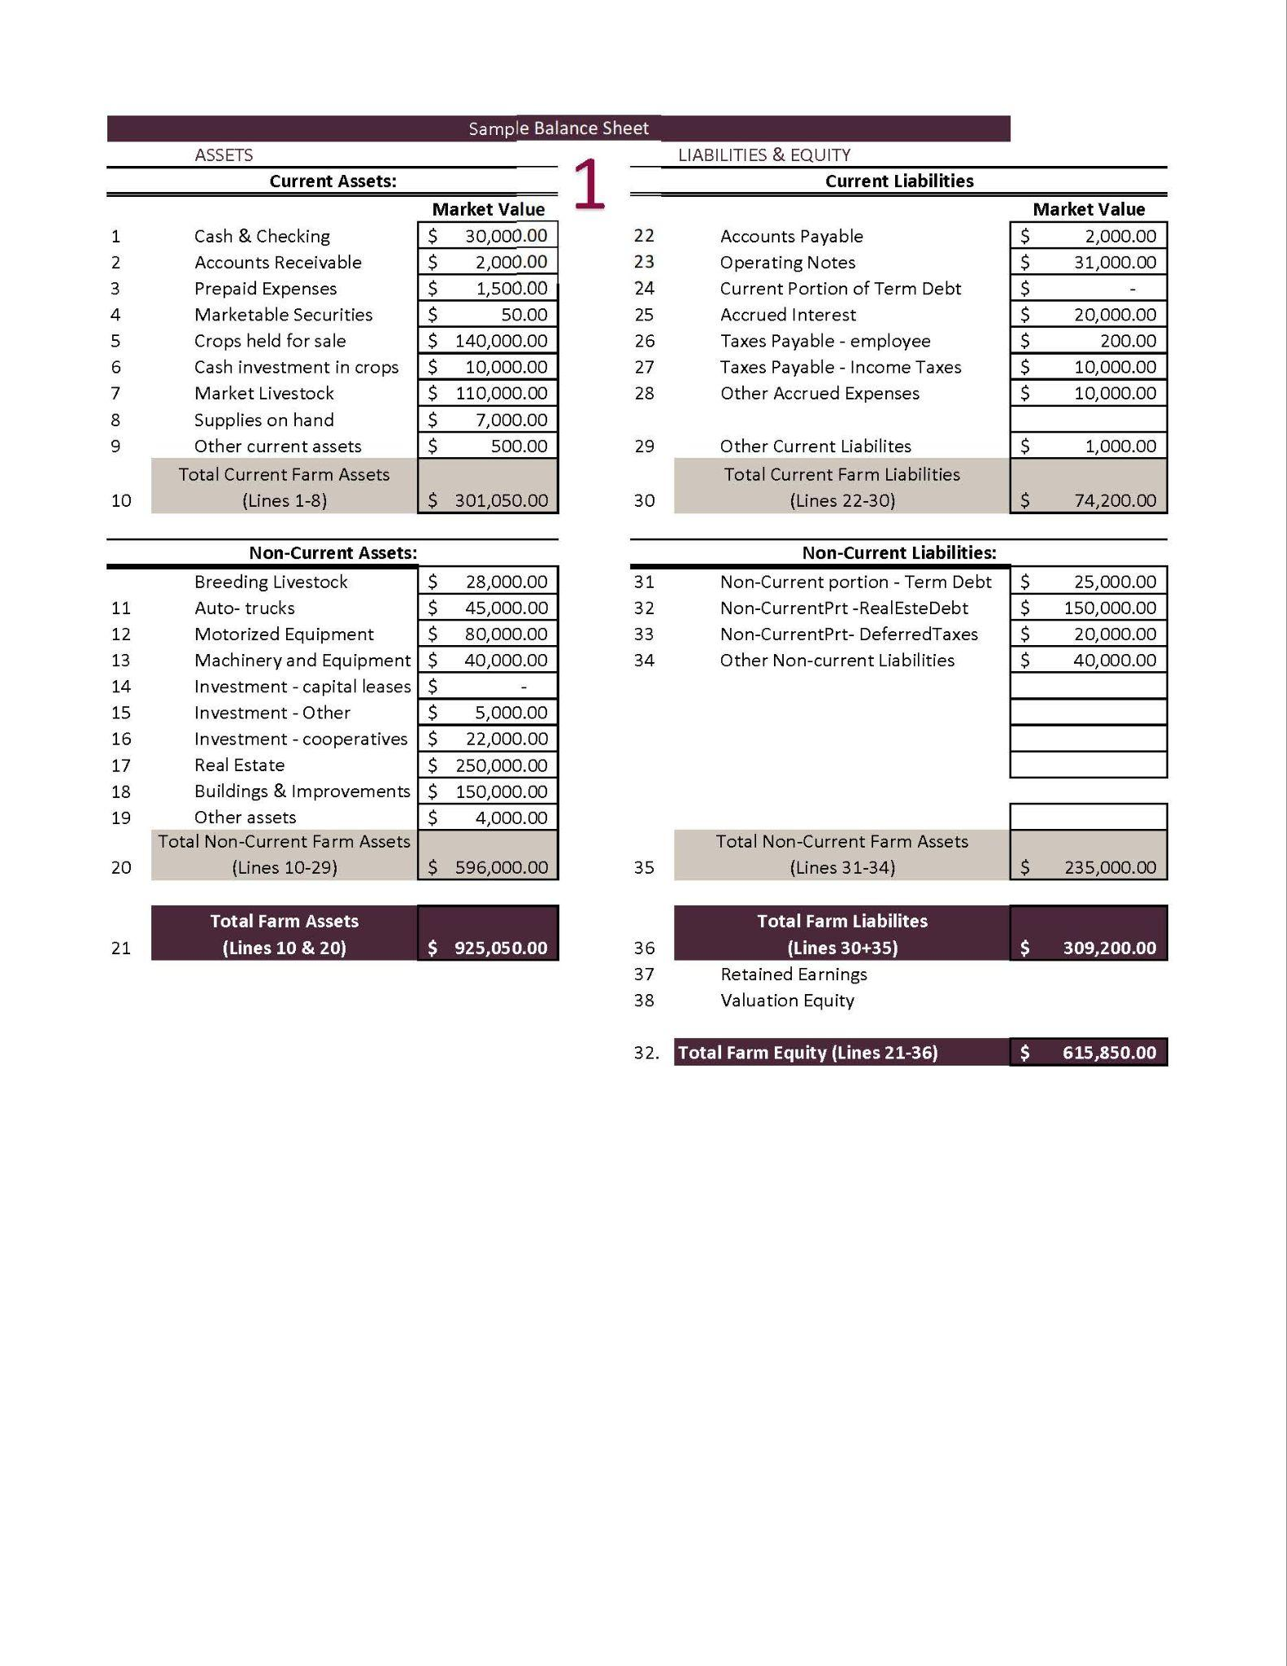

Slide 55
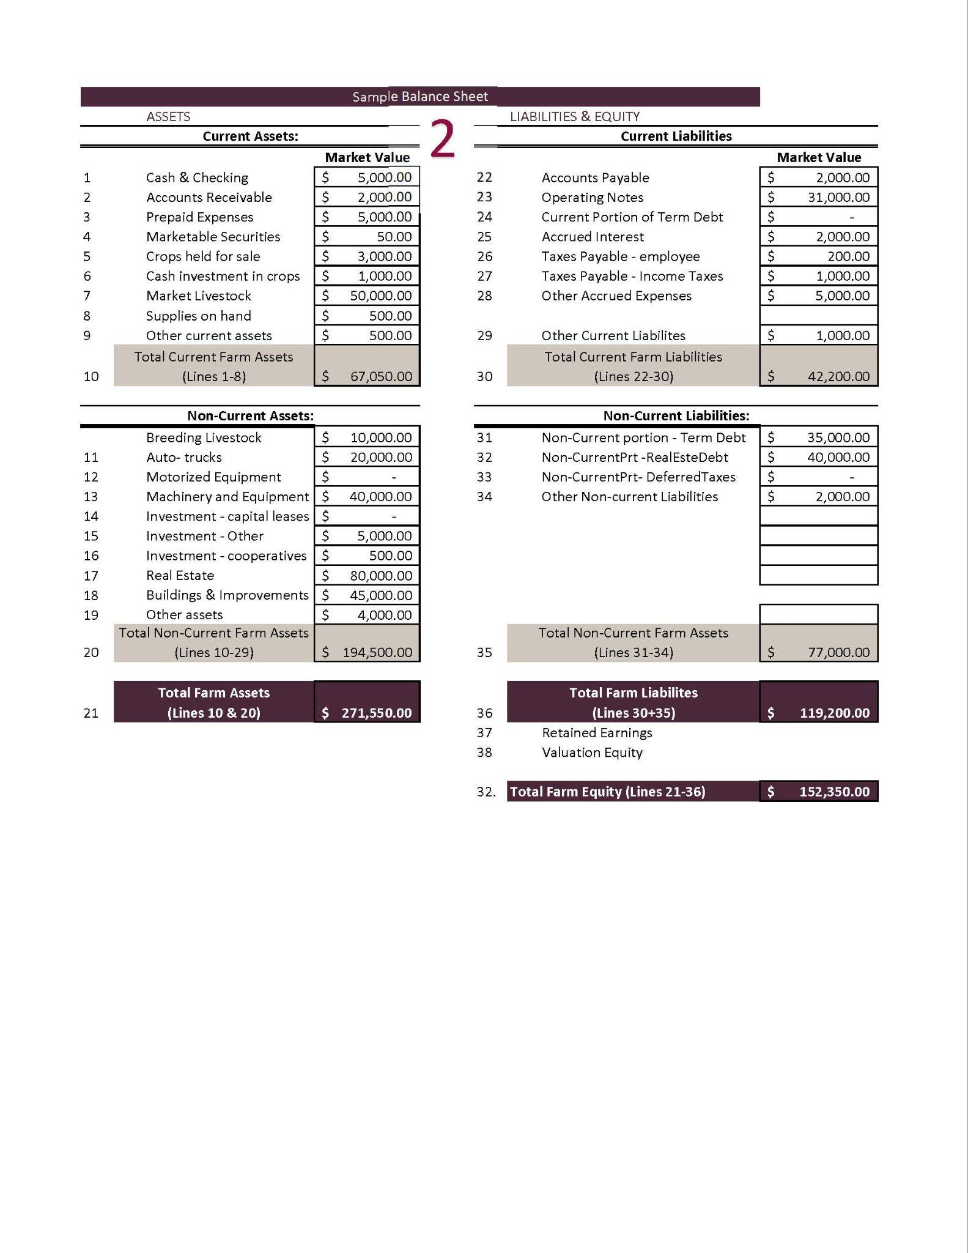

Slide 56
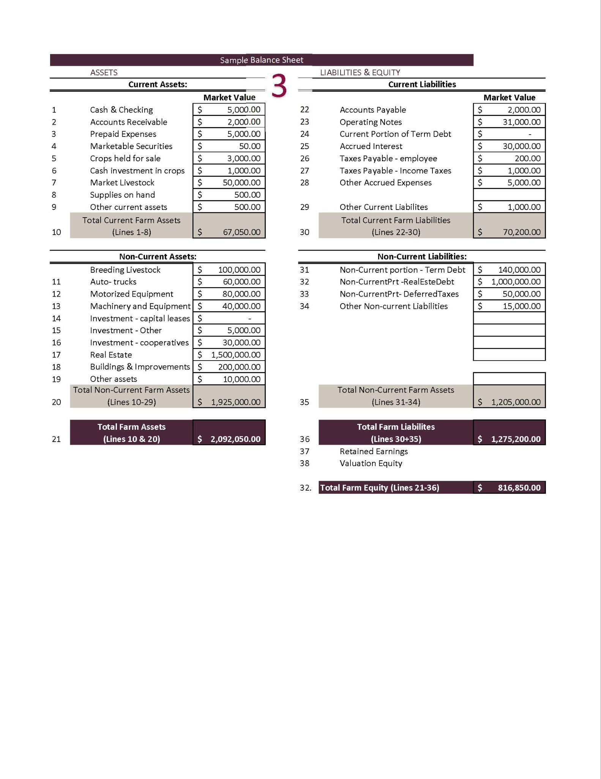

Slide 57
Financial Statement #2
Income Statements
aka
Profit and Loss Statements (P&L)

Slide 58
Profitability over a period of time.
Fiscal or Calendar Year or Production Cycle
Revenue
What you earned from selling crops, livestock, etc.
Expenses
What you spent on feed, seeds, labor, equipment, etc.
Income Statement aka Profit and Loss Statement (P&L)

Slide 59

Determine if income covers expenses
Essential for loan applications and tax planning
Guides management decisions
Used for setting goals and improving profitability
Why use a P&L?

Slide 60

Sales records
invoices, receipts
Expense records
seeds, feed, labor, equipment
Inventory changes
livestock, stored crops
Depreciation values
Loan Payments, Interest, and Taxes
Creating an P&L

Slide 61
Accrual Accounting
Large or complex farms should use this for better financial analysis and decision-making because it provides a more complete picture of income and expenses by recognizing them when earned or incurred, not just when cash is received or paid out.
Cash Accounting
Most small farms with simple operations can use cash accounting due to its simplicity and ability to manage cash flow better in volatile market conditions.
Cash or Accrual?

Slide 62
Many farmers are on a cash accounting system for taxes.
Their Schedule F shows the amount of cash sales less cash purchases and depreciation.
Schedule F

Slide 63
Profitability over a period of time.
Fiscal or Calendar Year or Production Cycle
Revenue
What you earned from selling crops, livestock, etc.
Expenses
What you spent on feed, seeds, labor, equipment, etc.
Ranch Income Statement
2025 Sales and Expenses
Category | Revenue | Category | Expenses
Cattle Sales | $190,000 | Feed & Veterinary | $(50,000)
Hunting Permits | $10,000 | Land Lease & Maintenance | $(40,000)
 |  | Labor & Other Expenses | $(40,000)
 |  | Depreciation | $(5,000)
 |  | Payments, Interest & Taxes | $(15,000)
 |  | Net Income | $50,000

Slide 64
Profitability over a period of time.
Fiscal or Calendar Year or Production Cycle
Revenue
What you earned from selling crops, livestock, etc.
Expenses
What you spent on feed, seeds, labor, equipment, etc.
Farm Income Statement
2025 Sales and Expenses
Category | Revenue | Category | Expenses
Corn Sales | $60,000 | Seed, Fertilizer, Pesticides | $(40,000)
Alfalfa Sales | $90,000 | Equipment Costs | $(10,000)
 |  | Labor & Other Expenses | $(20,000)
 |  | Depreciation | $(5,000)
 |  | Payments, Interest & Taxes | $(25,000)
 |  | Net Income | $50,000

Slide 65
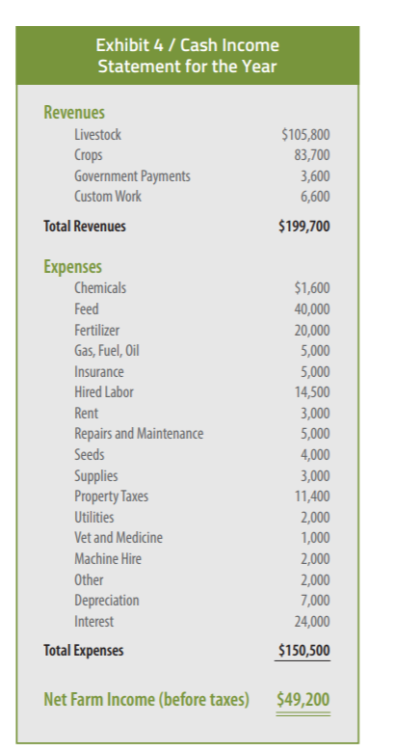
https://agwestfc.com/education-and-resources

Slide 66
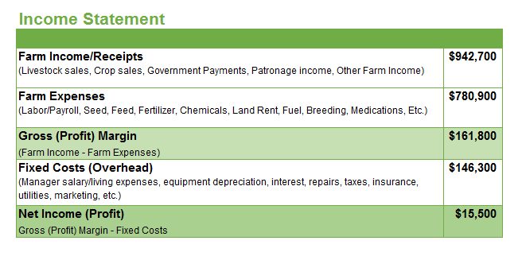
https://www.agsouthfc.com/news/blog/understanding-farm-financials-part-1
Gross Margin (Profit Margin) – The profit or loss of that year’s production.
Doesn’t account for fixed costs. An operation should have enough Gross Profit Margin to cover the operation’s fixed costs.
Net Income (Profit) – True picture of profit/loss of the farm operation.
Is the operating income sufficient to cover costs of both production and overhead.
$942,700 - $780,900
= $161,800
$161,800 - $146,300
= $15,500

Slide 67
Accrual adjusted income statement combines the cash basis accounting records with inventories from a balance sheet.
Increases or Decreases of the values of inventories from the beginning to the end of a year are shown on the income statement.
Accrual Adjustments

Slide 68
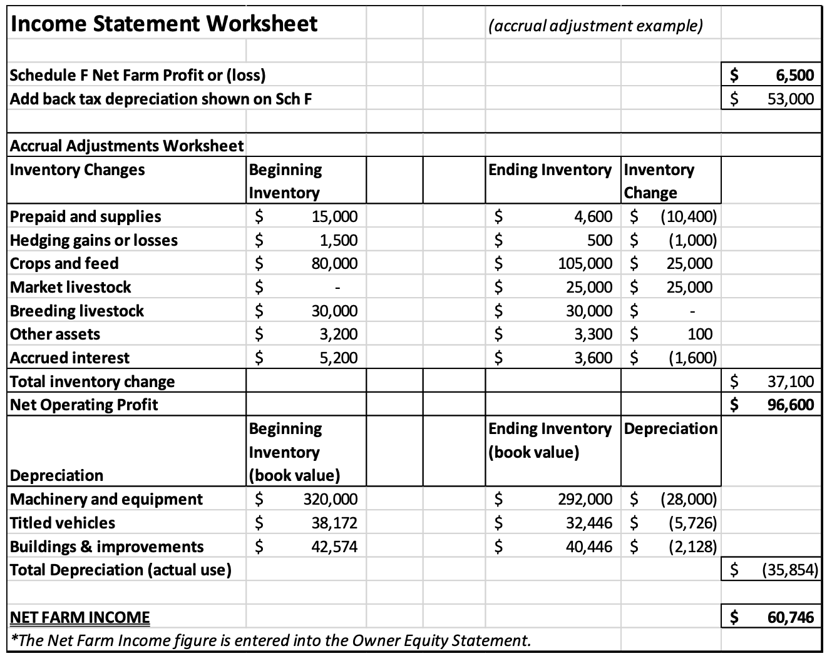
In this same example, all the weaned calves were sold before the first of the year
Livestock inventory on the beginning balance sheet is zero.
During the year the calves raised are all still in inventory at a $25,000 value at yearend.
By figuring these accrual adjustments, net farm income, otherwise known as “true” or real profitability is calculated for a given period.
https://cap.unl.edu/news/net-farm-income-impacts-net-worth-growth/

Slide 69
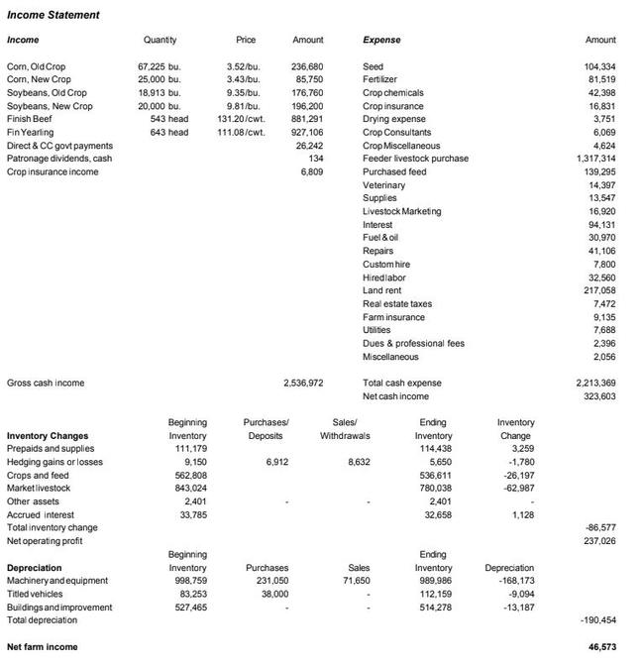
This accrual adjusted income statement from FINPACK shows a more complete picture of a farm’s annual finances than a simple cash based income statement.

Slide 70

Tracking P&L Changes Over Time
Year | Revenue | Expenses | Net Income ($)
2020 | 60,000 | (125,000) | (65,000)
2021 | 90,000 | (100,000) | (10,000)
2022 | 120,000 | (100,000) | 20,000
2023 | 135,000 | (105,000) | 30,000
2024 | 150,000 | (100,000) | 50,000

Slide 71
Income Statement for Decision Making

Slide 72
Increase Revenue
Find better markets, improve yields, diversify income, sell assets
Reduce Costs
Buy inputs in bulk, improve efficiency, reduce waste
Monitor
Review finances regularly, adjust operations
Income Statement for Decision Making

Slide 73
Not tracking small expenses
→ Keep detailed records
Forgetting depreciation
→ Calculate equipment value over time
Accrual Errors
→ Keep detailed records
Mixing personal & farm finances
→ Separate accounts
Common Mistakes & How to Fix Them

Slide 74

Farm accounting software
(QuickBooks, Excel, Ambrook, FINPACK, other Ag-specific apps)
Online income statement templates
NMSU Extension and farm financial advisors
Income Statement Help

Slide 75
Financial Statement #3
Cash Flow Statements

Slide 76

A financial tool that tracks the movement of cash in and out of an operation (usually on a monthly basis).
Cash Inflows
crop/livestock sales, gov’t payments, loans, grants
Cash Outflows
feed, fuel, labor, loan payments
Actual cash transactions, not accrual.
What is a Cash Flow Statement?

Slide 77

Beginning Cash Balance
Cash Inflows
Sales (livestock, crops, hay)
Government payments (ARC/PLC, EQIP)
Loans or advances
3. Cash Outflows
Operating expenses (seed, fuel, vet care)
Capital purchases
Debt payments
Labor costs
4. Ending Cash Balance
Components of a Cash Flow Statement

Slide 78
Simple Monthly Cash Flow Statement
January 1st: You start with $4,500 in your farm account
2025 Month by Month Revenues and Expenses
 | Jan | Feb | Mar | Apr | May | Jun | Jul | Aug | Sep | Oct | Nov | Dec
Inflows | 0 | 0 | $800 | $600 | 0 | 0 | 0 | 0 | 0 | $6,900 | $3,400 | 0
Outflows | $1,200 | $100 | $800 | $400 | $500 | $800 | $900 | $800 | $1,400 | $1,600 | $600 | $400
Net Flow | $-1,200 | $-100 | 0 | $200 | $-500 | $-800 | $-900 | $-800 | $-1,400 | $5,300 | $2,800 | $-400
Balance | $2,300 | $1,300 | $1,300 | $1,500 | $1,000 | $200 | $-700 | $-1,500 | $-2,900 | $2,400 | $5,200 | $4,800
How can you make it through this year with a negative account balance?

Slide 79
Monitor cash flow to ensure working capital is available throughout the production cycle.
Manage timing mismatches between income (fall harvest) and expenses (spring planting).
Optimize spending during low-revenue periods.
Time marketing decisions to maximize cash inflows.
Variability in Production and Markets may require additional funding.
Plan for obtaining lines of credit or reducing expenses.
Cash Flow Management for Seasonal Agriculture

Slide 80
Support decision-making on capital investments, equipment repairs, or input purchases.
Create a “Spending Plan” from past cash flow statements with predicted adjustments
Good Cash Flow Statements Support:
Loan applications and renewals
Lenders use this info to ensure sufficient liquidity to repay loans.
Cash Flows for Planning

Slide 81
Crucial for analyzing the cash flow associated with specific enterprises within your whole operation.
Stress testing under different price volatility “what if” scenarios.
Used to assess the feasibility of expansion and potential revenue streams.
If major events have happened (lost leases, changed major enterprises, etc.) then construct a new plan.
Cash Flows for Analysis and Projections

Slide 82
CASH FLOW
helps a business
GO!

Slide 83
Assess Financial Health
A snapshot of assets, liabilities, and equity, helps you understand your financial position to make informed decisions.
Improve Loan Access & Creditworthiness
Lenders evaluate a farm’s financial stability for loans or lines of credit necessary for expansion or operational improvements.
Track Progress Toward Goals
Monitor changes in net worth over time, track financial growth, debt reduction, or investment in new equipment and land.
Enhance Decision-Making & Risk Management
Identify strengths and weaknesses, adjust strategies, optimize resources, and mitigate market fluctuations risks or unexpected expenses.
Your Goals

Slide 84
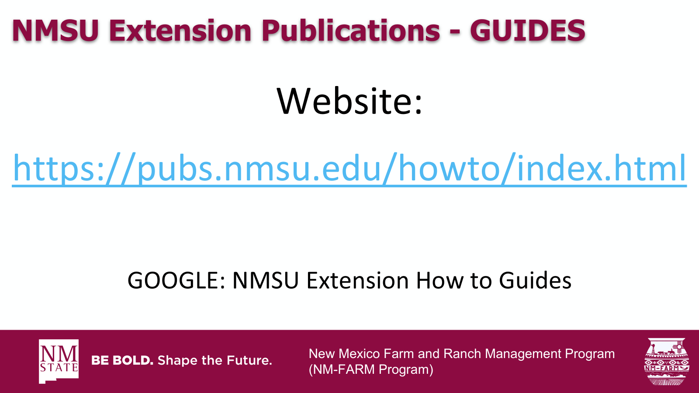

New Mexico Farm and Ranch Management Program (NM-FARM Program)

Slide 85
NM-FARM
Goals:
Develop a financial benchmarking program for NM farms and ranches
Increased financial sustainability for NM farmers and ranchers
Website: www.nmfarm.nmsu.edu
New Mexico Farm and Ranch Management Program (NM-FARM Program)

Slide 86

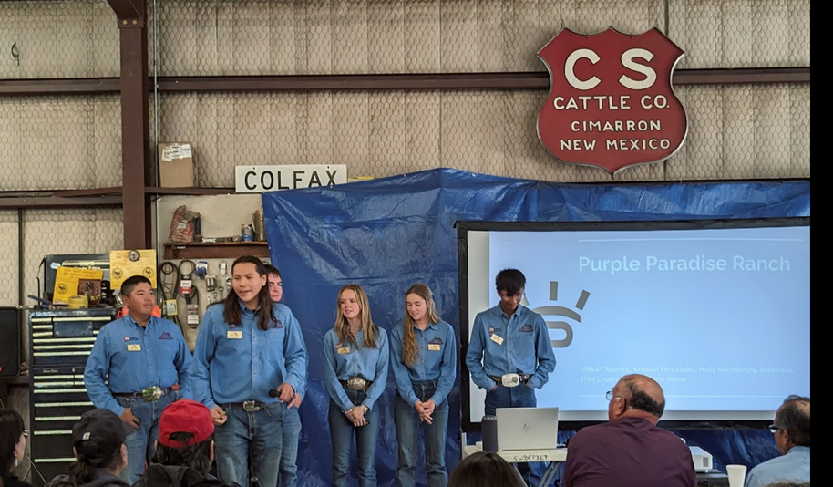
New Mexico Youth Ranch Management Camp
@ CS Ranch | Cimarron, NM
June 21-26, 2026
nmyrm.nmsu.edu
Helps youth appreciate the 'why' behind ranching.

Slide 87
Questions?
Jason Banegas
Zumbabwe@nmsu.edu

