Slide 1


Tribal Ranching Seminar Series
Land ,Governance, and Cultural Frameworks
Jason Banegas
Extension Economist
Cooperative Extension Service

Slide 2
The GOAL For This Learning Series
Gain Knowledge and Build Tools so you can keep doing what you love and pass it on.

Slide 3
Minimize Risk
and
Maximize Opportunity

Slide 4
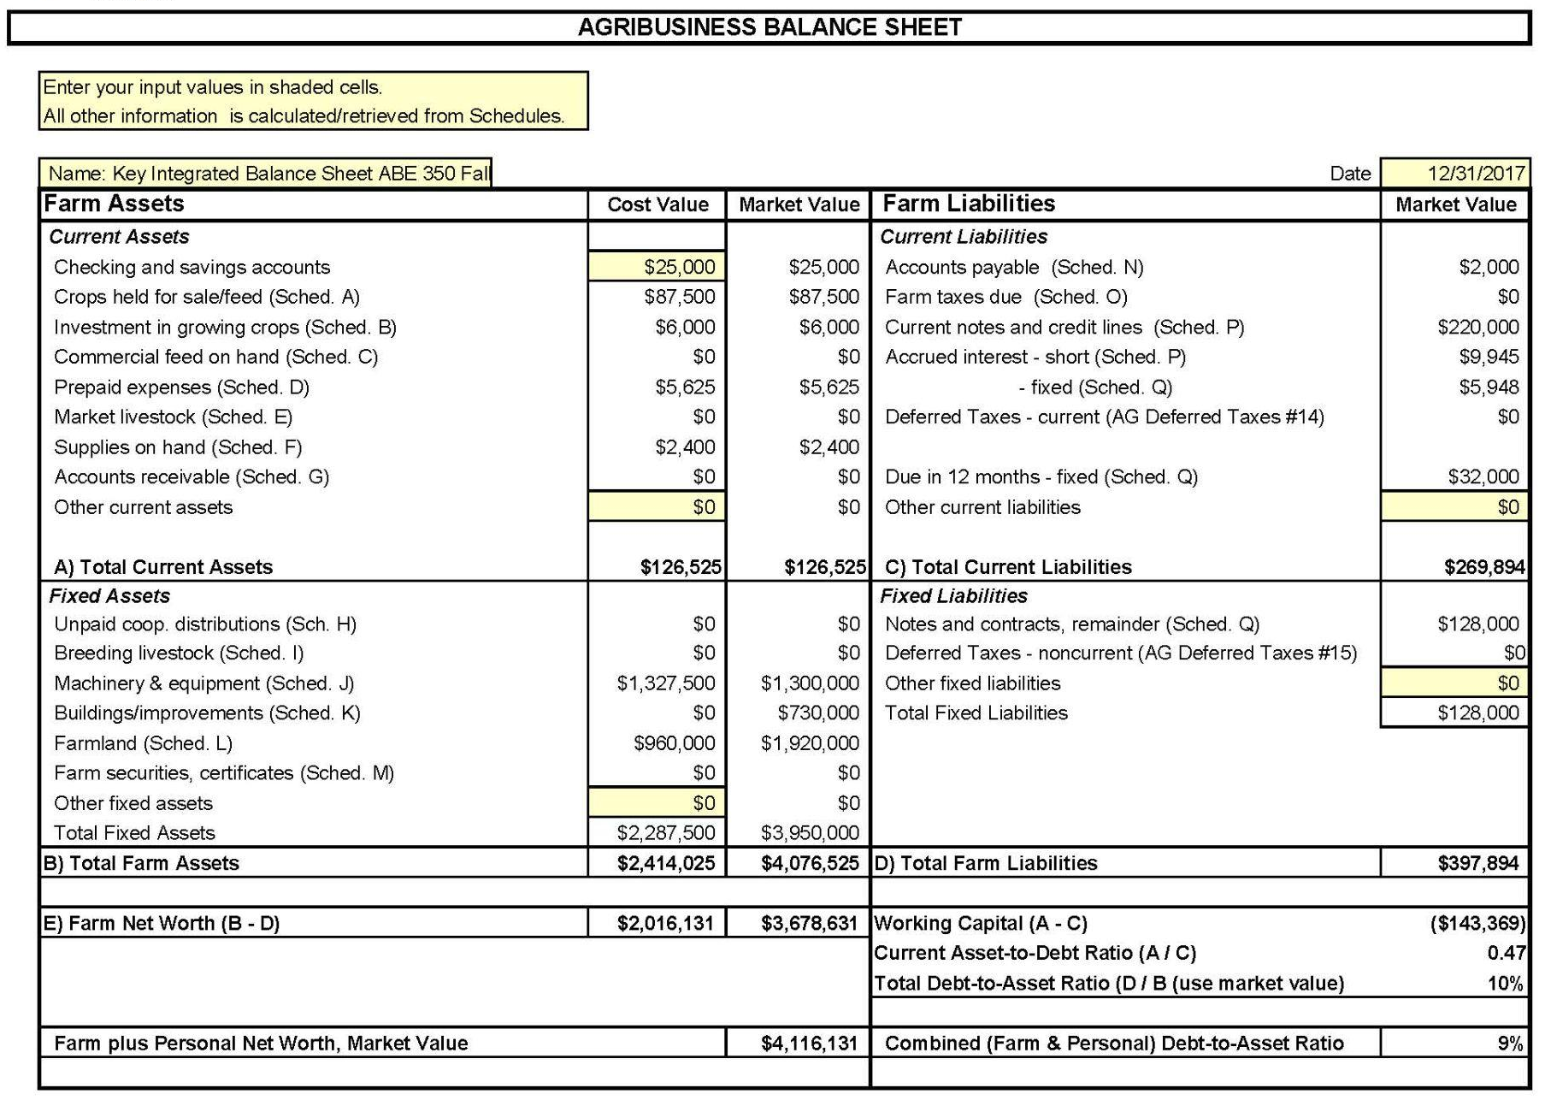
Balance Sheet
Everything Owned and Owed
A balance sheet shows your NET WORTH / OWNER EQUITY at a specific point in time
NET WORTH = Assets - Liabilities

Slide 5
Profitability over a period of time.
  Fiscal or Calendar Year or Production Cycle
Revenue
  What you earned from selling crops, livestock, etc.
Expenses
  What you spent on feed, seeds, labor, equipment, etc.
Ranch Income Statement aka P&L
2025 Sales and Expenses
Category | Revenue | Category | Expenses
Cattle Sales | $190,000 | Feed & Veterinary | $(50,000)
Hunting Permits | $10,000 | Land Lease & Maintenance | $(40,000)
 |  | Labor & Other Expenses | $(40,000)
 |  | Depreciation | $(5,000)
 |  | Payments, Interest & Taxes | $(15,000)
 |  | Net Income | $50,000

Slide 6
Simple Monthly Cash Flow Statement
January 1st: You start with $45,000 in your account
 | Jan | Feb | Mar | Apr | May | Jun | Jul | Aug | Sep | Oct | Nov | Dec
Inflows | 0 | 0 | 8,000 | 6,000 | 0 | 0 | 0 | 0 | 0 | 69,000 | 34,000 | 0
Outflows | 12,000 | 10,000 | 8,000 | 4,000 | 5,000 | 8,000 | 9,000 | 8,000 | 14,000 | 16,000 | 6,000 | 4,000
Net Flow | -12,000 | -10,000 | 0 | 2,000 | -5,000 | -8,000 | -9,000 | -8,000 | -14,000 | 53,000 | 28,000 | -4,000
Balance | 23,000 | 13,000 | 13,000 | 15,000 | 10,000 | 2,000 | -7,000 | -15,000 | -29,000 | 24,000 | 52,000 | 48,000
How can you make it through this year with a negative account balance?

Slide 7
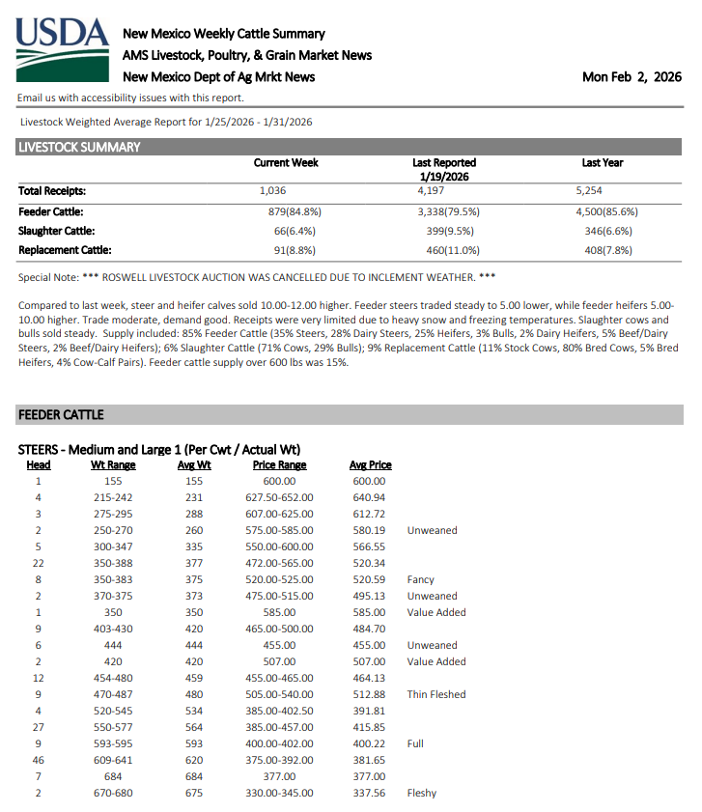
Cost of Production in a Cow-Calf Operation
Profit per Calf
  If weaned at 550 lbs and sold at $3.40/lb.
    Revenue = $1,870
  Unit cost is $2.23/lb x 550 lbs
    Cost = $1,226.50
→ Profit = $643.50 per calf
Expense Type | Amount($)
Feed | $18,000
Vet | $2,500
Fuel & Equipment | $5,000
Labor | $8,500
Land / opportunity cost | $4,000
Cow Depreciation | $11,000
Total | $49,000

Slide 8
Review from the 3rd WEBINAR
  Home Food Production vs. Business Mindset
  Do you know your Cost of Production?
  Co-ops, Value Added, Marketing

Slide 9
Review from the 4th WEBINAR
  Regenerative land practices as an economic management tool
  Drought management and cash flow strategies
  Herd genetics and transition process
https://aeab.nmsu.edu/extension/extension-economics.html

Slide 10
Assess Financial Health
Improve Loan Access & Creditworthiness
Track Progress Toward Goals
Enhance Decision-Making & Risk Management
Be in a position to use market outlooks, do feasibility analysis, grow your resources, strengthen your business.
The Goal is to Help You:

Slide 11
Topic Questions
Have you tried to start a project, like a well or corral, and hit roadblocks with agencies or chapters?
How did you handle it?

Slide 12
Purpose of Today’s Session
Topics covered:
  Characteristics of Tribal Ranching
  Governance and Grazing Rights
  Challenges and Risks
  Opportunities

Slide 13
Unique Characteristics of Tribal Ranching
Federal and State lease systems emphasize National/State standards and science-based rangeland health.
Tribal systems emphasize sovereign governance and community access.

Slide 14
Unique Characteristics of Tribal Ranching
Challenges
Tribal grazing can respect sovereignty but also administratively complex.
  Requires navigating both tribal law and BIA processes.
Tribal governance and range management systems
  Navajo Nation grazing permits vs. Ranch Units
  Livestock Associations, Communal grazing, etc.

Slide 15
Unique Characteristics of Tribal Ranching
Opportunities
Close alignment with tribal resource policy.
Ability to integrate traditional land stewardship.
Access based on membership, not economic position.
Associations can provide equipment, training, support for federal and state grants.

Slide 16
Topic Question
How many head of livestock do you run?
What’s your mix of species (cattle, sheep, goats)?
What is your grazing land like?
What systems do you work within, can you change it?
What can you do with your unique circumstances to reduce risk and maximize opportunity for your livestock operation?

Slide 17
Why Governance Matters
Decisions about fencing, grazing, water projects, or infrastructure often require multi-agency approval.
Your local knowledge can help avoid delays and conflict.
Governance is usually slow but can also ensure long-term stability.

Slide 18
Governance and Grazing Rights
Who governs your grazing permit or land use?
Chapter House
BIA or Tribal Natural Resource Office
Community Grazing Committee / Livestock Association
Other

Slide 19
Tribal Agriculture Development
Governance Matters
Producers are key stakeholders in tribal agriculture.
Government should support cultural, economic and land stewardship.
Clear decision-making processes within families, grazing committees, or co-ops are critical for long-term success.
Get involved and be vocal about your rights.

Slide 20
Governance and Grazing Rights
Who governs your grazing permit or land use?
Chapter House
BIA or Tribal Natural Resource Office
Community Grazing Committee / Livestock Association
Other

Slide 21
Grazing Risks and Challenges
Limited Resources and Unlimited Wants
Prime grazing land
Water access
Accessibility
Other

Slide 22
The Cost of Token / Holding Grazing
Where permits are tied to tribal membership and are difficult to reacquire if relinquished producers may keep small herds with low-productivity animals.
If these producers don’t have long-term improvement strategies, the livestock is a proxy for access, rather than a profit-generating enterprise.

Slide 23
The Cost of Token / Holding Grazing
Why it seems to make sense
Livestock represent food security.
Lack of collateralizable land and credit constraints can lead to operating capital constraints.
Scaling up feels risky when input costs are volatile and when markets are uncertain.

Slide 24
The Cost of Token / Holding Grazing
The Economic Problem
A permit holder keeps a few cattle or sheep just to retain the permit and loses the cost advantages of Economies of Scale. → Higher unit cost of production.
Prevents others from using the land productively = missed economic opportunities.

Slide 25
The Cost of Token / Holding Grazing
Other Problems
Less selection pressure → lower herd productivity
Small, inefficient herds are more exposed to risks.
Forage inefficiency and challenges to management strategies.
Delayed investments and improvements in equipment, fencing, water development, etc. etc.

Slide 26
The Cost of Token / Holding Grazing
Solutions
Cooperative production: stocking to share land and increase efficiency and shared expenses.
Focus on productivity based herd strategies: Better genetics
Rotational grazing to rest pastures to rebuild forage.
Encourage community participation, policy changes, and young/beginning rancher access to land.

Slide 27
Tax Opportunities for Ranching Operations
Livestock income is usually not fully exempt. Most ranching operations are taxable businesses Deduction strategies Expense management opportunities | Use the correct business structure CPA familiar with tribal taxation Tribal tax offices Tribal Extension agent Legal professionals

Slide 28
Example 1 – Selling Calves
A Navajo producer:
  Grazes cattle on Navajo Nation grazing permit land.
  Sells 18 calves at weaning, 500# @ $4.15cwt
  Receives $37,350 from livestock sales.
Calf sales are typically taxable business income.
  Livestock are treated as inventory/assets.
  Income is not “directly derived” from trust land itself.
  Cattle grazed on Navajo land are not tax free.

Slide 29
Example 2 – Leasing Allotted Trust Land
A tribal member:
  Owns individually allotted trust land
  Leases grazing rights to another producer
  Receives $4,500 in lease payments
May qualify for exemption because:
  Income is directly tied to trust land use.
  Land is a protected federal trust asset.
  Requires professional verification.

Slide 30
Example 3 – Producer Selling Livestock
Laguna Pueblo rancher:
  Raises cattle on Pueblo lands.
  Sells feeder calves.
  Reports ranch income.
Taxable Income
  Livestock sales = business income
  Not exempt solely due to tribal land status.

Slide 31
Example 4 – Fuel Tax Advantage
A producer:
  Purchases dyed diesel for ranch use.
  Uses fuel for water hauling, tractors, generators.
Potential tax advantage (More Common Benefit)
  Reduced fuel taxes.
  Refund credits
  Agricultural fuel exemptions
  Fuel savings often exceed potential income tax exemptions.

Slide 32
Example 5 – Depreciation
Pueblo livestock producer purchases:
  Used stock trailer → $9,000
Deduct depreciation
  Reduces taxable income.
  Creates legitimate tax savings.
  Works regardless of tribal tax exemption status.
  Most producers benefit more from expense deductions, depreciation, and loss offsets than from exemptions.

Slide 33
Example 6 – Small Herd Reporting Losses
Livestock producer:
  12 head cow herd.
  High hay costs during drought.
  Reports operating loss.
Loss may offset other income
  Reduces tax burden.
  Recognizes drought impact.
  Supports long-term business survival.
  Good records required.

Slide 34
Tax Opportunities for Ranching Operations
Maximize Business Deductions Feed Fuel Repairs Veterinary Equipment | Use Depreciation Aggressively Trailers Trucks (business portion) Fencing Water infrastructure | Track Losses Properly Especially important in: Drought years Herd rebuilding years High input cost periods

Slide 35
Producer Awareness
Many producers and tribal members may not fully understand or utilize these exemptions.
Tribal administrations and tax professionals play a key role in educating producers on how to legally benefit.
Are you or your tribal tax advisor familiar with how to apply these exemptions?
Would training on this be helpful?

Slide 36
Producer Awareness
Many producers and tribal members may not fully understand or utilize these exemptions.
Tribal administrations and tax professionals play a key role in educating producers on how to legally benefit.
Are you or your tribal tax advisor familiar with how to apply these exemptions?
Would training on this be helpful?

Slide 37
Financing Is Difficult for Tribal Ranchers
Trust Land Cannot Be Pledged as Collateral.
Grazing Permits Are Not Transferable Property Rights.
Lack of Collateralizable Assets.
Variability in ranching increases perceived risk.
Practical alternatives are needed

Slide 38
Financing Without Land Collateral
USDA Farm Service Agency (FSA) Loans
FSA loans:
  Do not require fee land ownership
  Accept livestock, equipment, and income as security
  Offer flexible underwriting
  Are designed for beginning and underserved producers

Slide 39
Financing Without Land Collateral
USDA Farm Service Agency (FSA) Loans
Operating Loans Livestock purchases Feed and hay Repairs and inputs Annual expenses | Farm Ownership Loans Equipment Improvements Infrastructure | Emergency Loans Drought recovery Disaster assistance

Slide 40
Financing Without Land Collateral
Community Development Financial Institutions (CDFIs)
Native American Bank and Regional tribal lending organizations
CDFI loans:
  Greater flexibility
  Cultural familiarity
  Alternative underwriting models
  Smaller loan tolerance

Slide 41
Financing Without Land Collateral
Livestock-Secured Lending
When land cannot be pledged:
  Livestock can serve as collateral.
  Equipment liens are common.
  Income assignments may be possible.

Slide 42
Financing Without Land Collateral
Cooperative & Association Financing
Participation in producer groups
  Aggregated marketing contracts
  More predictable revenue streams
  Reduced lender risk perception
  Shared infrastructure
Lenders are often more comfortable financing operations tied to structured marketing channels.

Slide 43
Financing Without Land Collateral
Microloans & Smaller Credit Products
Smaller collateral requirements for producers
  Hay purchases
  Small equipment
  Herd rebuilding

Slide 44
Strategies That Improve Financing Success
Good records reduce lender uncertainty.
Cost of Production Awareness.
Clear Use of Funds, Loans tied to specific productivity improvements.
Relationship Building often matters more than many producers expect.

Slide 45
Exploitation by Non-Tribal Organizations
Protecting tribal producers from exploitation
Outside groups may seek leases or partnerships without:
  Fair compensation
  Reinvestment into land, Infrastructure or its community
  Long term tribal benefits

Slide 46
Exploitation by Non-Tribal Organizations
Red Flags
Vague or one-sided contracts.
Promises of future investment with no timelines or benchmarks.
No transparency on profit-sharing or resource use.
Attempts to bypass tribal council or legal review.

Slide 47
Exploitation by Non-Tribal Organizations
Suggested Contract Clauses
Reinvestment Requirements
Audit Rights
Land Use Limits
Termination Clause
Benefit Sharing
Local Hiring Mandate

Slide 48
Competitive Advantages for Tribal Ranchers
Possible lower grazing costs due to communal lands or low-fee permits.
Eligibility for tribal USDA set-asides, conservation grants, and startup capital.

Slide 49
Competitive Advantages for Tribal Ranchers
Unique Strengths
Cultural connection to land, livestock and stewardship practices.
Traditional knowledge of sustainability.
Ability to brand livestock products with cultural identity and values.
Use your unique story to differentiate in the marketplace, build customer loyalty, and support community economic resilience.

Slide 50
Know how to assess your businesses financial health, know your costs, know your market, know your herd, know your community governance, know how to gain access to capital.

Slide 51
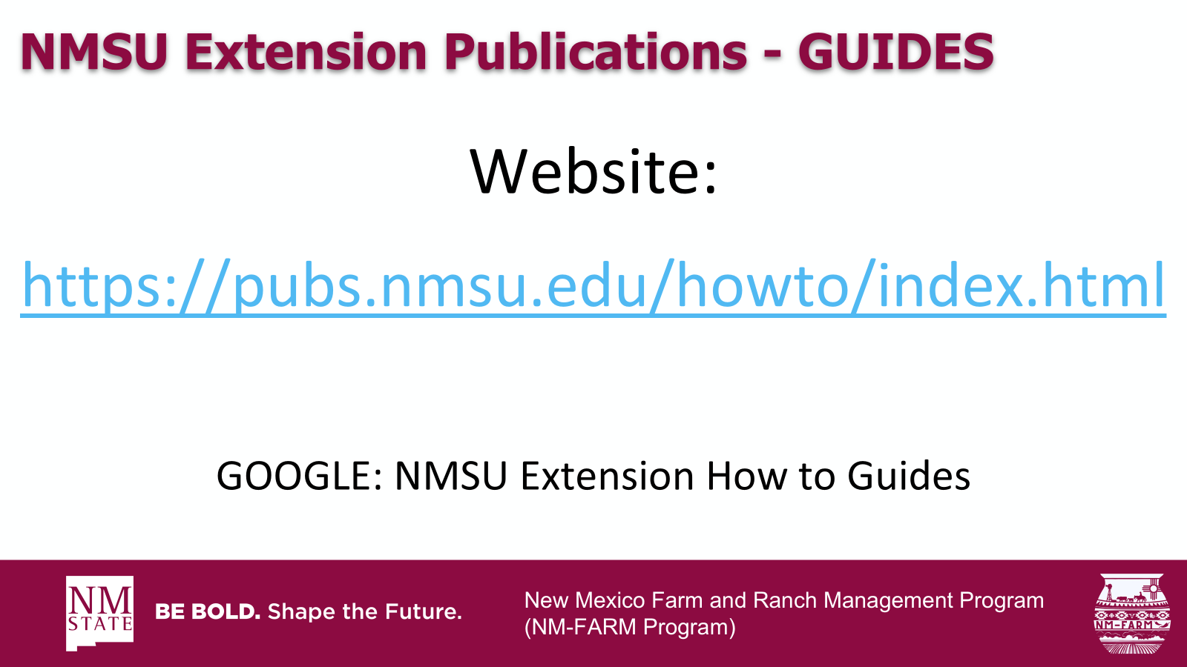

New Mexico Farm and Ranch Management Program
(NM-FARM Program)

Slide 52

NM-FARM
Goals:
  Develop a financial benchmarking program for NM farms and ranches
  Increased financial sustainability for NM farmers and ranchers
  Website: www.nmfarm.nmsu.edu
New Mexico Farm and Ranch Management Program
(NM-FARM Program)

Slide 53
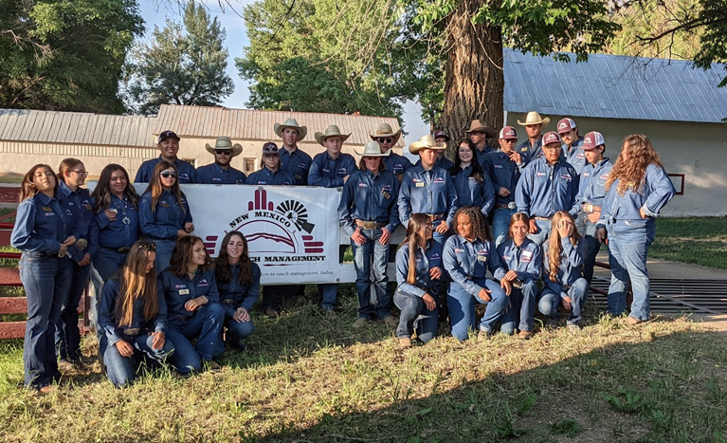
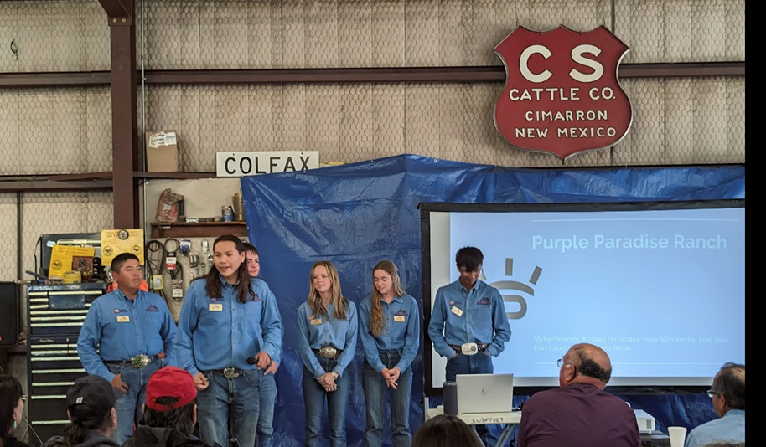
New Mexico Youth Ranch Management Camp
@ CS Ranch | Cimarron, NM
June 21-26, 2026
nmyrm.nmsu.edu
Helps youth appreciate the 'why' behind ranching.

Slide 54
Questions?
Jason Banegas
Zumbabwe@nmsu.edu

