Slide 1


Tribal Ranching Seminar Series
Livestock and Forage Production Systems
Jason Banegas
Extension Economist
Cooperative Extension Service

Slide 2
The GOAL For This Learning Series
Gain Knowledge and Build Tools so you can keep doing what you love and pass it on.

Slide 3
Minimize Risk
and
Maximize Opportunity

Slide 4
Key Lessons from the LAST WEBINAR
  Recordkeeping / Bookkeeping is Essential!
  Build tools to assess your Financial Health
  Track your progress toward your GOALS
  Improve Loan Access & Creditworthiness
  Enhance Decision-Making & Risk Management
https://aeab.nmsu.edu/extension/extension-economics.html

Slide 5
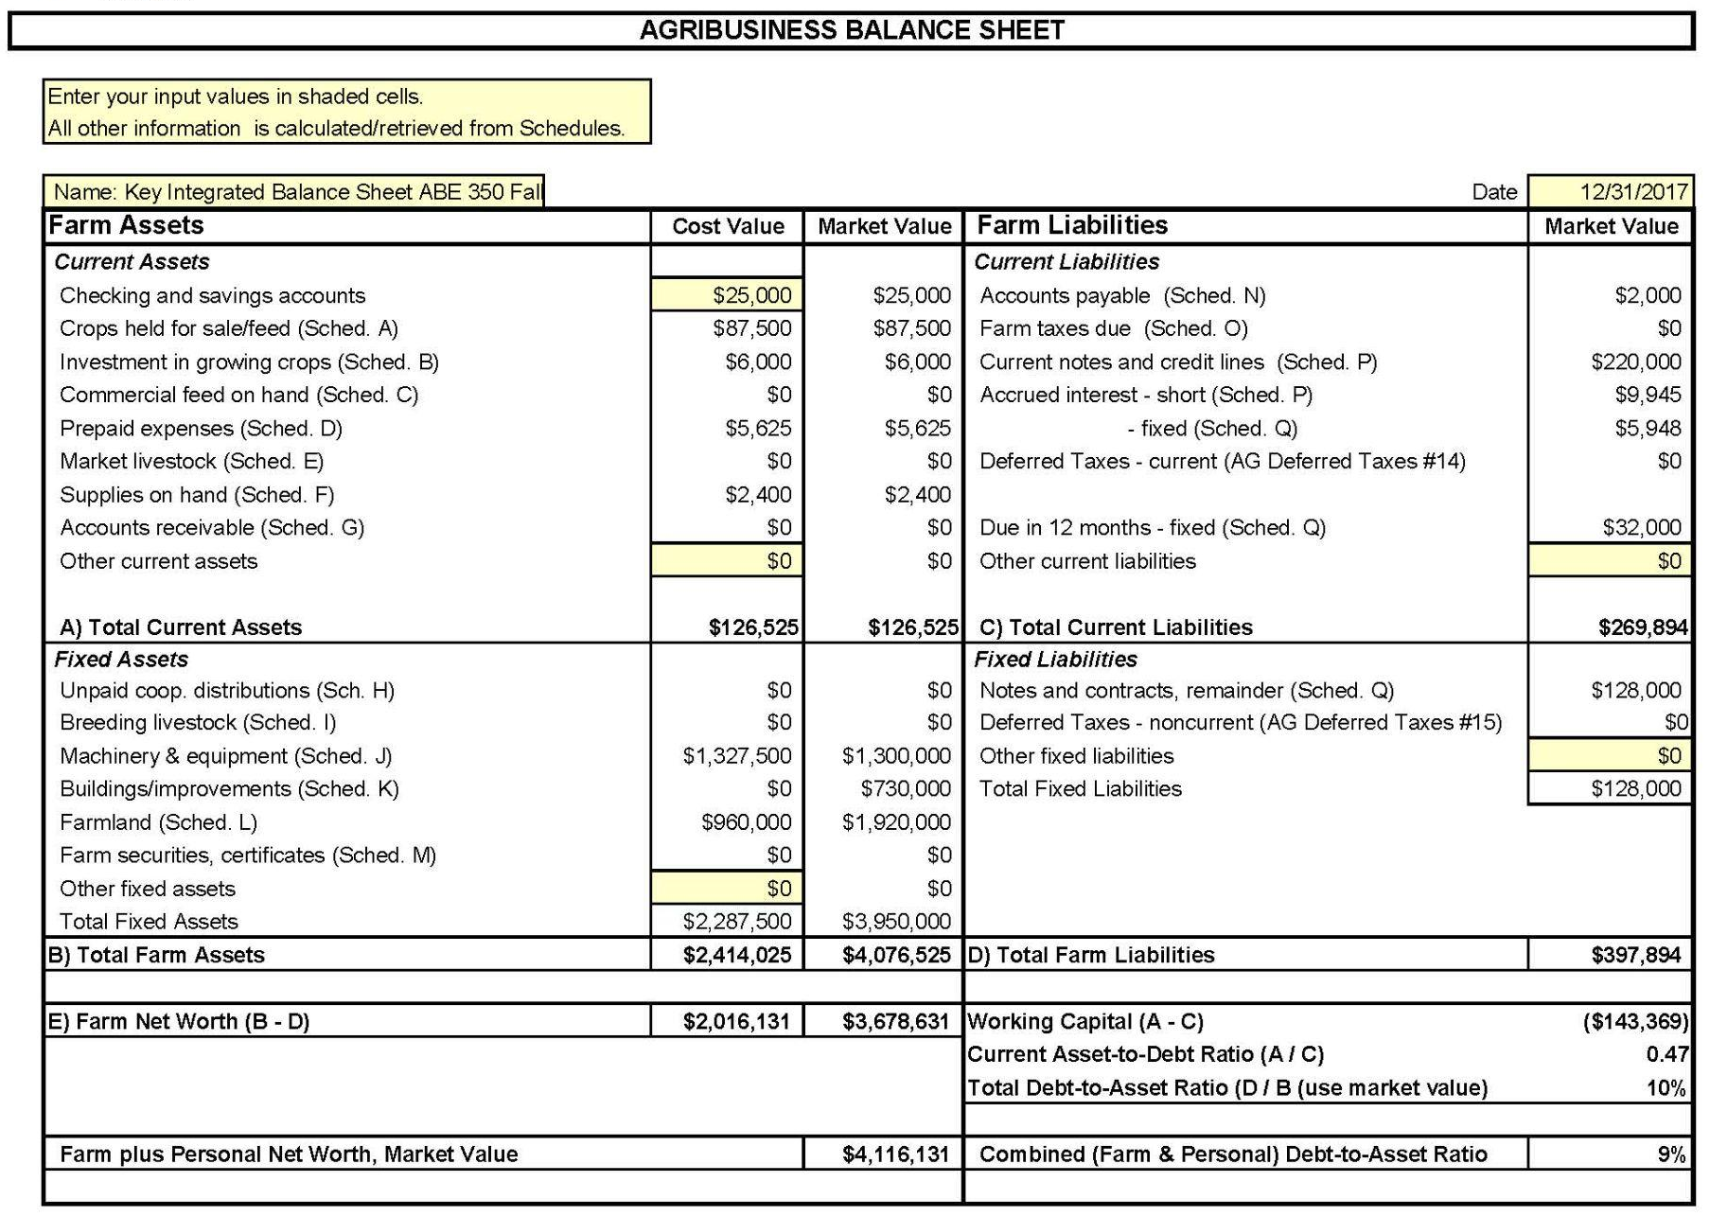
Balance Sheet
Everything Owned and Owed
A balance sheet shows your NET WORTH / OWNER EQUITY at a specific point in time
NET WORTH = Assets - Liabilities

Slide 6
Profitability over a period of time.
  Fiscal or Calendar Year or Production Cycle
Revenue
  What you earned from selling crops, livestock, etc.
Expenses
  What you spent on feed, seeds, labor, equipment, etc.
Farm Income Statement aka P&L
2025 Sales and Expenses
Category | Revenue | Category | Expenses
Corn Sales | $60,000 | Seed, Fertilizer, Pesticides | $(40,000)
Alfalfa Sales | $90,000 | Equipment Costs | $(10,000)
 |  | Labor & Other Expenses | $(20,000)
 |  | Depreciation | $(5,000)
 |  | Payments, Interest & Taxes | $(25,000)
Total Revenue | $200,000 | Total Expenses | $150,000
 |  | Net Income | $50,000

Slide 7
Profitability over a period of time.
  Fiscal or Calendar Year or Production Cycle
Revenue
  What you earned from selling crops, livestock, etc.
Expenses
  What you spent on feed, seeds, labor, equipment, etc.
Ranch Income Statement aka P&L
2025 Sales and Expenses
Category | Revenue | Category | Expenses
Cattle Sales | $190,000 | Feed & Veterinary | $(50,000)
Hunting Permits | $10,000 | Land Lease & Maintenance | $(40,000)
 |  | Labor & Other Expenses | $(40,000)
 |  | Depreciation | $(5,000)
 |  | Payments, Interest & Taxes | $(15,000)
Total Revenue | $200,000 | Total Expenses | $150,000
 |  | Net Income | $50,000

Slide 8
Simple Monthly Cash Flow Statement
January 1st: You start with $4,500 in your farm account
2025 Month by Month Revenues and Expenses
 | Jan | Feb | Mar | Apr | May | Jun | Jul | Aug | Sep | Oct | Nov | Dec
Inflows | 0 | 0 | $800 | $600 | 0 | 0 | 0 | 0 | 0 | $6,900 | $3,400 | 0
Outflows | $1,200 | $100 | $800 | $400 | $500 | $800 | $900 | $800 | $1,400 | $1,600 | $600 | $400
Net Flow | $-1,200 | $-100 | 0 | $200 | $-500 | $-800 | $-900 | $-800 | $-1,400 | $5,300 | $2,800 | $-400
Balance | $2,300 | $1,300 | $1,300 | $1,500 | $1,000 | $200 | $-700 | $-1,500 | $-2,900 | $2,400 | $5,200 | $4,800
How can you make it through this year with a negative account balance?

Slide 9
Check In & Reflection
What’s one thing you tried or thought more about since the last session?

Slide 10
Question / Topics from Previous Webinars
What Questions were asked in the last presentation and what topics did the audience want to expand on?
  Depreciation - For Tax purposes vs. realistic asset valuations
  Standardized Analysis Tools

Slide 11
Purpose of Today’s Session
Build skills to operate more confidently and profitably.
Topics covered:
  A Business Mindset
  Feeding Your Livestock
  Cost of Production
  Data for Decision Making

Slide 12
Home Food Production vs. Business Mindset
Home production emphasizes feeding your family/community. Often costs more than purchasing food retail. Food security and Sovereignty | Entrepreneurial thinking focuses on producing income. Grow your business and assets with profits. Requires planning to do it profitably.
Which one are you doing?

Slide 13
Home Food Production vs. Business Mindset
Home production emphasizes feeding your family/community. Often costs more than purchasing food retail. Food security and Sovereignty | Entrepreneurial thinking focuses on producing income. Grow your business and assets with profits. Requires planning to do it profitably.
Which one are you doing?

Slide 14
Home Food Production vs. Business Mindset
Deciding what you are doing and how you will do it changes everything.
  You can do both.
    BUT, it requires a strategy to divide and record your two operations correctly.
  You need to make a profit from your business to pay for your personal expenses.
    If not, you might be subsidizing a “hobby” with your $ and effort.

Slide 15
Real World Scenario
  Sarah
    Grows corn and raises a few sheep
    Has a job in town and uses that income for her supplies/feed/other expenses.
    Spends 8 hours a week on average taking care of crops and livestock and spends $1,000 a year on supplies/feed/other expenses.
    Shares her food among her family and neighbors.

Slide 16
Real World Scenario
  Does Sarah have a Business?

Slide 17
Real World Scenario
Sarah sees an opportunity: Demand for her corn and sheep products in her local market.
  Realized her crops and sheep have a unique value.
  She learns to calculate costs (Feed, water, labor, packaging…etc.)
  Sets prices to reflect quality of product and her costs.
  She sells wool for $400, one of her lambs for $250, and an older ewe for $175, and in the Fall sells $125 of her corn each week for 4 weeks at the market.
  She records all of her income and expenses and finds she has $325 more than she spent over the year.
  She still has her herd of sheep (replaced an old ewe with a lamb she kept), kept corn seed for next year, and gave her family and neighbors some corn and wool as well.

Slide 18
Real World Scenario
  Does Sarah have a Business?

Slide 19
Real World Scenario
Can Sarah keep doing what she is doing?
  She paid her expenses, she retained her productive assets (corn seed and sheep), and she gave away some of her products.
Can Sarah quit farming and sell her livestock operation?
She has assets that she can sell or give away.
Can Sarah expand her farm and livestock operation?
Reinvest her profits to:
  Create website
  Hire part-time help
  Lease another field or buy some more livestock
  Buy new equipment, etc.

Slide 20
Key Business Concepts
  Calculating costs
    Do you know how much your business is costing you?
  Profit
    Do you have $ after accounting for expenses?
  Reinvestment
    Using profits to buy better tools, improve land and grow herds.
    Invest in your family and community with your food production.

Slide 21
How much do you spend on
Hay / Feed per year?

Slide 22
How much do you spend on
Hay / Feed per year?
If you don’t know,
start tracking it now.

Slide 23
Feeding Your Livestock
Feed costs typically represent 40% to 60% of total annual cow-calf operating expenses
Costs are driven by feed types, storage, environmental conditions.
These can change significantly depending on market conditions.
Reducing storage losses and reducing hay wastage can result in savings.
Controlling feed costs is crucial for profitability.

Slide 24
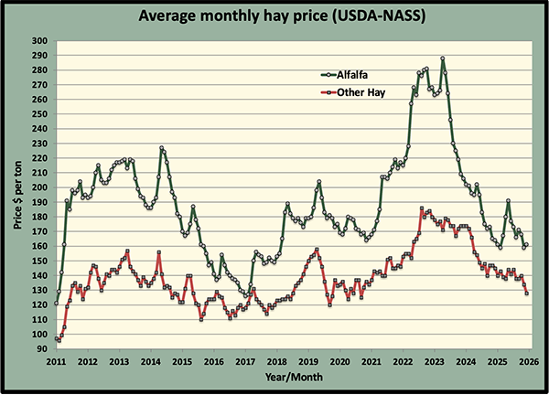
Feeding Your Livestock
https://hayandforage.com/article-5595-Ho-hum-hay-prices.html

Slide 25
Feed and Input Costs
  A 1,000 lb. Cow eats 25 lb. feed per day through the Winter.
  Assuming Grass Hay is $125/Ton
  $187.50 to feed it over 120 days.
    ~1 1/2 Tons of Hay
  $125 to feed it for 80 days.
    ~1 Ton of Hay

Slide 26
Is that animal going to be worth $187.50 or $125 more in the Spring?
Feed and Input Costs

Slide 27
What about a 600# calf that puts on 2# a day over winter?
Feed and Input Costs

Slide 28
Feed and Input Costs
How do you make a decision?
  Complicated question and answer:
    Animal characteristics (Age, Health, Etc.)
    Your available forage
    Market conditions
    Your available capital or ability to get a loan…

Slide 29
Feed and Input Costs
When feed costs rise above what the animal is worth or will be worth, you’re feeding away profit.

Slide 30
Feed and Input Costs
Why this matters:
  Too much dependence on hay = reliance on outside inputs
  Long-term drought or a harsh winter means feed budgets are often not realistic.

Slide 31
If Something Matters, it Should be Measured
Consistent Recordkeeping helps you:
  Calculate cost per calf.
  Determine profitability per animal.
  Compare across years or against other producers.
  Identify where cost can be cut.
  Identify where revenue can be increased.

Slide 32
Topic Question
Do you know your Cost of Production?
If not, what would you need to start tracking that?

Slide 33
Cost of Production in a Cow-Calf Operation
Unit Cost of Production = Cost to produce one unit
(e.g., lb. of weaned calf)
Formula
Unit Cost = Total Expenses ÷ Total lbs of weaned calf produced

Slide 34
Cost of Production in a Cow-Calf Operation
Why It Matters
  Knowing your per unit cost helps you to:
    Calculate profitability per calf
    Benchmark against previous production years and other producers.
    Identify cost reduction & revenue opportunities
    Make informed changes to your operation and pricing decisions.

Slide 35
Cost of Production in a Cow-Calf Operation
If you know the per pound cost to raise an animal, you know the per pound price you need to sell it for to break even.
If you don’t know the production cost you can’t make good decisions or compare your production to anyone else's.

Slide 36
Cost of Production in a Cow-Calf Operation
Step 1: Categorize your Costs
  Costs fall into two main types:
Fixed (Overhead) Costs (Costs that don’t change as you increase the number of cows) Building & Equipment depreciation Land rent or opportunity cost Labor (hired & owner labor) Taxes, Insurance, & fees | Direct / Variable Costs (costs that increase with each additional cow that’s added to the operation) Feed & supplements Veterinary & health expenses Breeding costs & cow depreciation Tags, vaccines, minerals

Slide 37
Cost of Production in a Cow-Calf Operation
Step 2: Assign Costs to Enterprise
  Many ranches have multiple enterprises (cow-calf, growing grass, breeding bulls, backgrounding etc.), allocate shared fixed costs proportionally.
  Example: allocate insurance by acreage, # animals, or revenue share.

Slide 38
Cost of Production in a Cow-Calf Operation
Cost accounting requires good records
  Challenges with shared costs across enterprises
  Tracking depreciation and opportunity costs
    https://beef.unl.edu/cow-depreciation-for-cow-calf-producers

Slide 39
Cost of Production in a Cow-Calf Operation
Total Annual Cow-Calf Expenses
Expense Type | Amount($)
Feed | $18,000
Vet | $2,500
Fuel & Equipment | $5,000
Labor | $8,500
Land / opportunity cost | $4,000
Cow Depreciation | $11,000
Total | $49,000

Slide 40
Cost of Production in a Cow-Calf Operation
Step 3: Weaned Calf Output
  Measure total pounds of calves weaned for a fiscal year.
    40 calves to be weaned at 550 lbs each
    → Total = 22,000 lbs

Slide 41
Cost of Production in a Cow-Calf Operation
Step 4: Compute Unit Cost
  Total expense = $49,000
  Weaned lbs = 22,000 lbs
Unit cost = $49,000 ÷ 22,000 lbs = $2.23 per lb

Slide 42
Cost of Production in a Cow-Calf Operation
Step 5: Compute Other Costs
Cost per Hundredweight Cost per cwt = $2.23×100 = $223/cwt | Cost per Breeding Female If 45 breeding females with $49,000 total expenses: $49,000 ÷ 45 = $1,089 per breeding female | Profitability Per Animal Selling price vs unit cost. If market price = $3.40/lb Gross margin = $3.40 – $2.23 = $1.17/lb

Slide 43
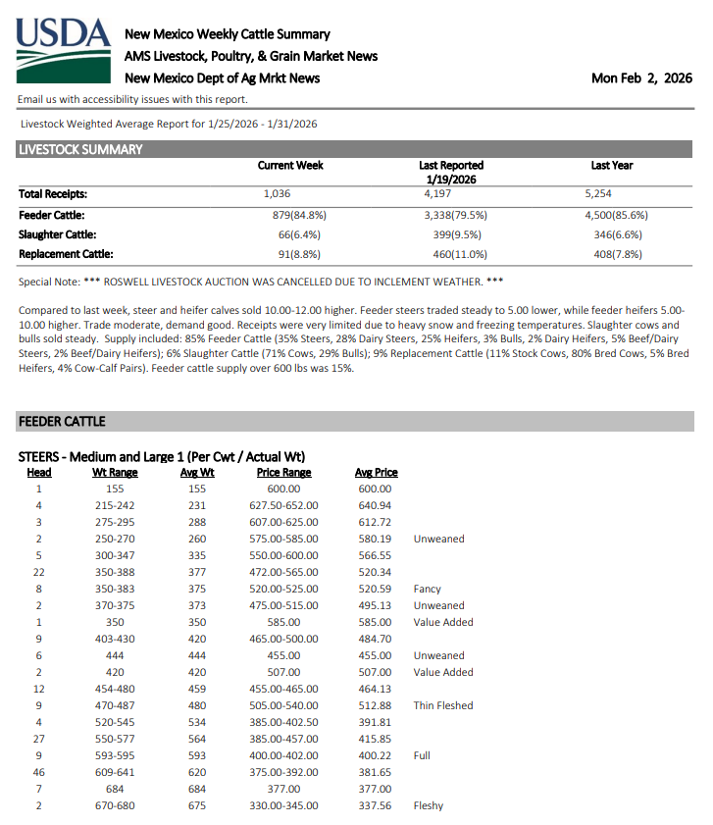
Cost of Production in a Cow-Calf Operation

Slide 44
Cost of Production in a Cow-Calf Operation
Profit per Calf
  If weaned at 550 lbs and sold at $3.40/lb.
    Revenue = $1,870
  Unit cost is $2.23/lb x 550 lbs
    Cost = $1,226.50
→ Profit = $643.50 per calf

Slide 45
Cost of Production in a Cow-Calf Operation
Profit = $643.50 per calf
Total Profit = $643.50 x 40 = $25,740

Slide 46
Break-Even Analysis and Ratios
Other Metrics that can help you evaluate your operation
  Breakeven Price aka Cost of Production
    Formula: Cost per Calf / Expected Sale Weight
    $1,226.50 / 550Ibs = $2.23/Ib needed to break even
  Feed Cost Ratio
    Feed costs / Total costs (under 50% in ideal grazing systems)
    $18,000 / $49,000 = .37 or 37%

Slide 47
Benchmarking Against Yourself Across Time
Track unit costs annually to see trends
  Compare 2020 vs 2021 vs 2022 vs 2023 vs 2024 vs 2025 costs
    Assess the effects of:
      Feed price changes
      Labor changes
      Fuel Costs

Slide 48
Benchmarking Against Other Producers
Compare with industry averages or peers to assess the competitiveness of your operation.
  Compare 2021 vs 2022 vs 2023 vs 2024 vs 2025 costs
  Using benchmarking for decision making.
    Higher cost than peers → assess your inefficiencies
    Lower cost → competitive advantage

Slide 49
Using Data for Decision Making
Link cost outputs to:
Marketing price forecasts
Investment decisions (e.g., new bull purchase)

Slide 50
Identify Where Costs Can Be Cut
Some approaches:
Spend less, maintain production
Spend less, increase production
Maintain costs, increase production
Less production but significantly lower costs
Spend more to increase output enough to offset cost

Slide 51
How Can Costs Be Cut?
Cost Cutting
Adjust calving season to utilize cheaper feed
Replace inefficient equipment
Optimize herd size to match pasture
Cost sharing agreements i.e. Cooperatives

Slide 52
Increase Revenue
Make more money
Diversify marketing channels (private treaty)
Retained ownership into stocker/feeder phase
Value-added sales (quarter beef, grass-finished)
Direct sales can yield higher gross margins.

Slide 53
Production Efficiency Takeaways
Smart management boosts returns
  Know your herd and know your costs.
  Good records: Herd data tracking improves decision-making.
  Financial ratios help track performance
  Weaning weights reflect forage quality and cow nutrition
  Strategic management = better performance + resilience

Slide 54
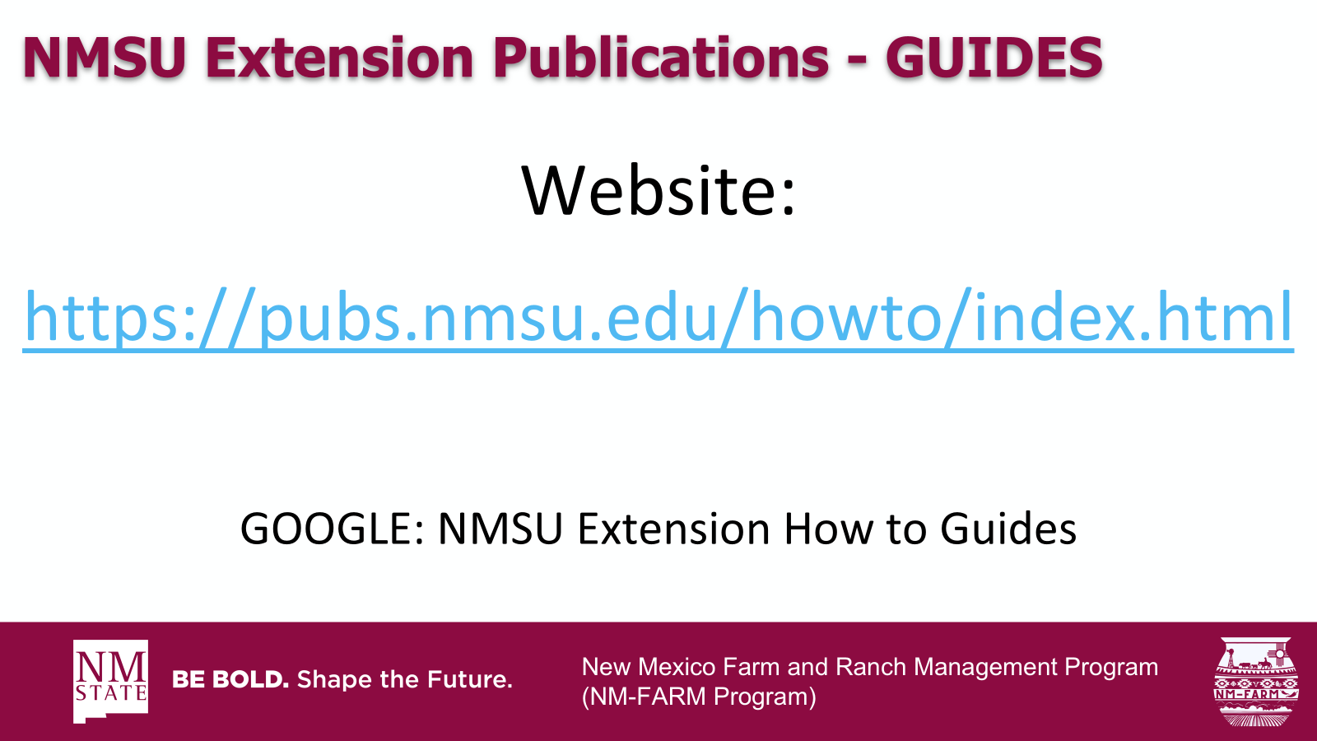

New Mexico Farm and Ranch Management Program
(NM-FARM Program)

Slide 55

NM-FARM
Goals:
  Develop a financial benchmarking program for NM farms and ranches
  Increased financial sustainability for NM farmers and ranchers
  Website: www.nmfarm.nmsu.edu
New Mexico Farm and Ranch Management Program
(NM-FARM Program)

Slide 56
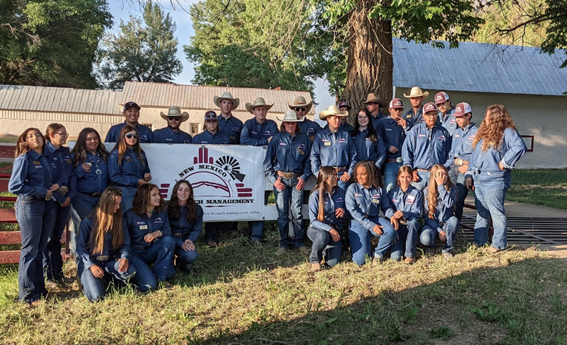
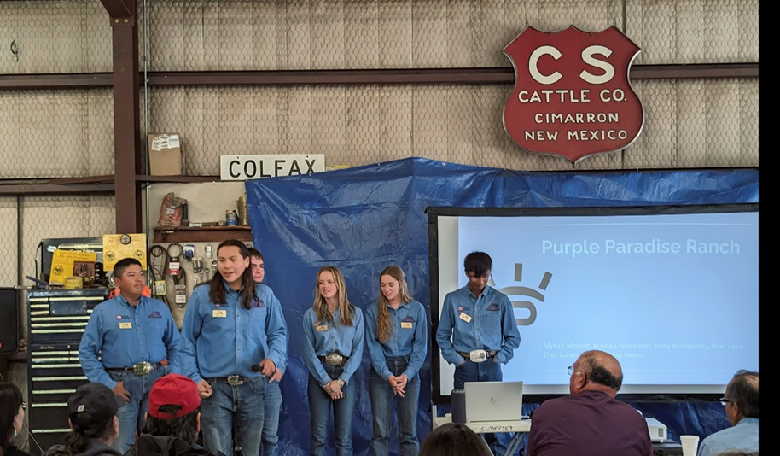
New Mexico Youth Ranch Management Camp
@ CS Ranch | Cimarron, NM
June 21-26, 2026
nmyrm.nmsu.edu
Helps youth appreciate the 'why' behind ranching.

Slide 57
Questions?
Jason Banegas
Zumbabwe@nmsu.edu

