Slide 1


Tribal Ranching Seminar Series
Marketing, Cooperatives, and Value-Added Strategies
Jason Banegas
Extension Economist
Cooperative Extension Service

Slide 2
The GOAL For This Learning Series
Gain Knowledge and Build Tools so you can keep doing what you love and pass it on.

Slide 3
Minimize Risk
and
Maximize Opportunity

Slide 4
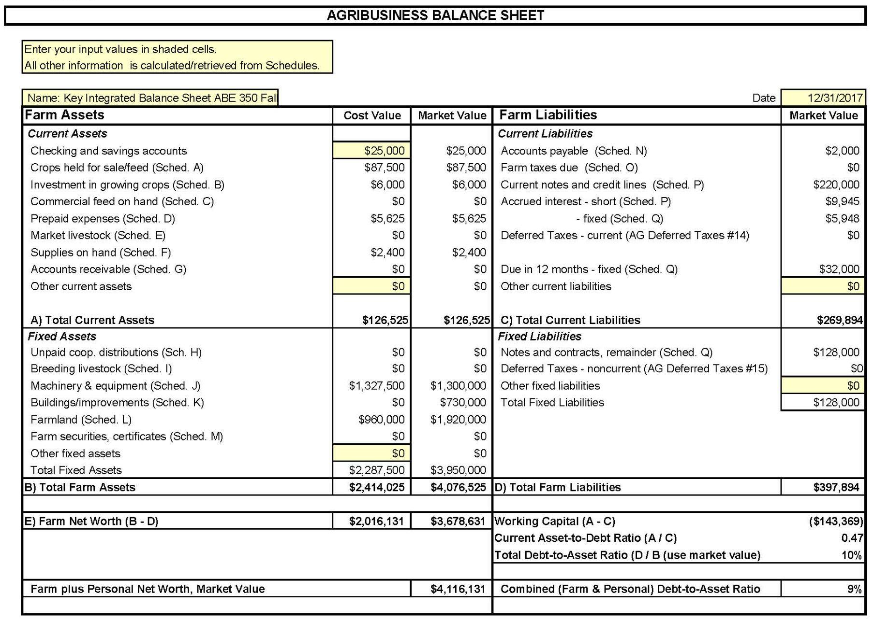
Balance Sheet
Everything Owned and Owed
A balance sheet shows your NET WORTH / OWNER EQUITY at a specific point in time
NET WORTH = Assets - Liabilities

Slide 5
Profitability over a period of time.
  Fiscal or Calendar Year or Production Cycle
Revenue
  What you earned from selling crops, livestock, etc.
Expenses
  What you spent on feed, seeds, labor, equipment, etc.
Ranch Income Statement aka P&L
2025 Sales and Expenses
Category | Revenue | Category | Expenses
Cattle Sales | $190,000 | Feed & Veterinary | $(50,000)
Hunting Permits | $10,000 | Land Lease & Maintenance | $(40,000)
 |  | Labor & Other Expenses | $(40,000)
 |  | Depreciation | $(5,000)
 |  | Payments, Interest & Taxes | $(15,000)
 |  | Net Income | $50,000

Slide 6
Simple Monthly Cash Flow Statement
January 1st: You start with $45,000 in your account
 | Jan | Feb | Mar | Apr | May | Jun | Jul | Aug | Sep | Oct | Nov | Dec
Inflows | 0 | 0 | 8,000 | 6,000 | 0 | 0 | 0 | 0 | 0 | 69,000 | 34,000 | 0
Outflows | 12,000 | 10,000 | 8,000 | 4,000 | 5,000 | 8,000 | 9,000 | 8,000 | 14,000 | 16,000 | 6,000 | 4,000
Net Flow | -12,000 | -10,000 | 0 | 2,000 | -5,000 | -8,000 | -9,000 | -8,000 | -14,000 | 53,000 | 28,000 | -4,000
Balance | 23,000 | 13,000 | 13,000 | 15,000 | 10,000 | 2,000 | -7,000 | -15,000 | -29,000 | 24,000 | 52,000 | 48,000
How can you make it through this year with a negative account balance?

Slide 7
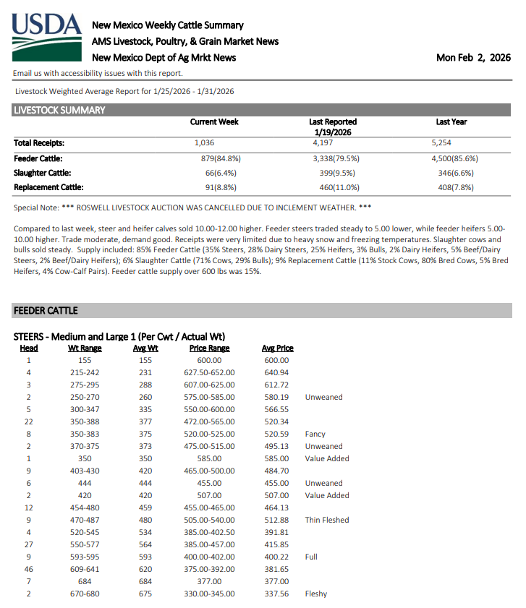
Cost of Production in a Cow-Calf Operation
Profit per Calf
  If weaned at 550 lbs and sold at $3.40/lb.
    Revenue = $1,870
  Unit cost is $2.23/lb x 550 lbs
    Cost = $1,226.50
→ Profit = $643.50 per calf
Expense Type | Amount($)
Feed | $18,000
Vet | $2,500
Fuel & Equipment | $5,000
Labor | $8,500
Land / opportunity cost | $4,000
Cow Depreciation | $11,000
Total | $49,000

Slide 8
Question & Review from the LAST WEBINAR
  Home Food Production vs. Business Mindset
  How much do you spend on Hay / Feed per year?
  Do you know your Cost of Production?
  Cutting Expenses and/or Increasing Revenue.
https://aeab.nmsu.edu/extension/extension-economics.html
Bookkeeping and expense tracking are the foundation of good management.

Slide 9
Purpose of Today’s Session
Topics covered:
  Cooperatives and Cost Sharing
  Marketing Strategy
  Value Added after Production

Slide 10
Topic Question
Do you want to run a livestock business that supports your family with income from your operation?
Do you want to keep livestock for food security/sovereignty for your family and community?
A combination of Both?

Slide 11
Cow-Calf Operation Profitability
Area of NM and Size of Operation | Breakeven
Central, Small (43 head) | $389.83
Central, Medium (170 head) | $144.27
Central, Large (333 head) | $146.77
Southwest, Small (76 head) | $311.99
Southwest, Medium (180 head) | $212.93
Southwest, Large (315 head) | $225.37
Northeast, Medium (190 head) | $215.29
Northeast, Large (333 head) | $202.18
Southeast, Medium (180 head) | $195.19
Southeast, Large (360 head) | $196.19
2024 Projected Livestock CARE https://costsandreturns.nmsu.edu/index.html

Slide 12
Cost of Production in a Cow-Calf Operation
SMALL Operation (43-76 calves)
  If weaned at 550 lbs and sold at $415.85/ctw.
    Revenue = $2,287.18
  Production cost is $350.91/cwt x 550 lbs
    Cost = $1,930
→ Profit = $357.18 per calf
→ Total Profit = $15,358 - $27,146
MEDIUM-LARGE (170-180 calves)
  If weaned at 550 lbs and sold at $415.85/ctw.
    Revenue = $2,287.18
  Production cost is $191.92/cwt x 550 lbs
    Cost = $1,055.56
→ Profit = $1,231.62 per calf
→ Total Profit = $209,038 - $221,692

Slide 13
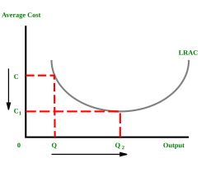
Scaling Up for Profit and Value
Economies of Scale:
Cost advantages that enterprises obtain due to their scale of operation, and are typically measured by the amount of output produced per unit of cost (production cost).

Slide 14
Remember Sarah With Her Corn and Sheep?
Small herds and small farms often can’t generate enough income to support a family unless heavily subsidized.
  What would she do to grow her business?
  How does she cut her costs / increase her revenue?
  How can she invest in her business to be more efficient?
What if expanding your operation to get economies of scale is not possible?

Slide 15
Cooperatives

Slide 16
Organizing for Profit and Value
If Sarah bought winter hay for her sheep together with 5 other ranchers how much better of a price could they get?
If 10 farmers sold sweet potatoes together how much better of a price could they get for transport/freight costs to send them to get processed?

Slide 17
Strength in Numbers for Profit and Value
Cooperatives, Grazing Groups, Buying Clubs, Unions, etc. offer collective strength.

Slide 18
An “Informal” Cooperative
Several ranchers within the same Chapter or Pueblo community jointly use:
  A stock trailer
  Portable panels
  A squeeze chute

Slide 19
An “Informal” Cooperative
Instead of each family purchasing expensive equipment individually:
  One producer owns the trailer
  Another owns the chute
  Another owns panels

Slide 20
An “Informal” Cooperative
How it works informally:
  Verbal agreements or community norms govern use
  Maintenance responsibilities are shared
  Scheduling is coordinated through relationships rather than contracts

Slide 21
An “Informal” Cooperative
Why it succeeds:
  Reduces capital costs
  Strengthens community ties
  Increases operational efficiency

Slide 22
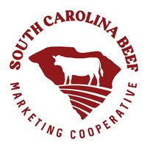

What is a Cooperative
  Legal/Administrative entity.
  User/Member owned, locally-based and participatory.
  Address market failures where private/government doesn’t provide a needed service or product.
  Help small producers have benefits like their larger competitors.

Slide 23
Cooperating Helps You:
  Buy feed, seed, fuel, minerals, etc. in bulk
  Fill truckloads, Access larger markets together (schools, restaurants, casinos, institutional buyers)
  Share storage, delivery, labor, processing, equipment
  Share Artificial Insemination (AI) services
  Coordinated breeding windows

Slide 24
Why Join a Co-Op Instead of Going it Alone?
  Co-ops help ranchers save money, share costs, and access services they might not afford individually.
  Members benefit from collective bargaining, better market access, and shared knowledge.
  Qualify for USDA Rural Cooperative Development Grants and other funding.

Slide 25
How to Co-Op
Trust and Communication Matter
  Co-ops need clear rules, and member and community buy-in.
Match Scale to Capacity
  Align business plans with infrastructure and herd size.
Start Small, Plan Smart
  Test ideas on a manageable scale before investing heavily.
Design a Sustainable Marketing Strategy

Slide 26
Topic Question
Who are 3 nearby ranchers you could partner with?
What’s one piece of equipment you could share with your neighbors?
What would it take to make it happen?

Slide 27
Co-Op Challenges
Lack of volume
  Not enough animals to sell, feed, or process consistently.
Infrastructure issues
  Water, Power, Storage, Refrigeration, Greenhouse management, etc.
Regulatory hurdles
  Difficulties with inspection and compliance.
Marketing Gaps
  No clear strategy to distribute and sell beef, wool, vegetables, etc.

Slide 28
Cooperative Resources
  Navajo Sustainable Agriculture Project
    A NMSU Cooperative Extension Service (NM-CES) initiative delivered in collaboration with the Diné College Land Grant Office and Community Outreach & Patient Empowerment (COPE) Program, and the San Juan, McKinley, and Cibola County NMSU Extension Offices
    https://nsa.nmsu.edu/index.html
  Cooperative Development Foundation
    Build capacity for the co-ops through grantmaking and programming.
    https://www.cdf.coop/

Slide 29
Cooperative Resources
Rocky Mountain Farmers Union
  Provides education programs to build understanding of co-ops, local foods, and agriculture
  https://rmfu.org/
InterTribal Buffalo Council
  Supports sustainable Tribal buffalo programs and provides training and technical assistance on the development of feasibility analyses, business plans and marketing plans.
  https://www.itbcbuffalonation.org/

Slide 30
Cooperative Resources
Successes and Challenges
  Increasing Abundance with Native Communities Cooperative Development Training, Nov 2022
    The NAAF is partnering with the Cooperative Development Foundation (CDF) to facilitate a return to the cooperative model in ways that honor the values of every group in Native communities.
    https://www.rd.usda.gov/newsroom/success-stories/increasing-abundance-native-communities-cooperative-development-training
  First Ever Native American Food Hub Created in New Mexico, December 26, 2013
    The Ten Southern Pueblos Council contracted with the Acoma Business Enterprises to serve as the fiscal manager and apply for a Rural Business Enterprise Grant (RBEG) through USDA.
    https://www.usda.gov/about-usda/news/blog/first-ever-native-american-food-hub-created-new-mexico
  ‘A sanctuary’: how neglected Native American communities are organizing their own food hubs, June 6, 2024
    It received a $250,000 grant from the US Department of Agriculture (USDA) to expand and build the Hopi food hub, which was set to open in November 2024.
    https://sust.unm.edu/news/2024/06/a-sanctuary.html?utm_source=chatgpt.com

Slide 31
Cooperating for Profit and Value
What’s stopping you from joining or starting a cooperative?
What would make it easier?

Slide 32
Value-Added

Slide 33


Value-Added Opportunities for Producers
Enhance your product by improving quality, changing its physical state, establishing it as certified, etc.
  Pre-harvest - Vaccinations, Hormone-free, Organic
  Processing - Packaged jerky, dried meats
  Marketing - Branded beef (recognizable labels and story)
These changes can increasing revenue and possibly profit

Slide 34
Value-Added Risks for Producers
Pre-harvest, Processing, and Marketing
  Requires investment (vaccine costs, production changes, processing equipment, legal work, permits, etc.)
  Can be labor intensive.
  You must built a strong customer base and brand recognition.

Slide 35
Branding Meat for Identity and Value
Commodity beef
vs.
Specialty or Niche

Slide 36
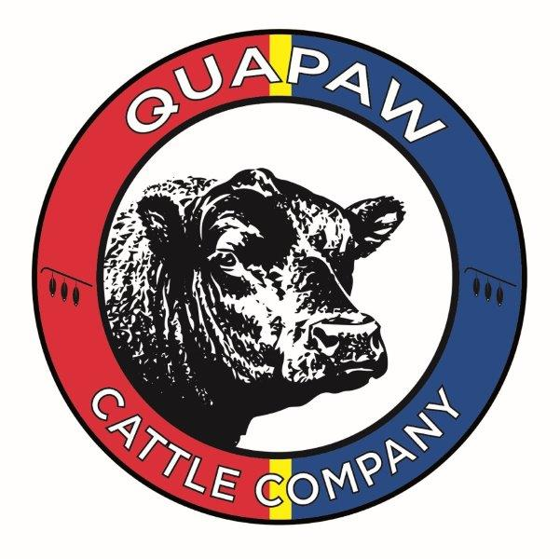


Branding Meat for Identity and Value
Strong demand exists for culturally branded local meat with:
  A label that reflects cultural stewardship
  Native breed traits
  Grazing practices
  Promotes tribal identity, tells a story

Slide 37
Branding Meat for Identity and Value
Benefits
  Differentiates tribal beef in competitive markets.
  Attracts consumers looking for authentic, local, and sustainable meat.
  Builds value within food systems.

Slide 38
Branding Meat for Identity and Value
Next Steps
  Determine brand values and vision.
    What makes your beef unique?
  Define quality and standards.
    Antibiotic or hormone free? Free-range or grass-fed? Butchering practices?
  Protect trademarks and promote with cultural integrity.

Slide 39
Branding Meat for Identity and Value
What makes your product unique
Marketing, labeling, and pricing strategies.
Partner with others & sell together?
You want a product that demands a higher price due to its perceived or actual value.

Slide 40
Branding Meat for Identity and Value
Establish your brand and reputation, manage your product to command higher prices, and focus on long-term value creation.

Slide 41
Marketing

Slide 42
Marketing in General
Identifying, anticipating, and satisfying customer needs and wants through the creation, communication, and delivery of value.

Slide 43
Marketing for Tribal Beef Producers
  Have you ever sold livestock, meat, crafts, crops directly to customers?
  What worked?
  What didn’t?

Slide 44
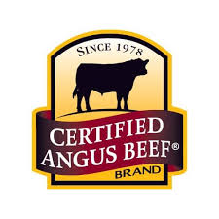

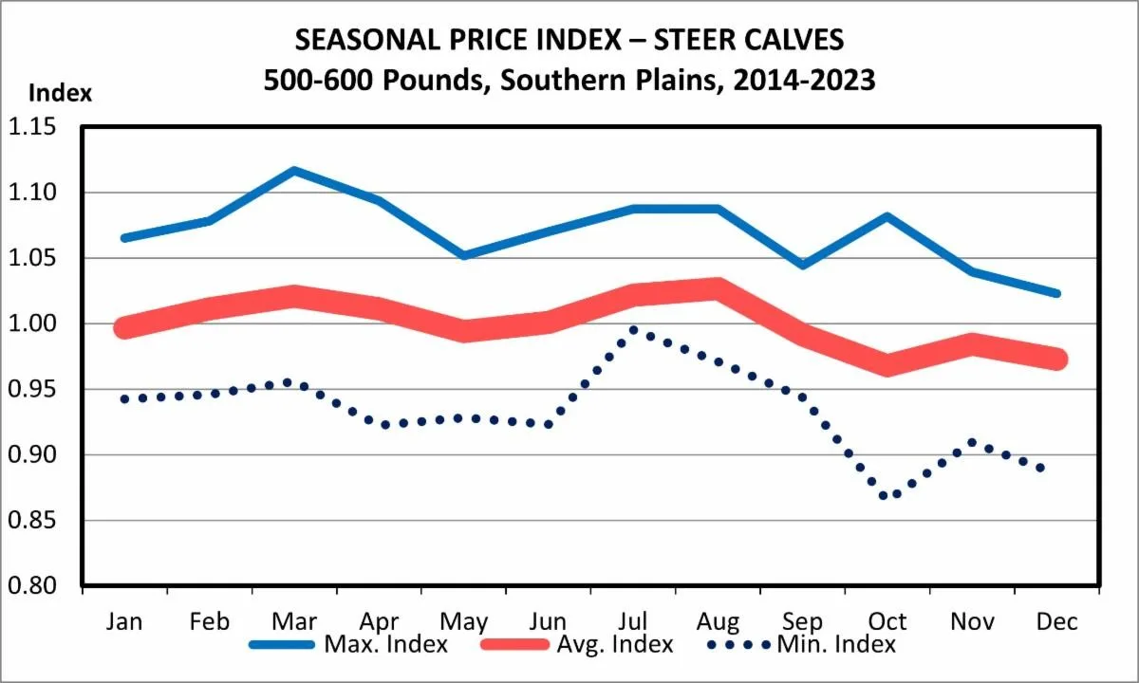

Marketing for Tribal Beef Producers
  Production-Driven Value
  Preconditioning and Genetics
  Seasonal Marketing Strategy
  Targeted Sales

Slide 45
Marketing for Tribal Beef Producers
Targeted Sales
  Choosing between local auction barns, private treaty sales, internet auctions, wholesalers, retailers, etc.

Slide 46
Marketing for Tribal Beef Producers
  Start small
    Sell to local families or events
  Learn your market
    Track demand and preferences
  Understand your costs before expanding

Slide 47
Marketing for Tribal Beef Producers
Why it matters
  Tribal entities (schools, food hubs, casinos, etc.) and local restaurants spend millions on food each year, mostly from outside vendors.
Community Connections are Powerful
  Keep money local and support food sovereignty.
  Strengthens cultural and economic sustainability.

Slide 48
Marketing for Tribal Beef Producers
Building a Local Market for Your Beef
  Explore Selling Platforms
  E-commerce websites and marketplaces
  Tribal casinos and hotel restaurants
  School nutrition programs and BIE institutions
  Farmers markets and community-supported agriculture

Slide 49
Access Local Markets
  Engage with tribal council or economic development staff.
  Partner with other ranchers to meet volume needs.
  Provide a consistent supply with a written business plan.
  Contract your beef processing with USDA-certified or state-inspected processors.

Slide 50
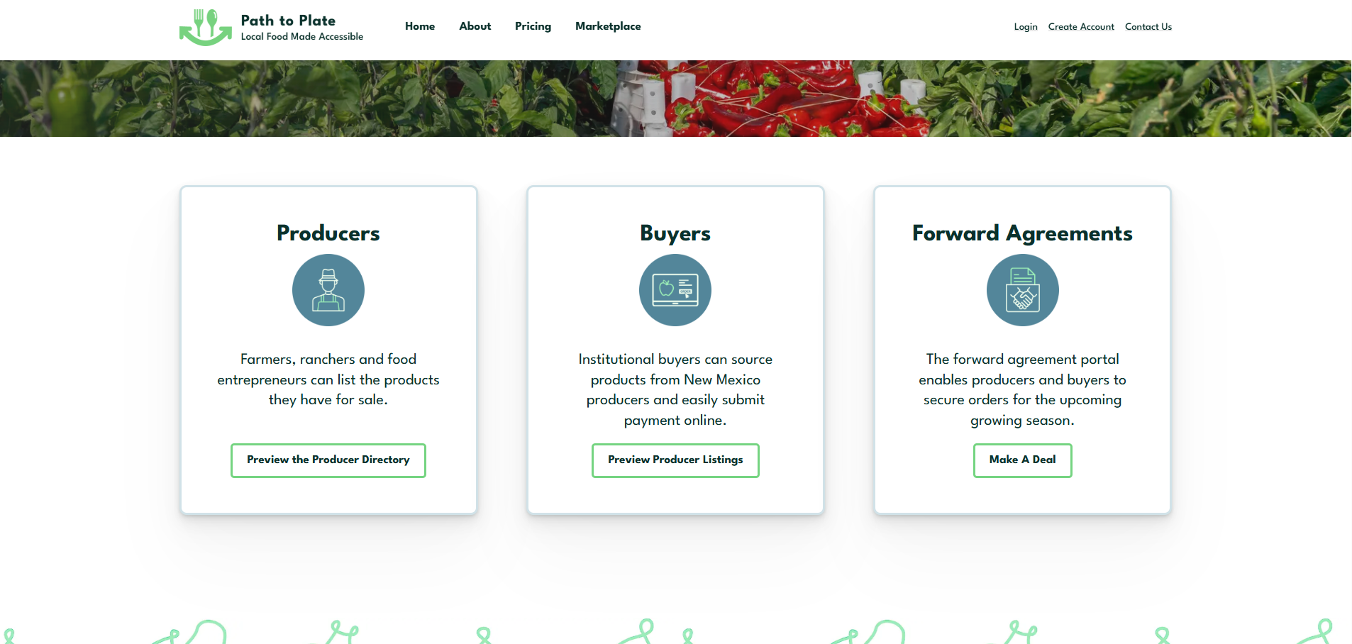

Slide 51
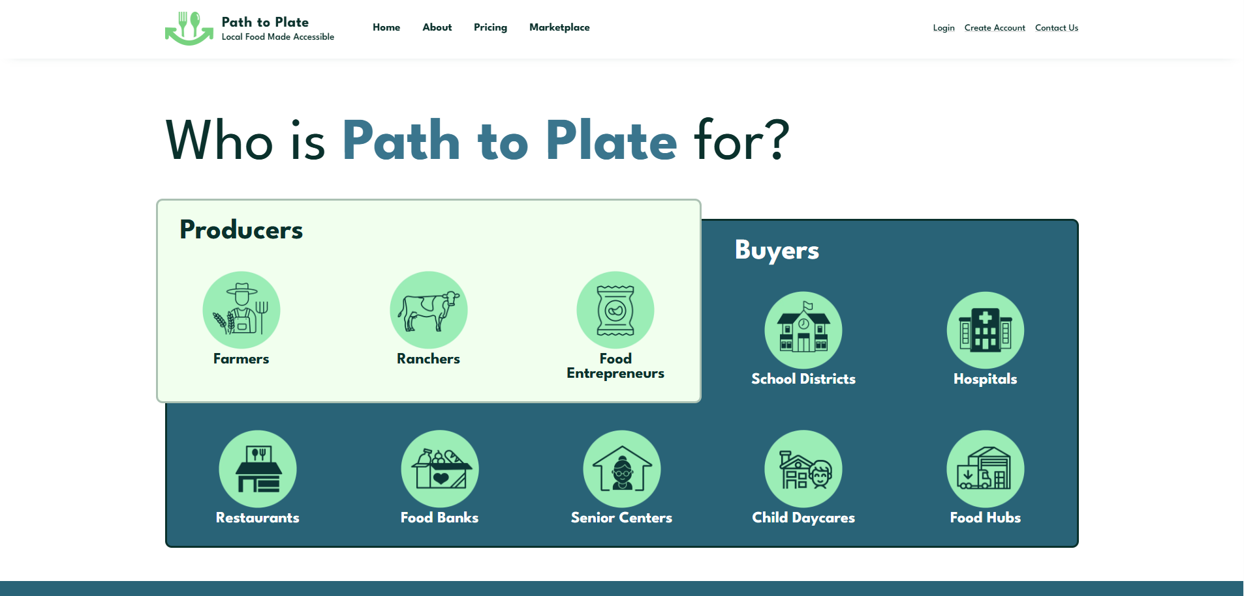

Slide 52
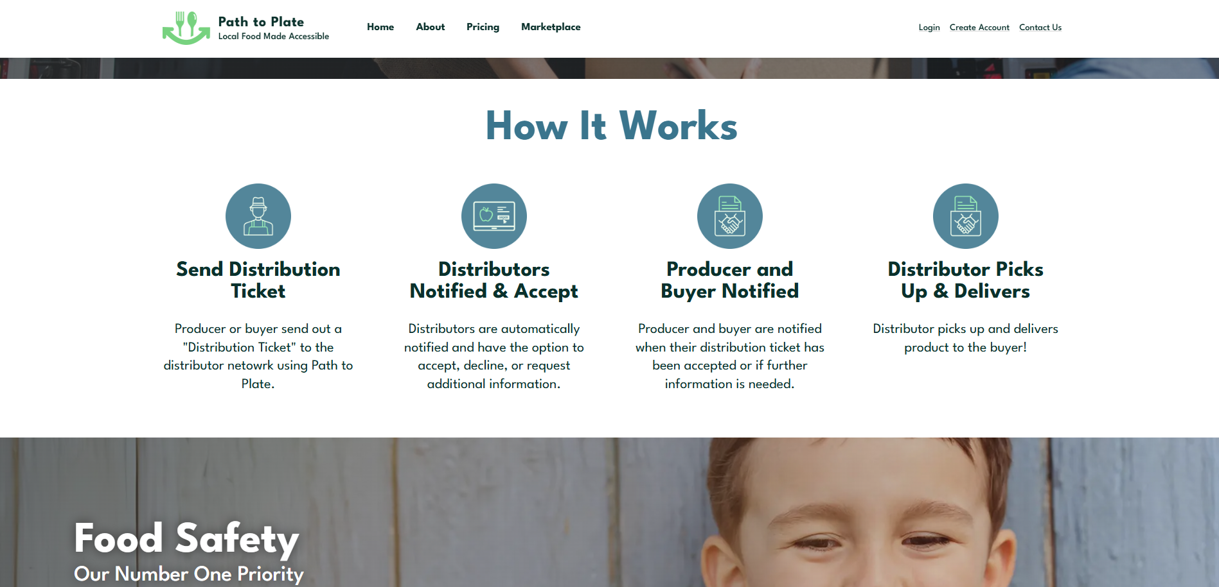

Slide 53
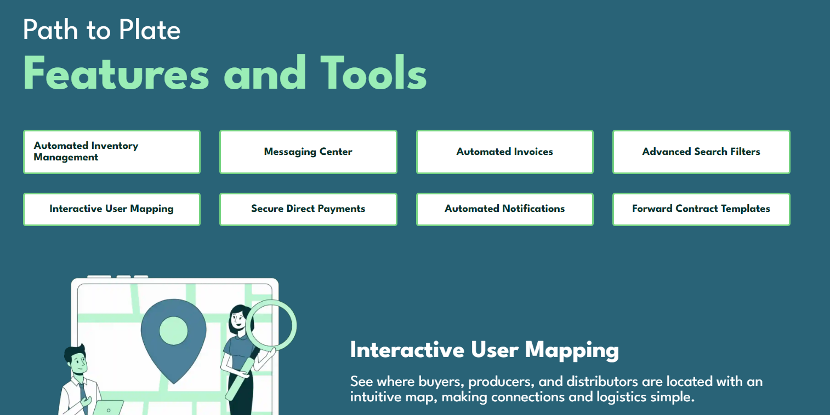

Slide 54
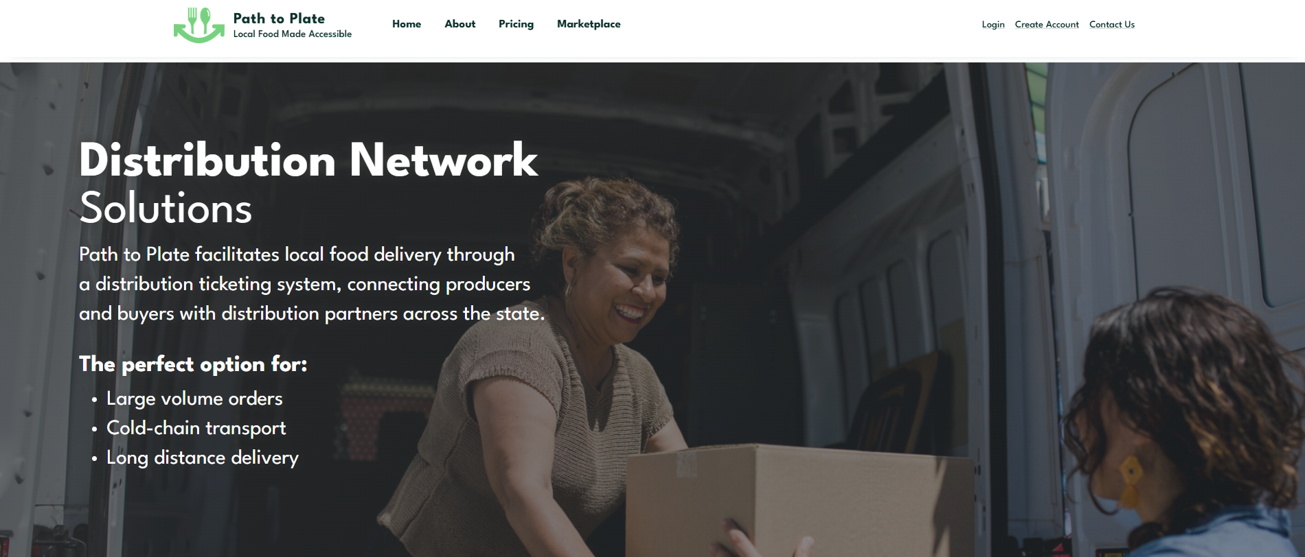
pathtoplatenm.com

Slide 55
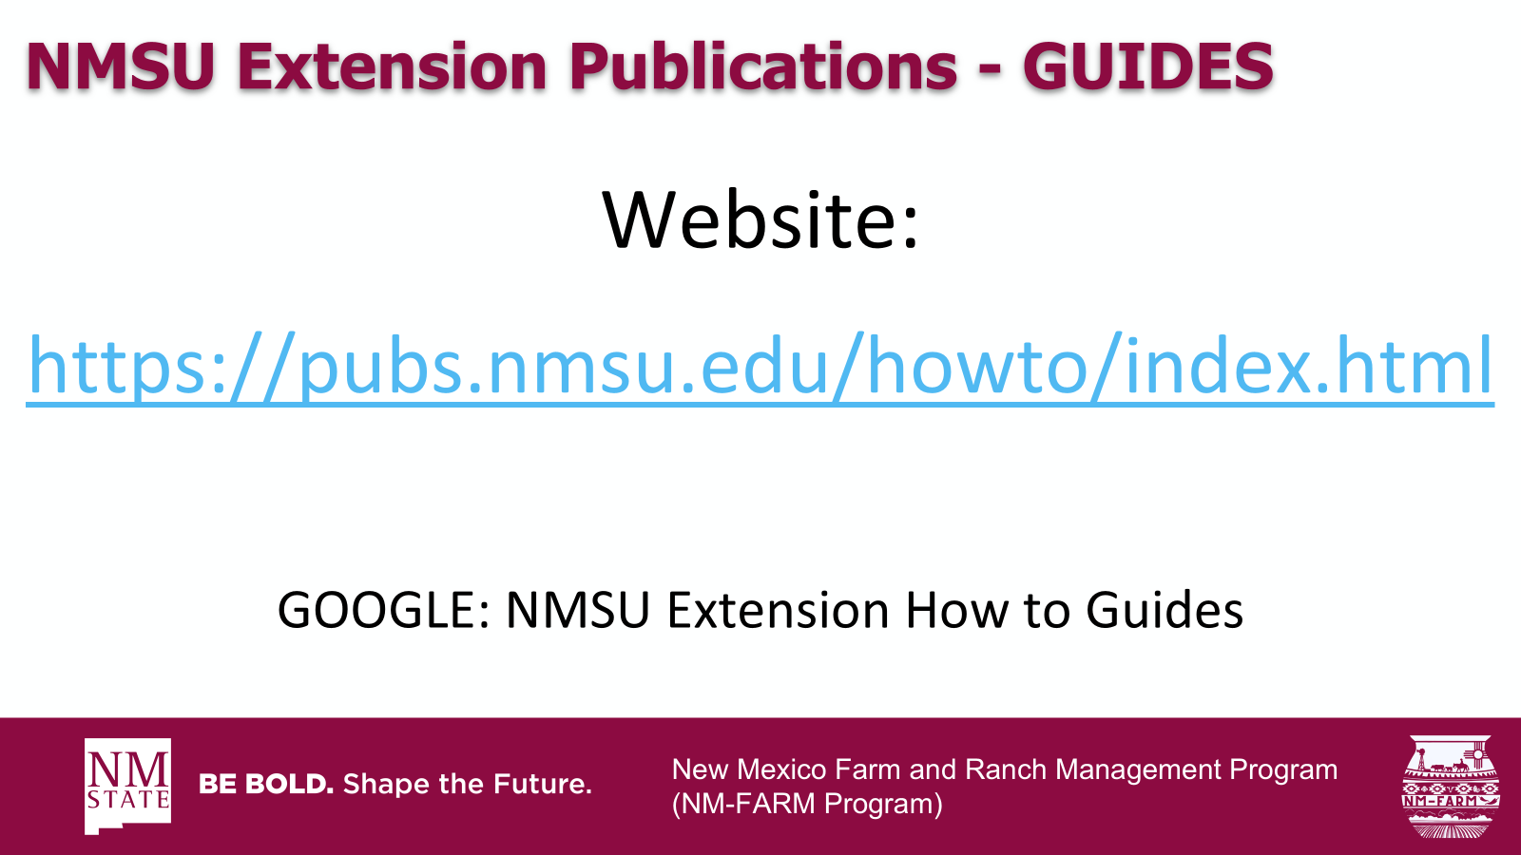

New Mexico Farm and Ranch Management Program
(NM-FARM Program)

Slide 56

NM-FARM
Goals:
  Develop a financial benchmarking program for NM farms and ranches
  Increased financial sustainability for NM farmers and ranchers
  Website: www.nmfarm.nmsu.edu
New Mexico Farm and Ranch Management Program
(NM-FARM Program)

Slide 57
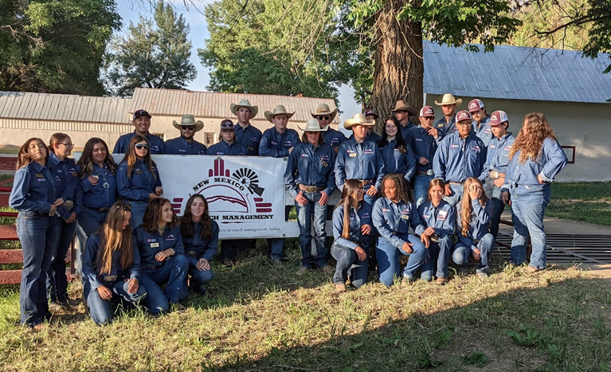
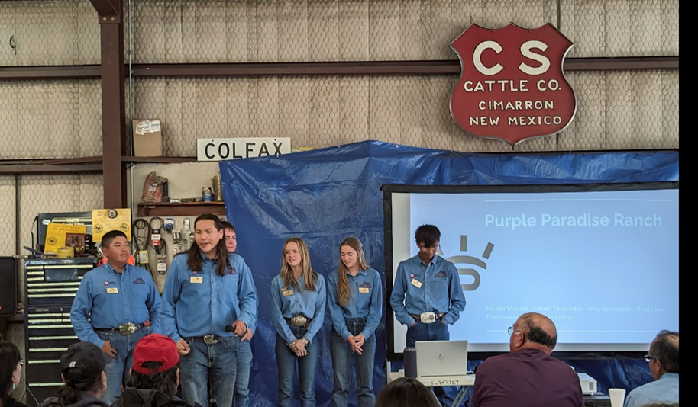
New Mexico Youth Ranch Management Camp
@ CS Ranch | Cimarron, NM
June 21-26, 2026
nmyrm.nmsu.edu
Helps youth appreciate the 'why' behind ranching.

Slide 58
Questions?
Jason Banegas
Zumbabwe@nmsu.edu

