Slide 1


Tribal Ranching Seminar Series
Strategic Growth, Sustainability, and Resilience
Jason Banegas
Extension Economist
Cooperative Extension Service

Slide 2
The GOAL For This Learning Series
Gain Knowledge and Build Tools so you can keep doing what you love and pass it on.

Slide 3
Minimize Risk
and
Maximize Opportunity

Slide 4
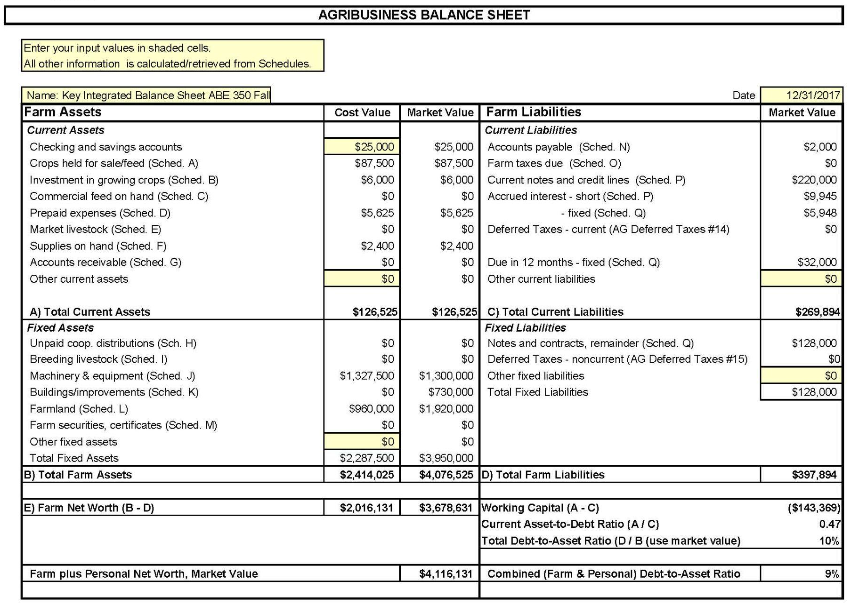
Balance Sheet
Everything Owned and Owed
A balance sheet shows your NET WORTH / OWNER EQUITY at a specific point in time
NET WORTH = Assets - Liabilities

Slide 5
Profitability over a period of time.
  Fiscal or Calendar Year or Production Cycle
Revenue
  What you earned from selling crops, livestock, etc.
Expenses
  What you spent on feed, seeds, labor, equipment, etc.
Ranch Income Statement aka P&L
2025 Sales and Expenses
Category | Revenue | Category | Expenses
Cattle Sales | $190,000 | Feed & Veterinary | $(50,000)
Hunting Permits | $10,000 | Land Lease & Maintenance | $(40,000)
 |  | Labor & Other Expenses | $(40,000)
 |  | Depreciation | $(5,000)
 |  | Payments, Interest & Taxes | $(15,000)
 |  | Net Income | $50,000

Slide 6
Simple Monthly Cash Flow Statement
January 1st: You start with $45,000 in your account
 | Jan | Feb | Mar | Apr | May | Jun | Jul | Aug | Sep | Oct | Nov | Dec
Inflows | 0 | 0 | 8,000 | 6,000 | 0 | 0 | 0 | 0 | 0 | 69,000 | 34,000 | 0
Outflows | 12,000 | 10,000 | 8,000 | 4,000 | 5,000 | 8,000 | 9,000 | 8,000 | 14,000 | 16,000 | 6,000 | 4,000
Net Flow | -12,000 | -10,000 | 0 | 2,000 | -5,000 | -8,000 | -9,000 | -8,000 | -14,000 | 53,000 | 28,000 | -4,000
Balance | 23,000 | 13,000 | 13,000 | 15,000 | 10,000 | 2,000 | -7,000 | -15,000 | -29,000 | 24,000 | 52,000 | 48,000
How can you make it through this year with a negative account balance?

Slide 7
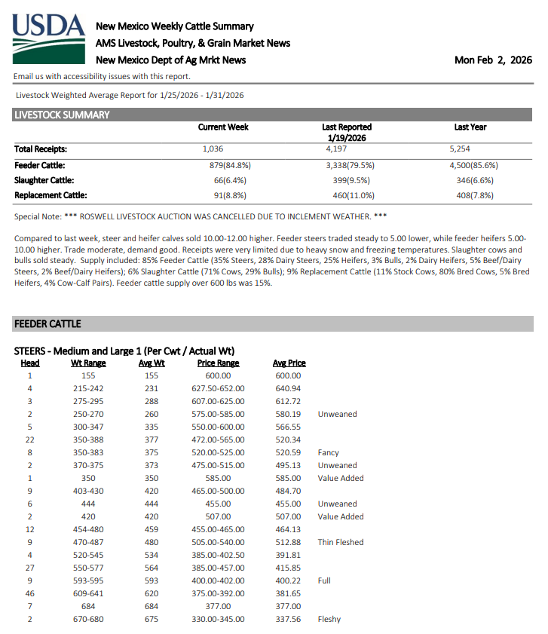
Cost of Production in a Cow-Calf Operation
Profit per Calf
  If weaned at 550 lbs and sold at $3.40/lb.
    Revenue = $1,870
  Unit cost is $2.23/lb x 550 lbs
    Cost = $1,226.50
→ Profit = $643.50 per calf
Expense Type | Amount($)
Feed | $18,000
Vet | $2,500
Fuel & Equipment | $5,000
Labor | $8,500
Land / opportunity cost | $4,000
Cow Depreciation | $11,000
Total | $49,000

Slide 8
Question & Review from the LAST WEBINAR
  Home Food Production vs. Business Mindset
  Do you know your Cost of Production?
  Co-ops, Value Added, Marketing
https://aeab.nmsu.edu/extension/extension-economics.html
Bookkeeping and expense tracking are the foundation of good management.

Slide 9
Assess Financial Health
Improve Loan Access & Creditworthiness
Track Progress Toward Goals
Enhance Decision-Making & Risk Management
Be in a position to use market outlooks, do feasibility analysis, grow your resources, strengthen your business.
The Goal is to Help You:

Slide 10
Topic Questions
Do you want to keep ranching?
Do you want to use assets for your retirement or pass them to family?
Do you want to be able to weather a storm, drought, market crash, etc.?

Slide 11
Purpose of Today’s Session
Topics covered:
  Strategic Growth
  Sustainability
  Resilience

Slide 12
Grass First
Ranching success starts with sustainable forage and understanding your land’s carrying capacity.

Slide 13
Regenerative Land Practices
  Holistic and regenerative practices aren’t just conservation techniques, they are economic management tools.
  Adaptive rotational grazing, adequate rest periods, strategic reseeding, and riparian protection increase forage productivity, water retention, and drought resilience.

Slide 14
Regenerative Land Practices
  These practices can reduce external input expenses such as supplemental feed.
  Healthy plant communities and soil directly influences animal performance and operational stability.

Slide 15
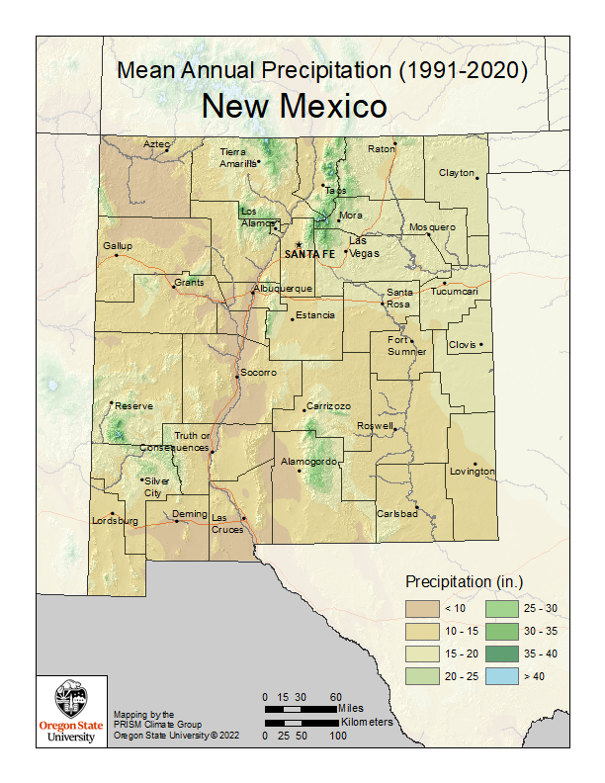
Precipitation Driven Production Systems
Many tribal ranches operate in semi-arid areas with low precipitation.
No irrigation? = 100% reliance on rain and snowmelt.

Slide 16
Precipitation Driven Production Systems
Precipitation Awareness
  Have you tracked rainfall in the past?
  How does rainfall affect your forage plan?
    Delayed grazing start
    Shortened season
    Less forage availability

Slide 17
Precipitation Driven Production Systems
  Drought management is ultimately about preserving the long-term viability of your ranch, not just surviving the current year.
  Successful operations treat drought as a recurring business risk rather than an emergency.
  Overgrazing during drought creates multi-year economic damage.

Slide 18
Precipitation Driven Production Systems
Short-Term Drought Management Strategies
Destocking
  The most effective drought response is reducing herd numbers early before forage conditions collapse.
  Forage is your primary asset, while animals are inventory. Maintain RDM.
Early Weaning
  Weaning calves early (60–120 days) significantly reduces pressure on cows and forage.
  When cow herd retention is desired but forage quantity declines.
Supplemental Feeding
  Only for short-term forage gaps to protect high-value stock to preserve body condition.

Slide 19
Precipitation Driven Production Systems
Long-Term Drought Management Strategies
Protect Rangeland Health
  Increase rest periods, rotate grazing areas, and protect riparian areas
Water Management
  Small improvements in water efficiency can increase grazing capacity.
Flexible Herd Structure
  Mix of stable cow-calf herd and stocker cattle that can be sold quickly.
Drought as a Culling Opportunity to improve long-term herd productivity

Slide 20
What would you do?
  Develop a Written Drought Plan.
  Decide forage utilization limits and measure accurately.
  Decide your thresholds for:
    Destocking
    Body conditions
    Financial
  USDA or tribal grants for water improvements?

Slide 21
Insurance for Risk Reduction
When to Consider Enrollment?
  Is your operation in a drought-prone area?
  If yes, do you rely on pasture or forage?
  If yes, can you financially absorb major feed losses?
  If no, consider Insurance.
Pasture, Rangeland, and Forage (PRF) Insurance

Slide 22
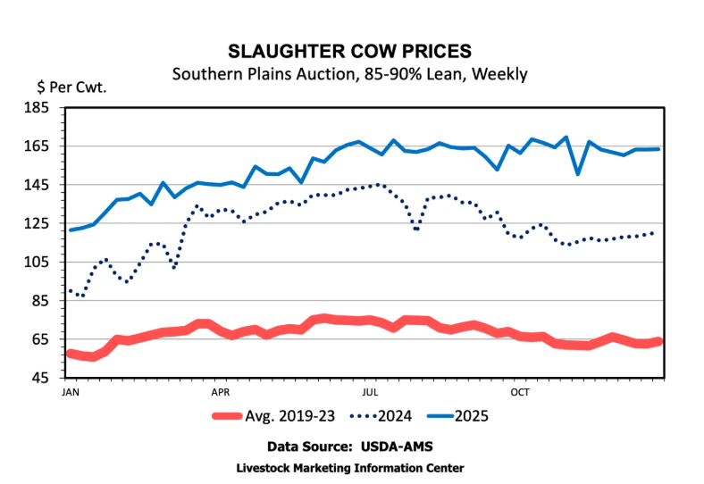
Should I feed? Should I sell? Can I hold?
Cost of feeding vs. market value
  1200# Cull market value: $1,920
  Hay + supplement cost: $2.00/day
  90-day feeding → $180 per cow
After supplemental feeding will your sale price offset the feed costs?

Slide 23
Should I feed? Should I sell? Can I hold?
  Many drought losses are from feeding low-return animals.
  Selling early may be a better economic decision if feeding consumes a substantial part of the animal’s value, especially if forage recovery is uncertain.
  Cost of production provides minimum price needed to retain animals.

Slide 24
Drought Cash Flow Strategy
During droughts expenses spike while revenues decline.
  Expected hay purchases: $25,000
  Operating cash reserves: $12,000
Without early cattle sales your operation may face:
  High-interest borrowing
  Delayed payments
  Financial stress
Selling selected animals early protects liquidity and avoids debt.

Slide 25
Value of Land and Forage vs. Animals
Financial analysis reframes drought decisions to make forage the primary asset.
If feeding hay costs exceed:
Future calf revenue gains
Long-term rangeland damage costs
Debt service burden
Then herd reduction protects land and forage health and financial stability.

Slide 26
Value of Land and Forage vs. Animals
Financial analysis reframes drought decisions to make forage the primary asset.
If feeding hay costs exceed:
Future calf revenue gains
Long-term rangeland damage costs
Debt service burden
Then herd reduction protects land and forage health and financial stability.

Slide 27
Herd Genetic Improvements
Genetics are a long-term investment in better animals
  Healthier and more adapted to local conditions
  Heat and drought tolerance
  Fertility under stress
  Frame sized for limited forage on arid land
  Strong maternal instincts
  Weaning Weight
Select traits to best fit your Land and Operation

Slide 28
Herd Genetic Challenges
Limited bull availability
Expensive or lack of AI services
Isolation of herds

Slide 29
Herd Genetic Comparison
Cow-calf operation with 25 breeding cows
Factor | Strategic Genetics | “Average” Herd
Pregnancy Rate | 92% | 82%
Calf Survival | 96% | 90%
Calves Weaned | 22 calves | 18 calves
Avg Weaning Weight | 550 lbs | 475 lbs
Market Price (example) | $4.15/lb | $4.15/lb

Slide 30
Herd Genetic Comparison
Cow-calf operation with 25 breeding cows
Strategic Genetics 22 calves × 550 lbs = 12,100 lbs total 12,100 lbs × $415 cwt = $50,215 | Average Herd 18 calves × 525 lbs = 10,500 lbs total 10,500 lbs × $415 cwt = $43,575

Slide 31
Herd Genetic Comparison
Genetics influence costs through efficiency
Expense Category | Strategic Genetics | “Average” Herd
Winter Feed | Lower | Higher
Vet / Health | Lower Variability | Higher Variability
Feed Cost / Cow (winter) | $200 | $225
Total (25 cows) | $5,000 | $5,625

Slide 32
Herd Genetic Comparison
Total Economic Impact
Revenue Gain | $6,640
Feed Cost Reduction | $625
Net Annual Advantage | ≈ $7,265 per year
For a 25-cow herd, this is a major shift, not just a marginal improvement.

Slide 33
Price Amplifies Genetic Value
At higher calf prices:
Every additional pound matters more
Every additional calf matters more
Inefficiency becomes more expensive
Lower reproductive rates and lighter calves become very costly mistakes that compound over time.

Slide 34
Bull Investment
Genetic progress is incremental, not immediate.
Bull Type | Approximate Cost
Average / commodity bull | $5,000
Performance-tested bull | $10,000
The bull influences: 25 cows, Several calf crops, Hundreds of calves over time.

Slide 35
Bull Investment
How quickly does a better quality bull pay for itself?
What about AI Services?

Slide 36
Replacement Female Strategy
Improves future herd productivity.
Retain better heifers
Purchase select females
Cull poor performers
Also influences calf crops but more costly and takes longer to replace breeding females.

Slide 37
Genetic Improvement Timeline
Herd transition is a multi-year process.
Short-Term (1–2 Years) | Medium-Term (3–5 Years) | Long-Term (5–8+ Years)
Upgrade bulls | Replacement females enter herd | Herd phenotype stabilizes
Begin culling | Reproductive efficiency improves | Longevity improvements visible
Identify poor performers | Reduced health problems | Lower replacement pressure
Early visible calf quality gains | Lower maintenance costs | Greater drought resilience
uniformity, reproductive improvement | financial benefits accelerate | profitability differences realized

Slide 38
Herd Genetic Improvements
Especially important for small producers with limited capital.
Genetics are a capital investment into your productive assets.

Slide 39
Herd Genetic Improvements
What qualities would you want to improve in your herd?
Who in your area has animals with those traits?

Slide 40
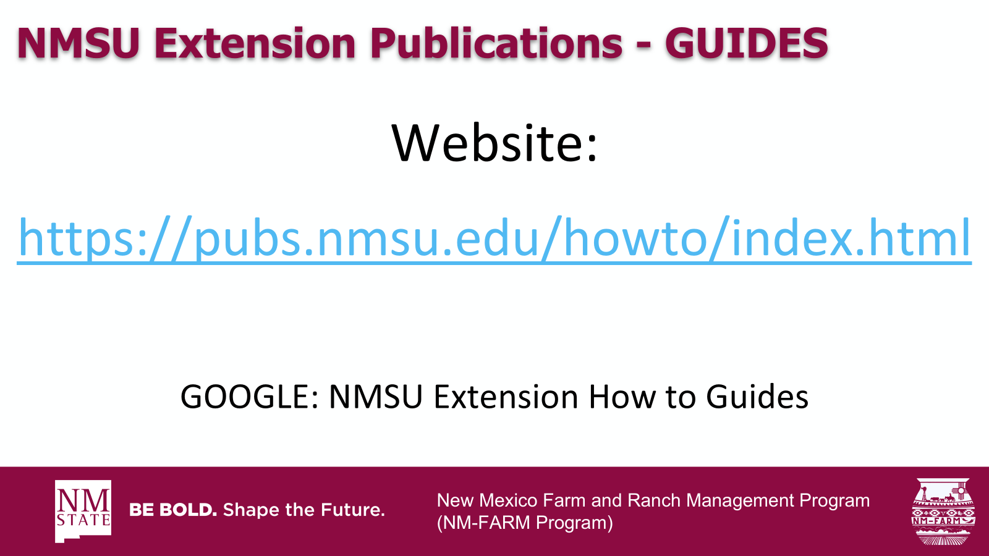
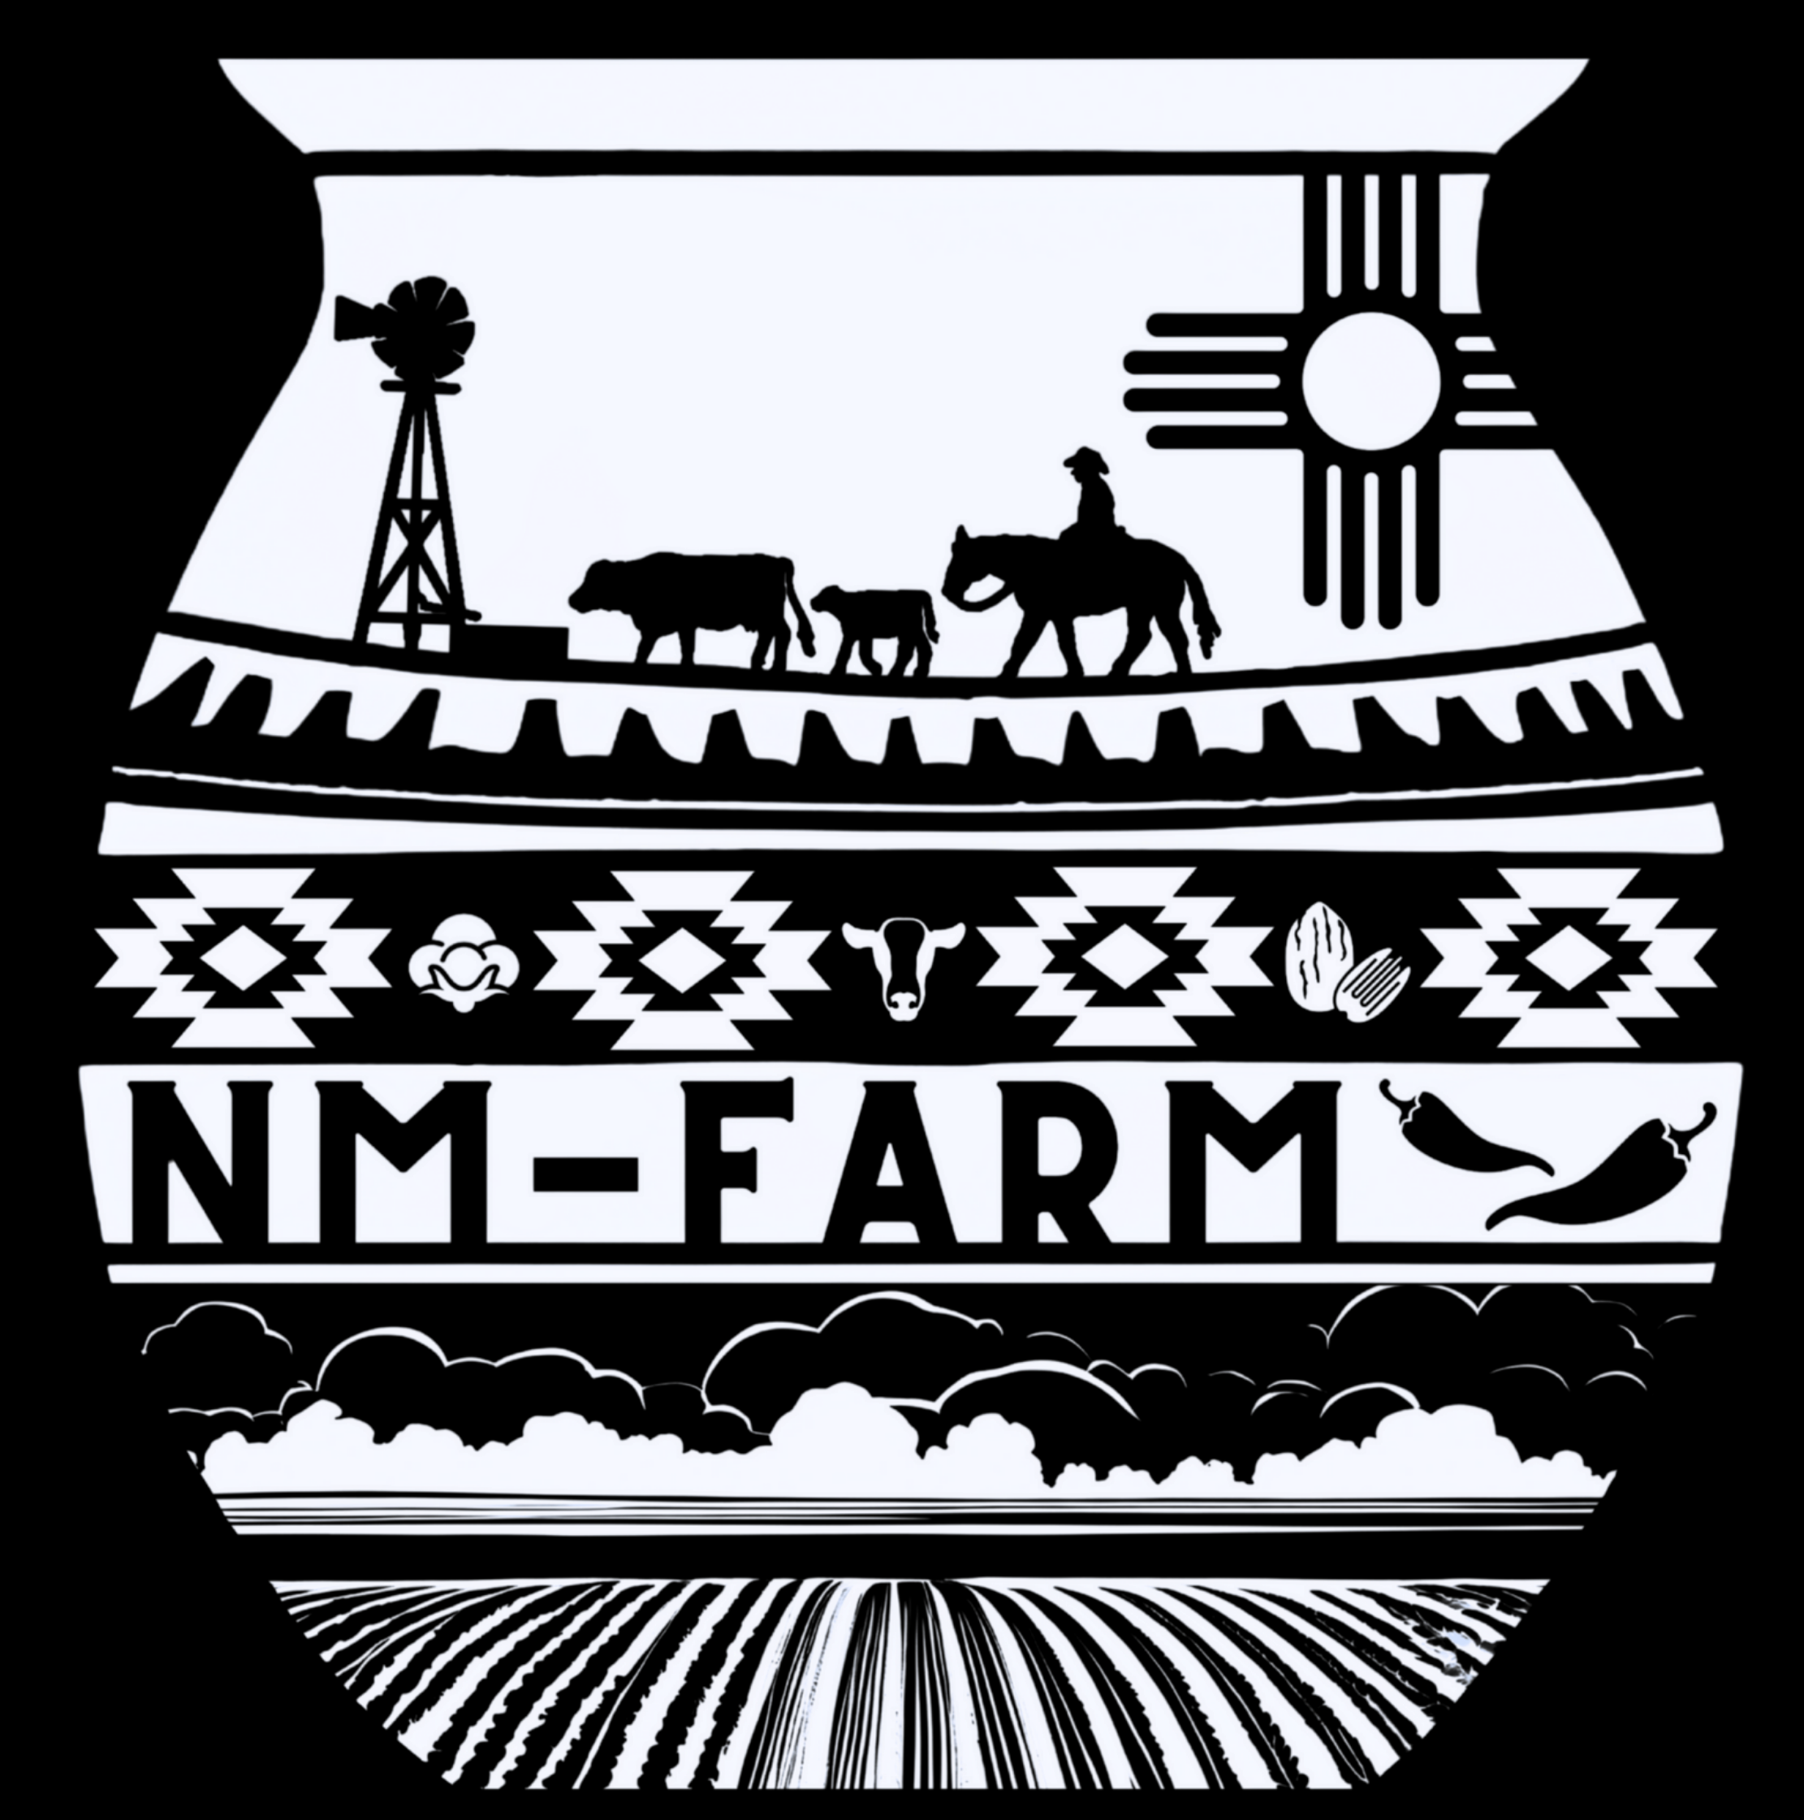
New Mexico Farm and Ranch Management Program
(NM-FARM Program)

Slide 41

NM-FARM
Goals:
  Develop a financial benchmarking program for NM farms and ranches
  Increased financial sustainability for NM farmers and ranchers
  Website: www.nmfarm.nmsu.edu
New Mexico Farm and Ranch Management Program
(NM-FARM Program)

Slide 42
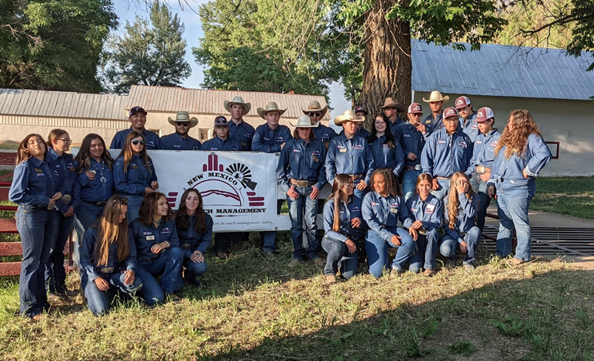
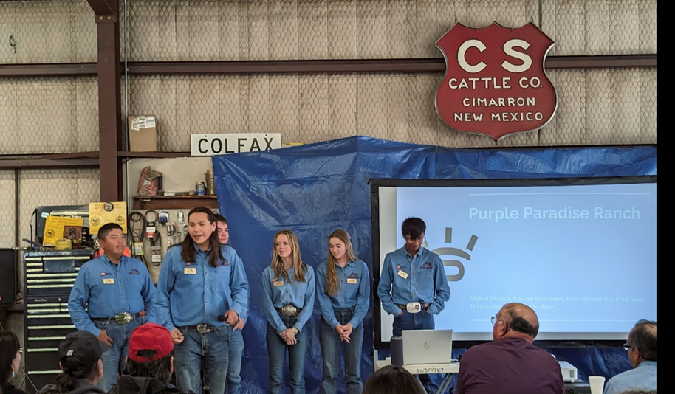
New Mexico Youth Ranch Management Camp
@ CS Ranch | Cimarron, NM
June 21-26, 2026
nmyrm.nmsu.edu
Helps youth appreciate the 'why' behind ranching.

Slide 43
Questions?
Jason Banegas
Zumbabwe@nmsu.edu

